Slide 1
FLD : Future Line of Demarcation

Slide 2
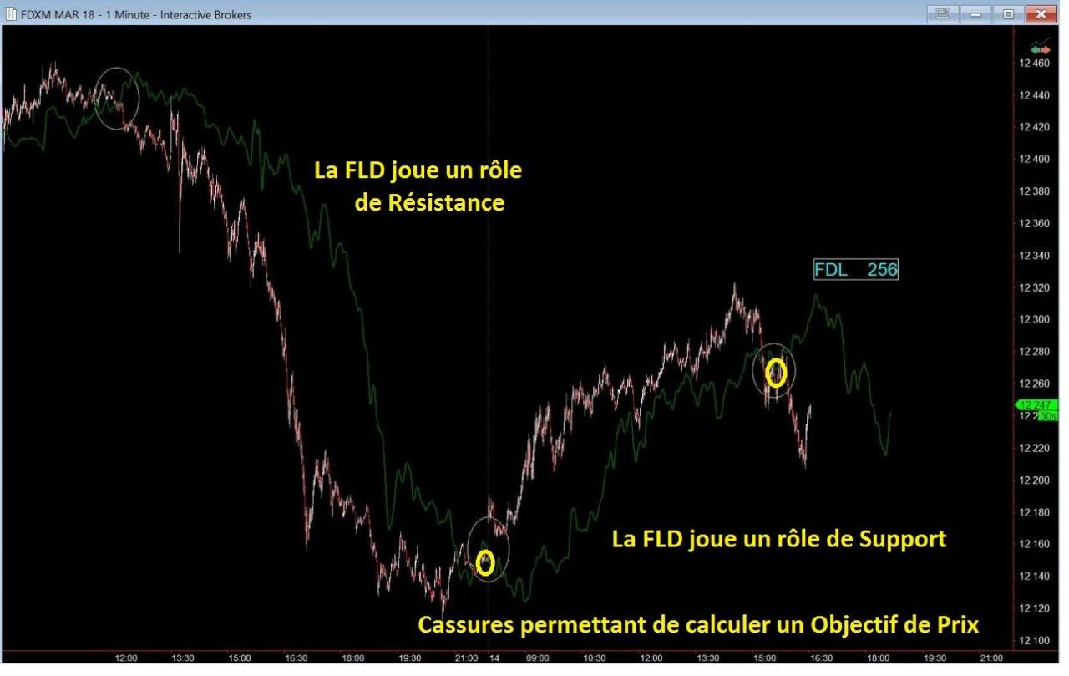
The various roles of a FLD

Slide 3
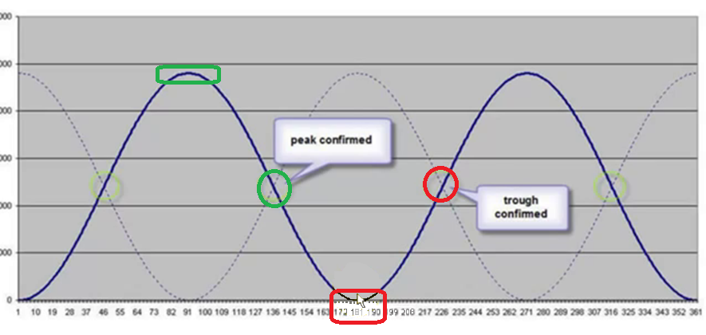
The crossing of Price Action with its FLD confirms the Peak or the Trough of the cycle

Slide 4
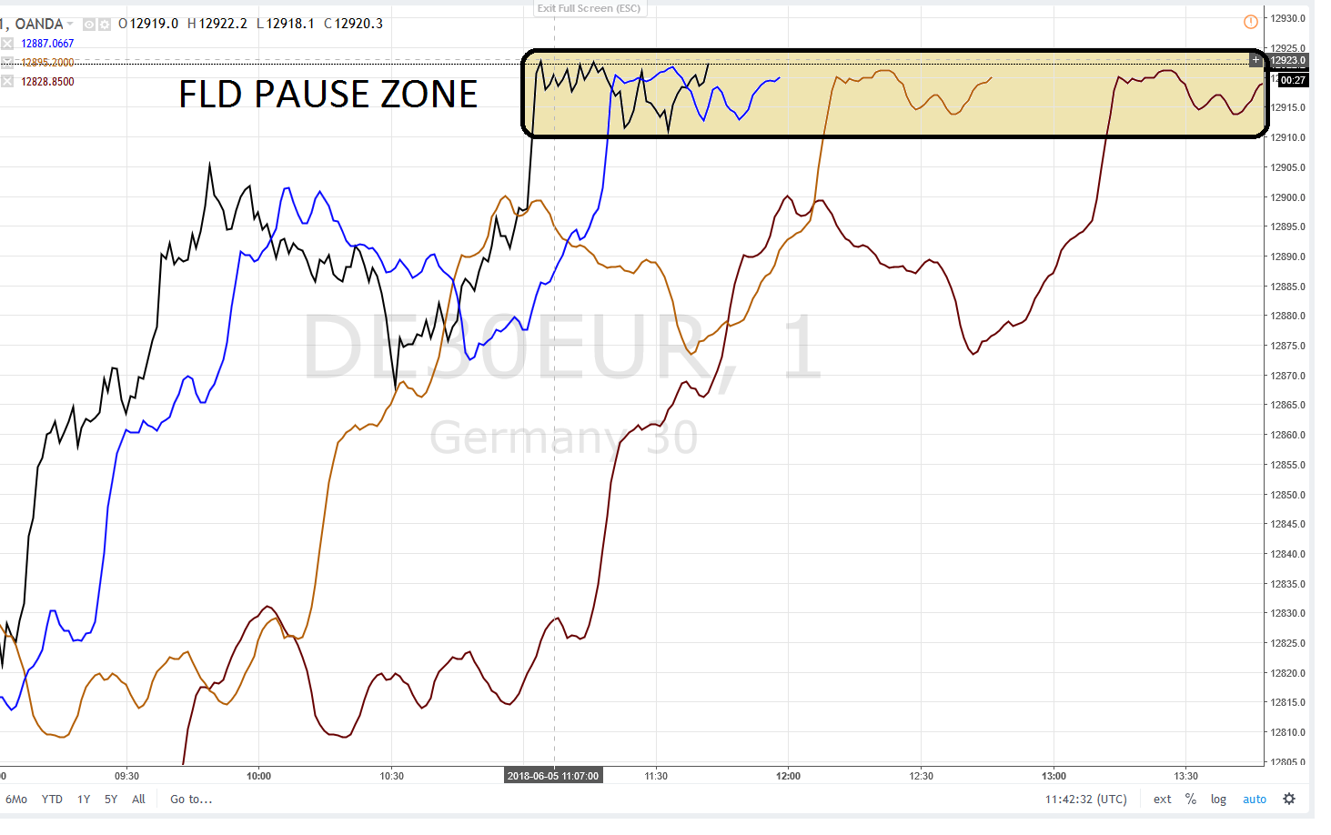
FLD Pause Zone

Slide 5
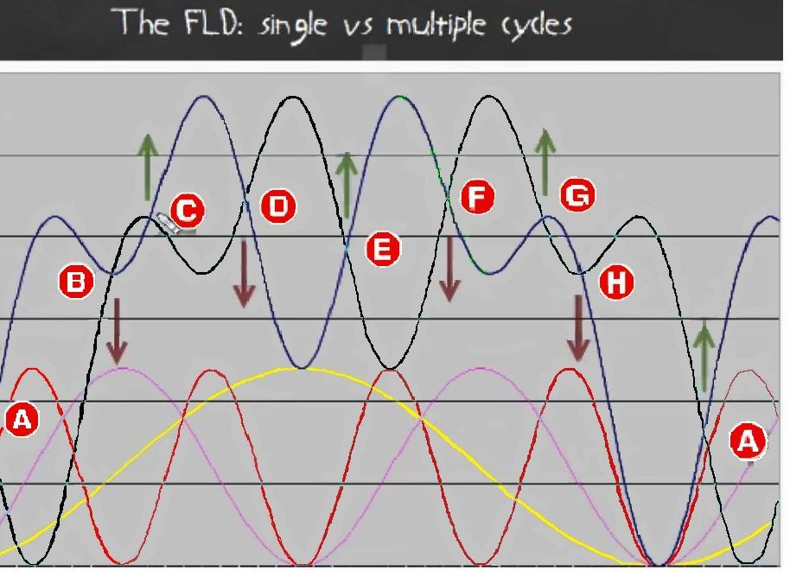
Adding 3 Cycles : a composite Cycle and its FLD

Slide 6
Understanding the parameters used for the demonstration
The Amplitude of each of the Cycles is identical
Every Cycle has a period DOUBLE of the one of the adjacent lower Cycle
The period of the purple Cycle is double that of the red Cycle
The yellow Cycle has quadruple period (2 x 2)
of that of the red Cycle

Slide 7
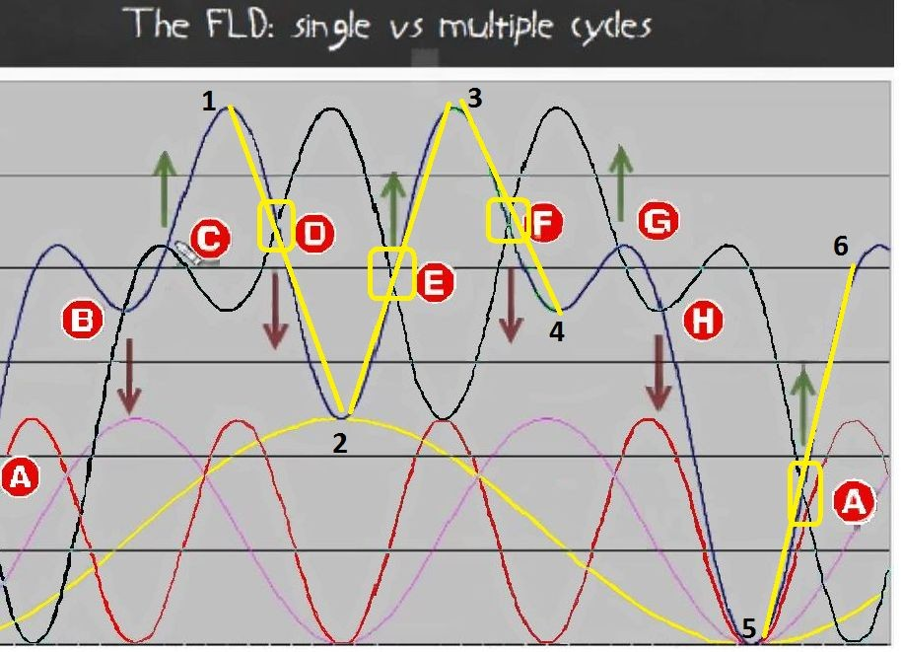
Structural Crossings A D E F

Slide 8
50 % of the crossings Price Action / FLD do not allow to calculate a target price
Only when Price Action composite Cycle – sum of the 3 cycles – moves through its FLD at specific crossings (noted A, D, E, F) – this fact allows STRUCTURALLY to calculate a Price Targets
Other crossings (noted B, C, G, H) build Support or Resistance
In this case Price Action follows parallely the FLD or bounce

Slide 9
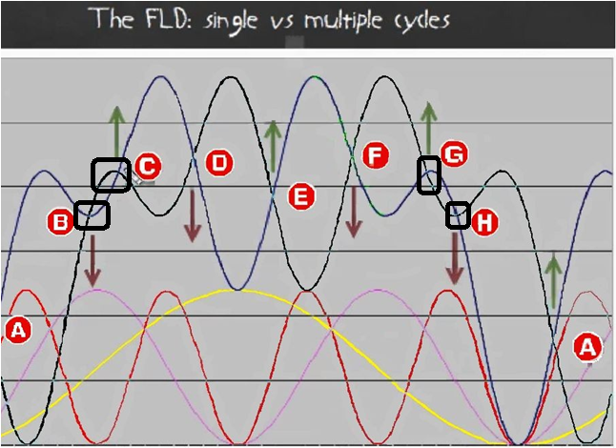
Price Action composite Cycle crossings B C G H with its FLD do not allow to calculate a target price

Slide 10
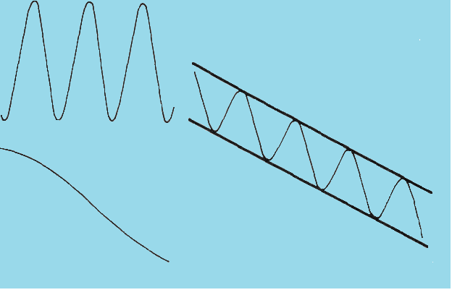
You have to take into account the downtrending Underlying Trend

Slide 11
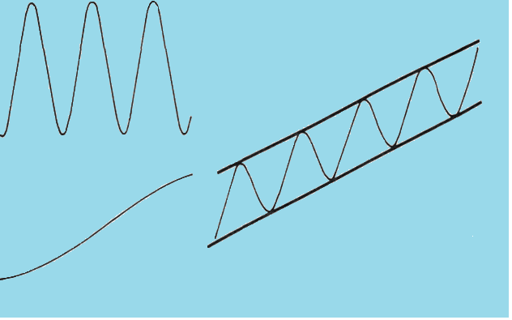
You have to take into account the uptrending Underlying Trend

Slide 12
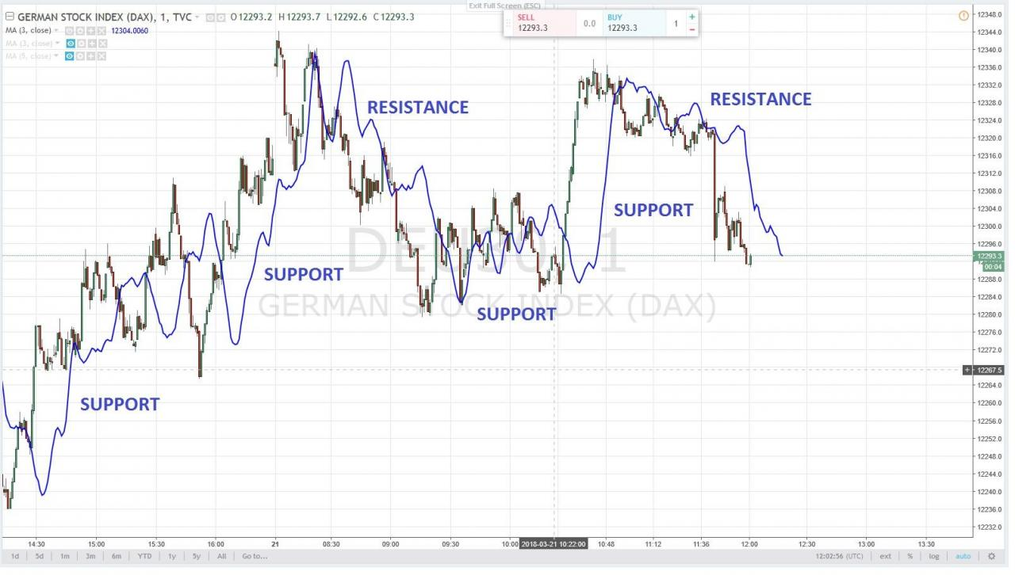
By construction, in 50 % of cases only,
FLD’s act as Support or Resistance

Slide 13
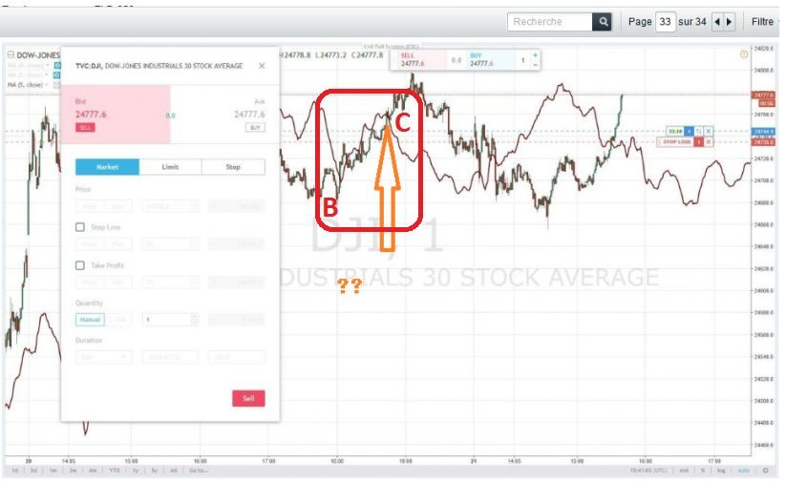
Price Action follows very closely FLD BC

Slide 14
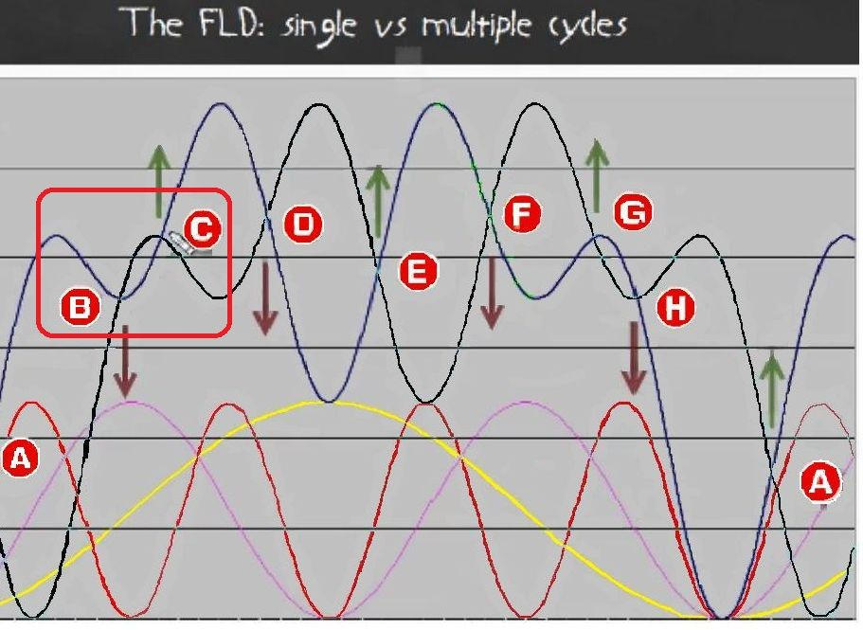
Theoretical Resistance BC

Slide 15
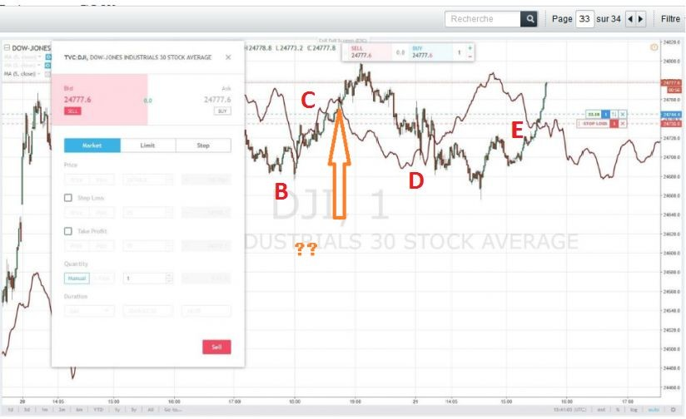
The FLD acts as a Resistance (BC)

Slide 16
Theory

Slide 17
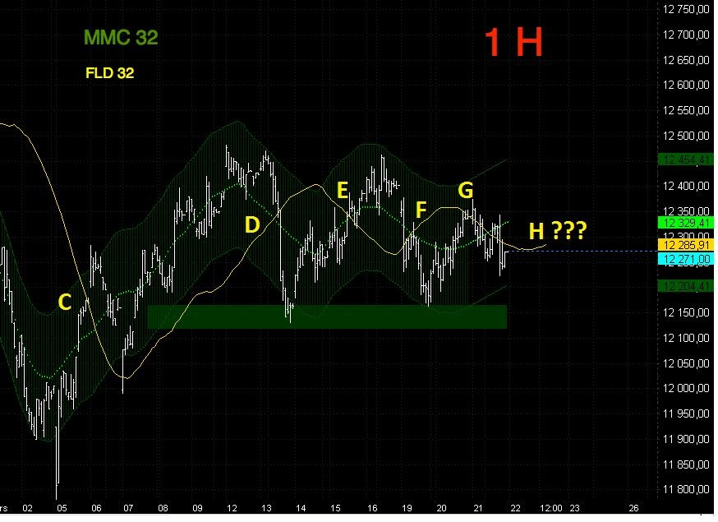
And Reality

