Slide 1
FLD : Future Line of Demarcation

Slide 2
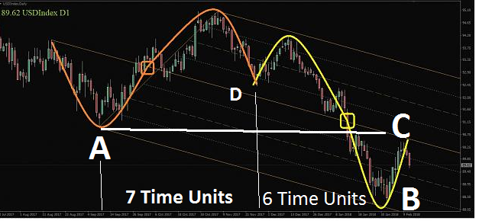
Price Action shows most of the time a sinewave behaviour

Slide 3
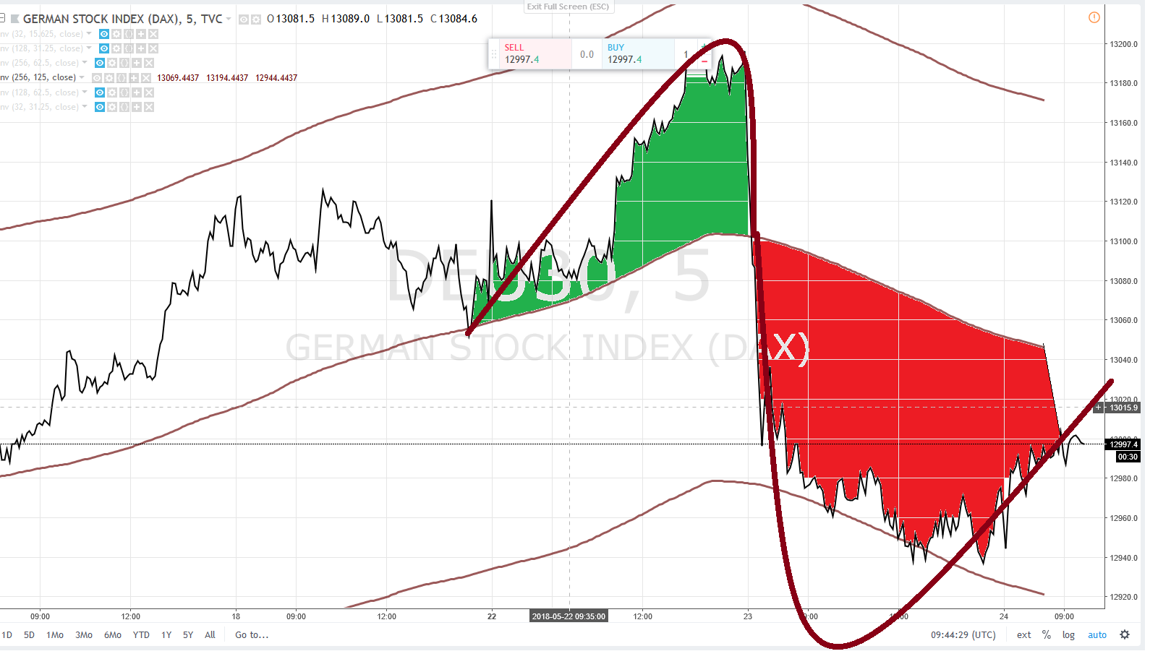
DAX : sine wave

Slide 4
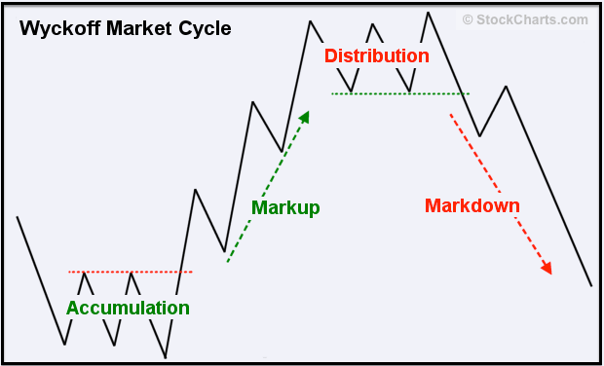
Richard Wyckoff

Slide 5
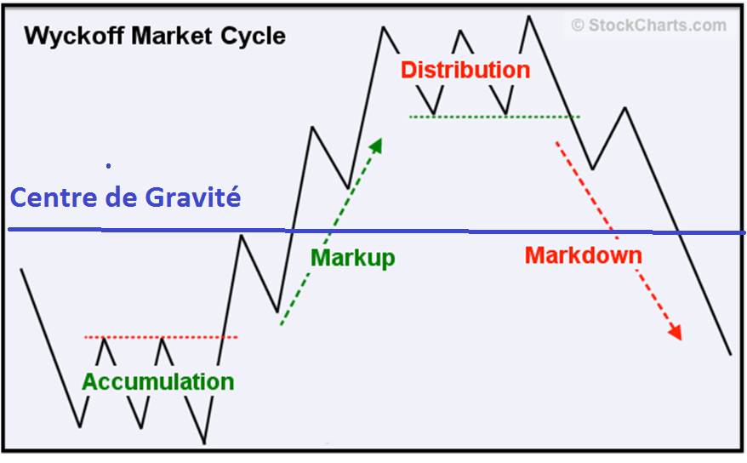
Richard Wyckoff

Slide 6
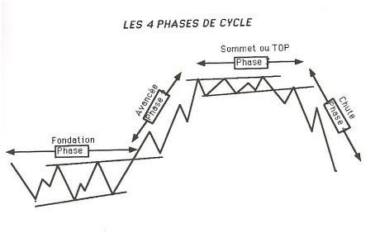
Stan Weinstein

Slide 7
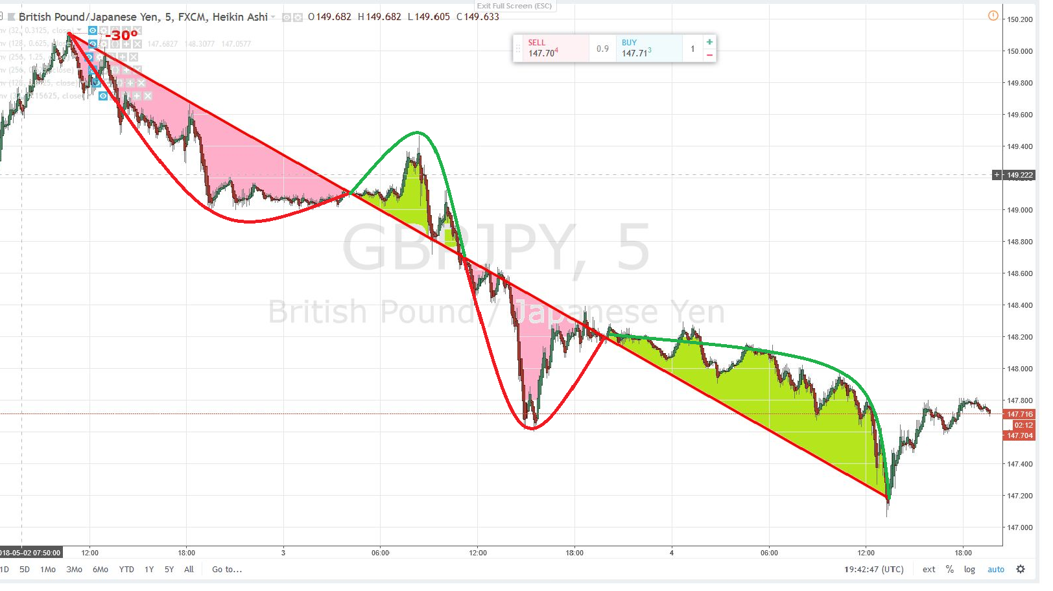
GBPJPY : Reading correctly a chart
Price Action sinewave + a Down Trend

Slide 8
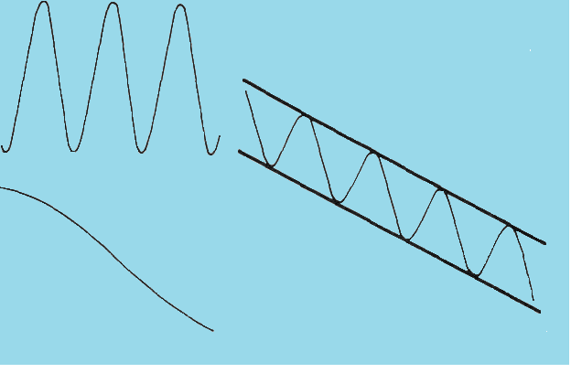
Theoretical Down Channel

Slide 9
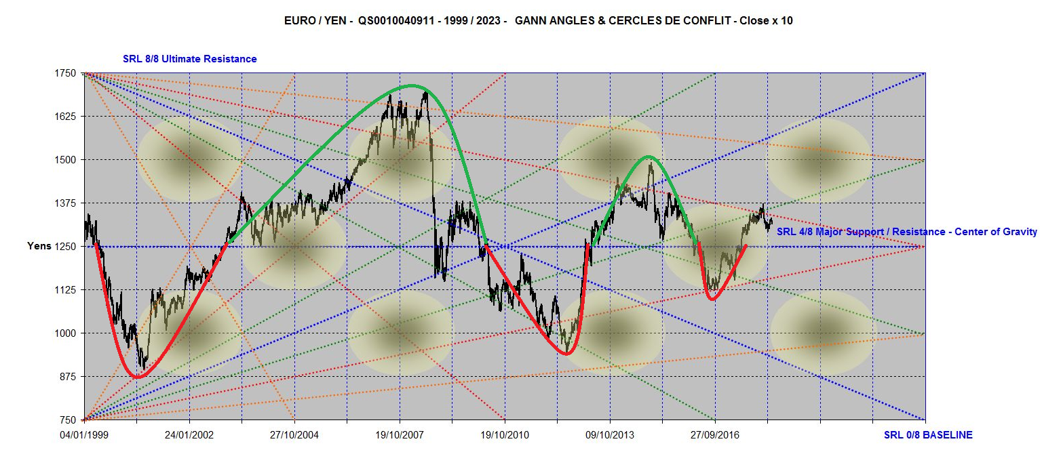
Price Action sinewaves, a key concept : the Center of Gravity

Slide 10
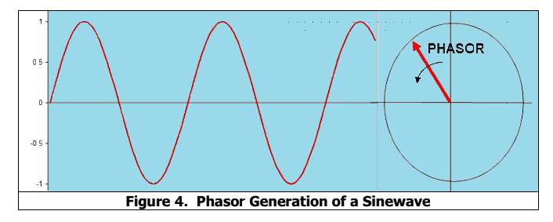
How you generate a sinewave

Slide 11
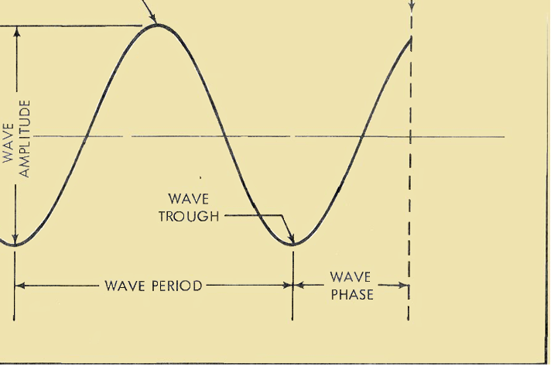
Hurst Cycle

Slide 12
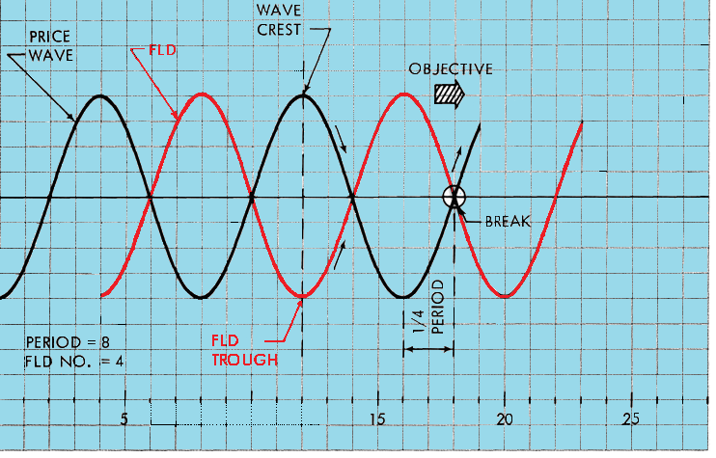
FLD : how it works

Slide 13
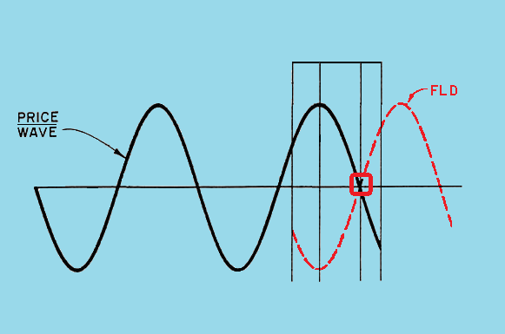
The FLD is the projection of Price Action in the future of ½ period of the observed cycle

Slide 14
Price Action breaks its FLD, halfway of its down or up trending Swing

Slide 15
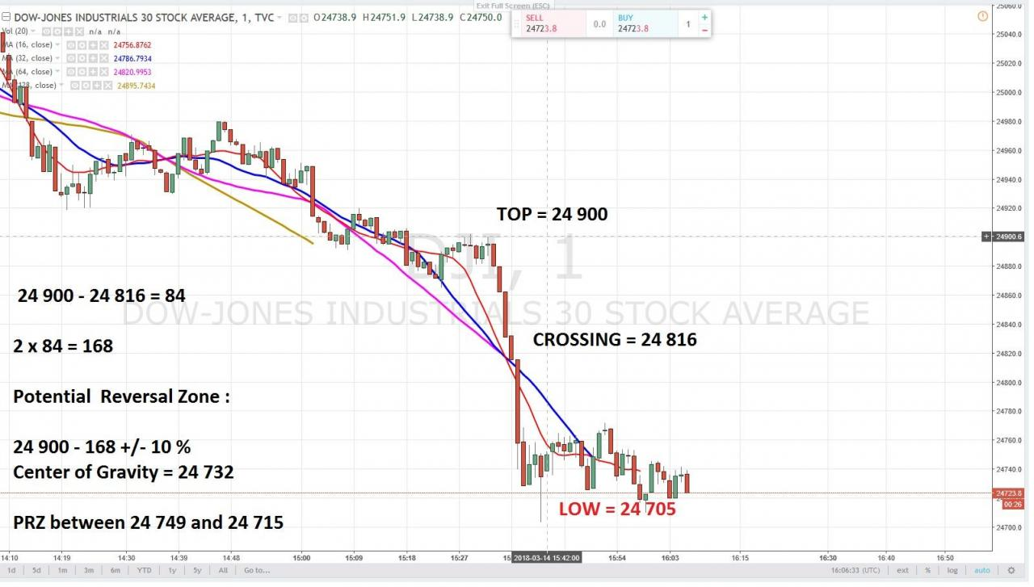
Compare with a Centered Moving Averages Crossing

Slide 16
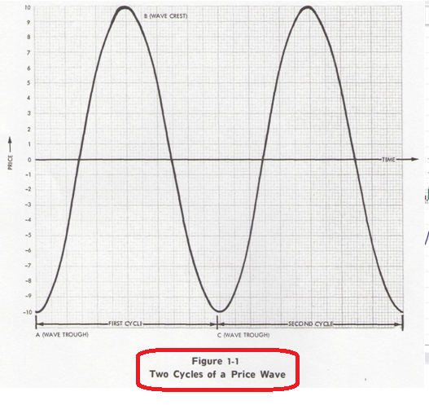
Only repetition generates a « Cycle »

