Slide 1
FLD : Future Line of Demarcation

Slide 2
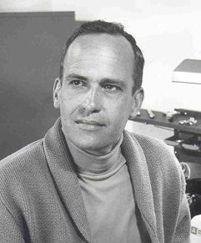
Theory of irrational decision processes
The Wave Theory of Price Action

Slide 3
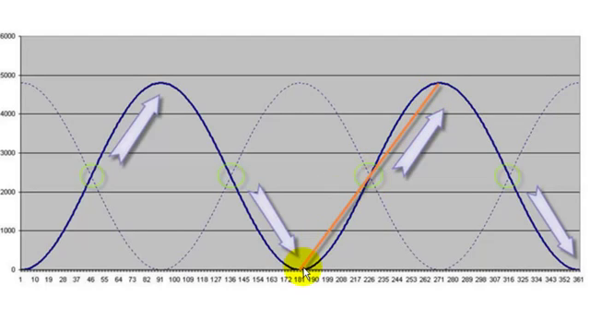
Theory : Repetition of a Wave creates a « Cycle »

Slide 4
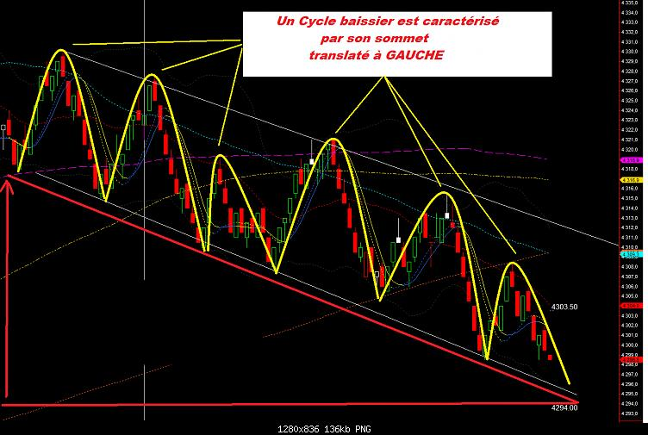
Real trading life :
Repetition of a Wave creates a « Cycle »

Slide 5
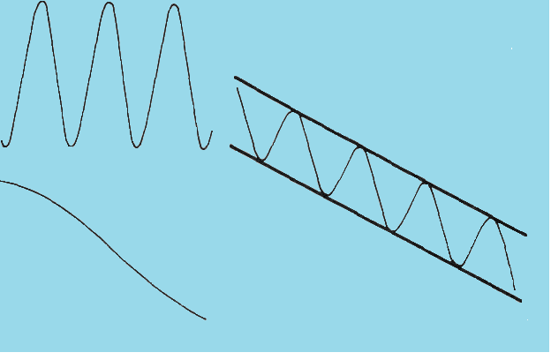
Theoretical Down Channel

Slide 6
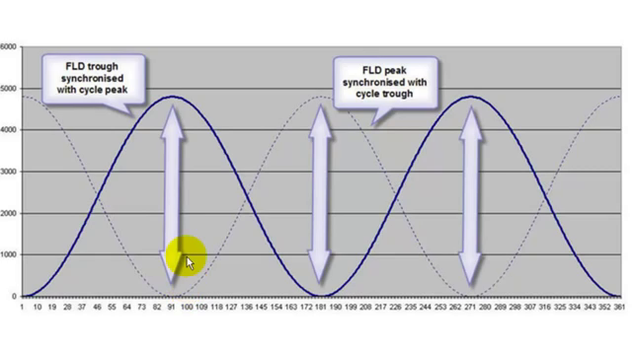
FLD Theory

Slide 7
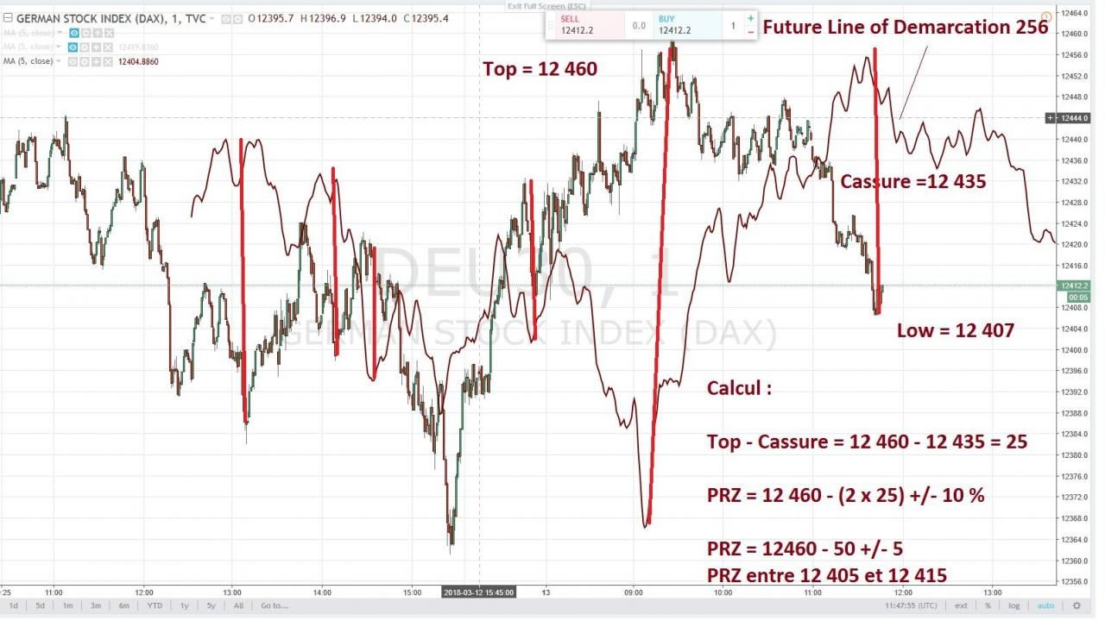
FLD Peaks are synchronized with Cycles troughs, and conversely

Slide 8
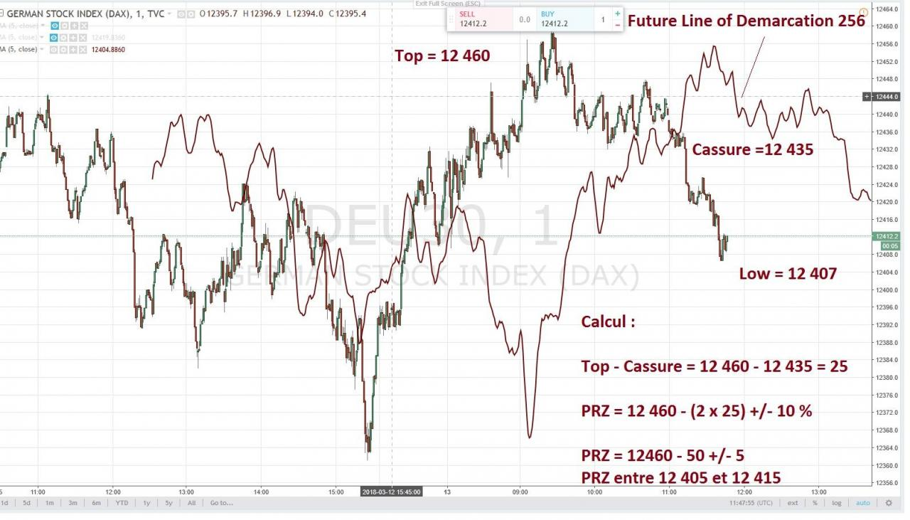
How to use a FLD

Slide 9
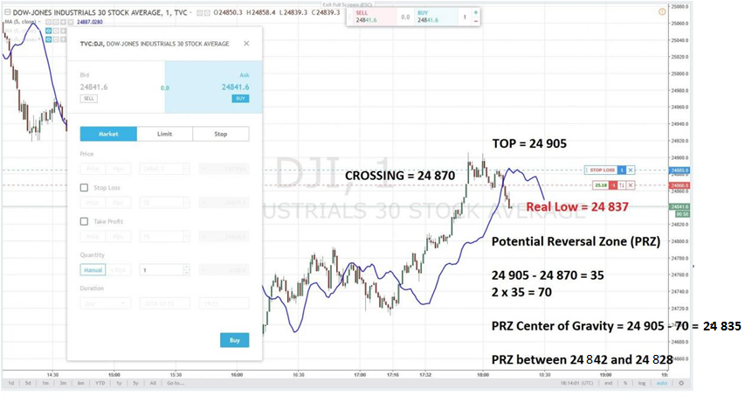
Calculating a target price with a FLD

Slide 10
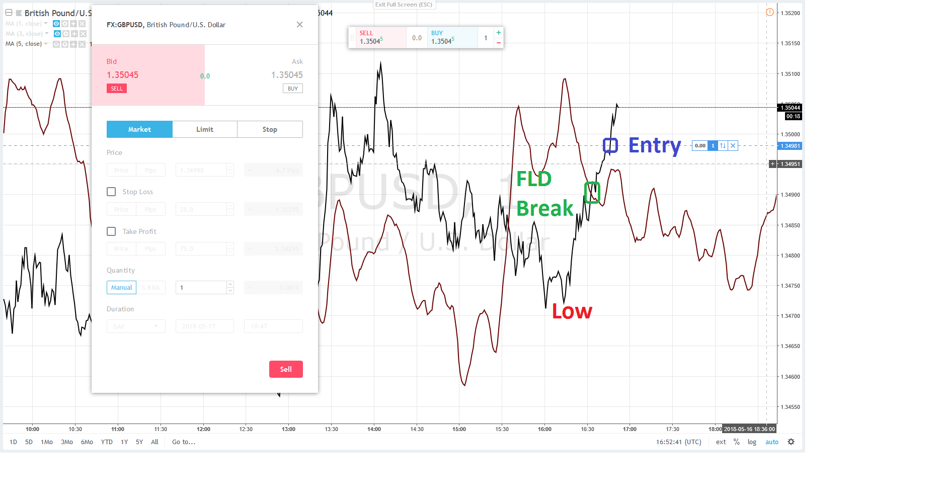
Entry after a FLD break on the upside

Slide 11
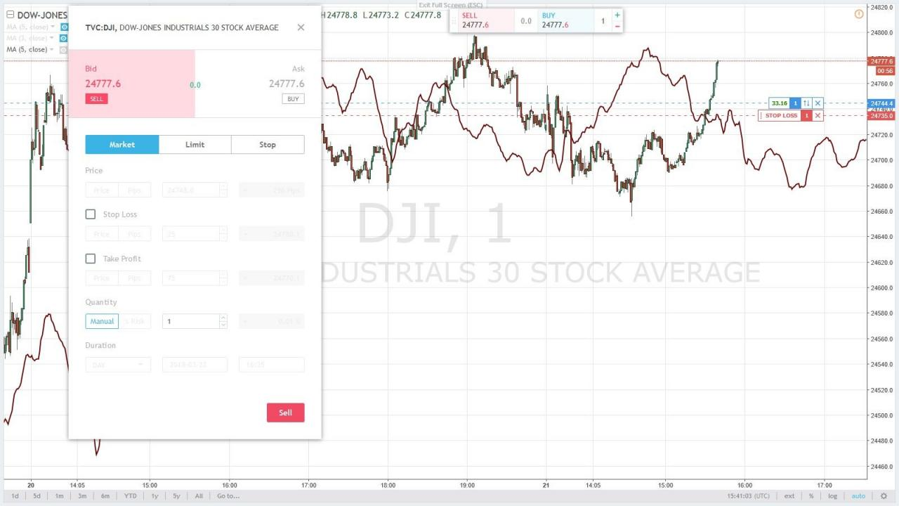
Which Low to choose to calculate the FLD ?

Slide 12
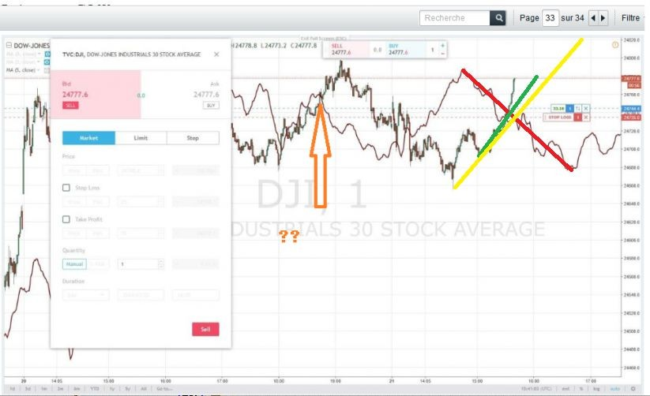
2 possible origins to calculate successive Price Targets

