Slide 1
SQ9 NOVAK REICH

Slide 2
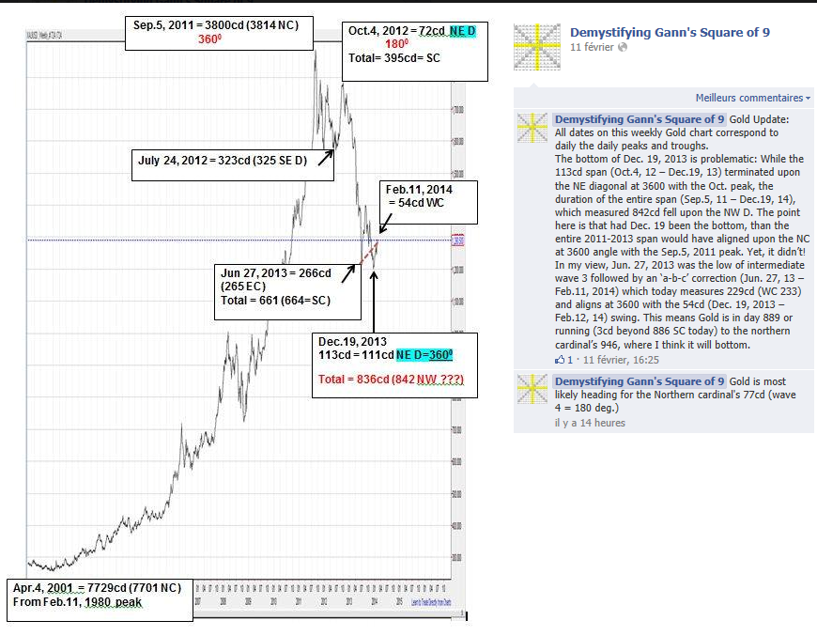
GOLD

Slide 3
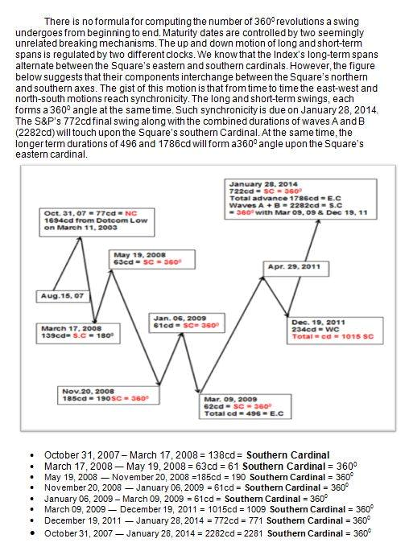

Slide 4
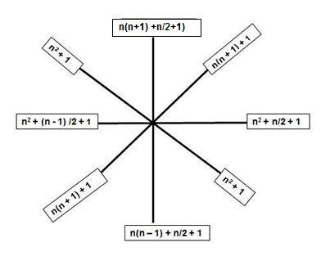

Slide 5


