Slide 1
Circles of Conflict

Slide 2
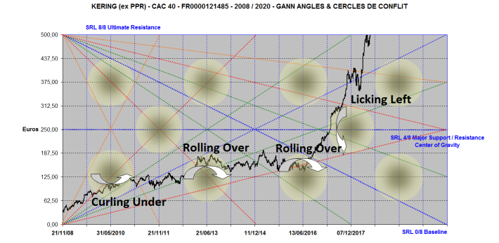
Curling Under, Rolling Over

Slide 3
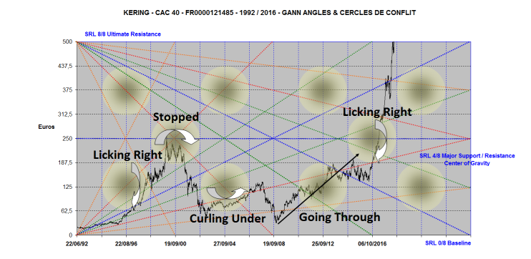
Licking Right, Going Through

Slide 4
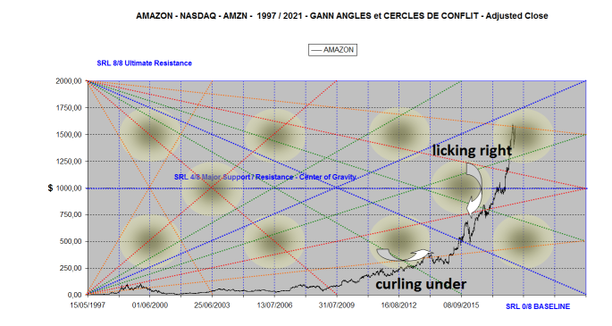
Curling Under, Licking Right

Slide 5
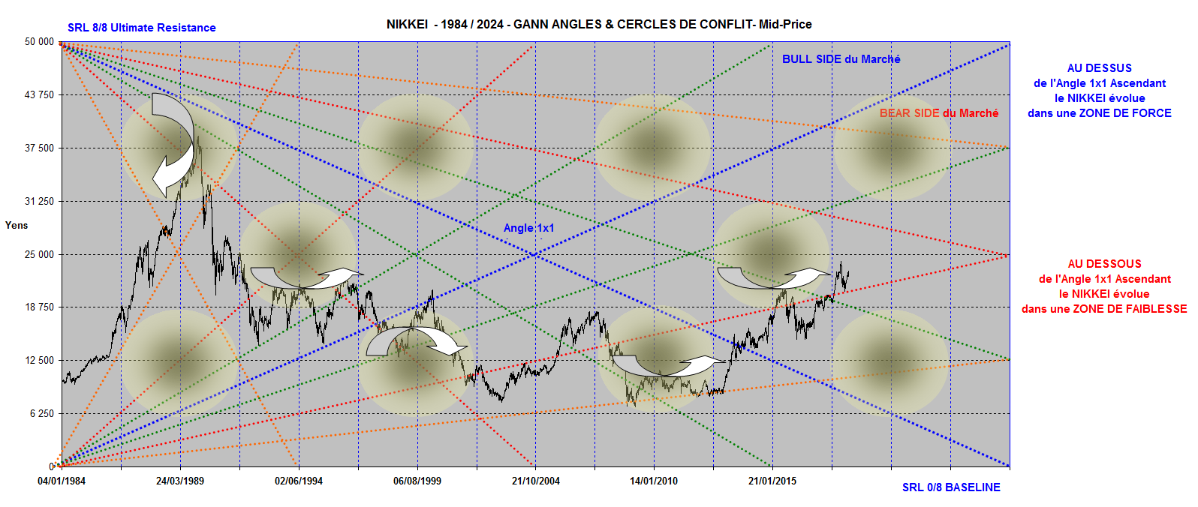
NIKKEI avoids Circles of Conflict

Slide 6
GBPJPY 30 minutes

Slide 7
According to GANN, Angle (1x1)
– 1 Price Unit x 1 Time Unit – is the Angle where Price and Time are balanced.

Slide 8
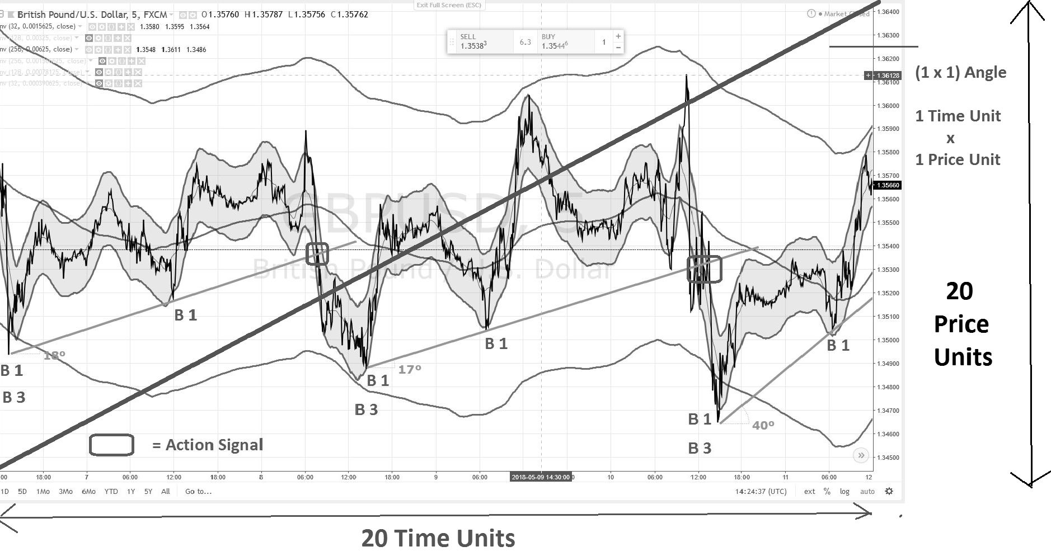
Practical Application on TradingView

Slide 9
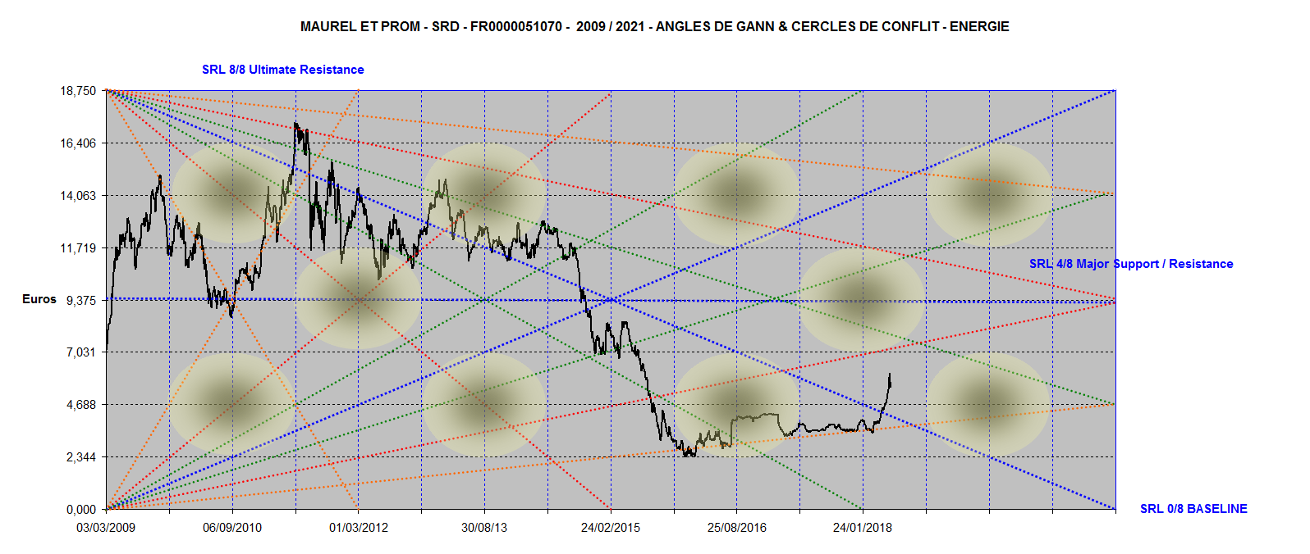
Maurel & Prom, no color, no comments

Slide 10
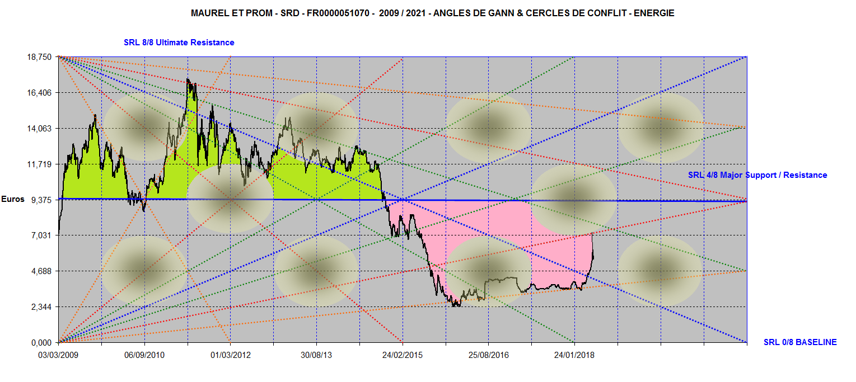
Center of Gravity,
Strength, Weakness
Maurel & Prom 2009 / 2021

Slide 11
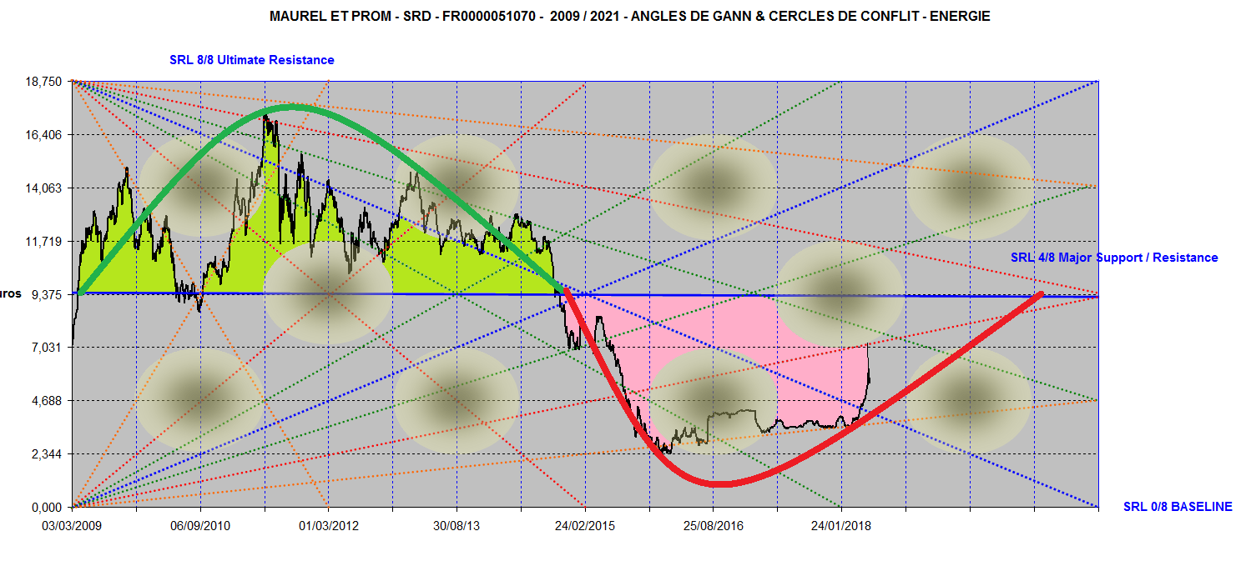
Center of Gravity & Sine Wave
Maurel et Prom 2009 / 2021

Slide 12
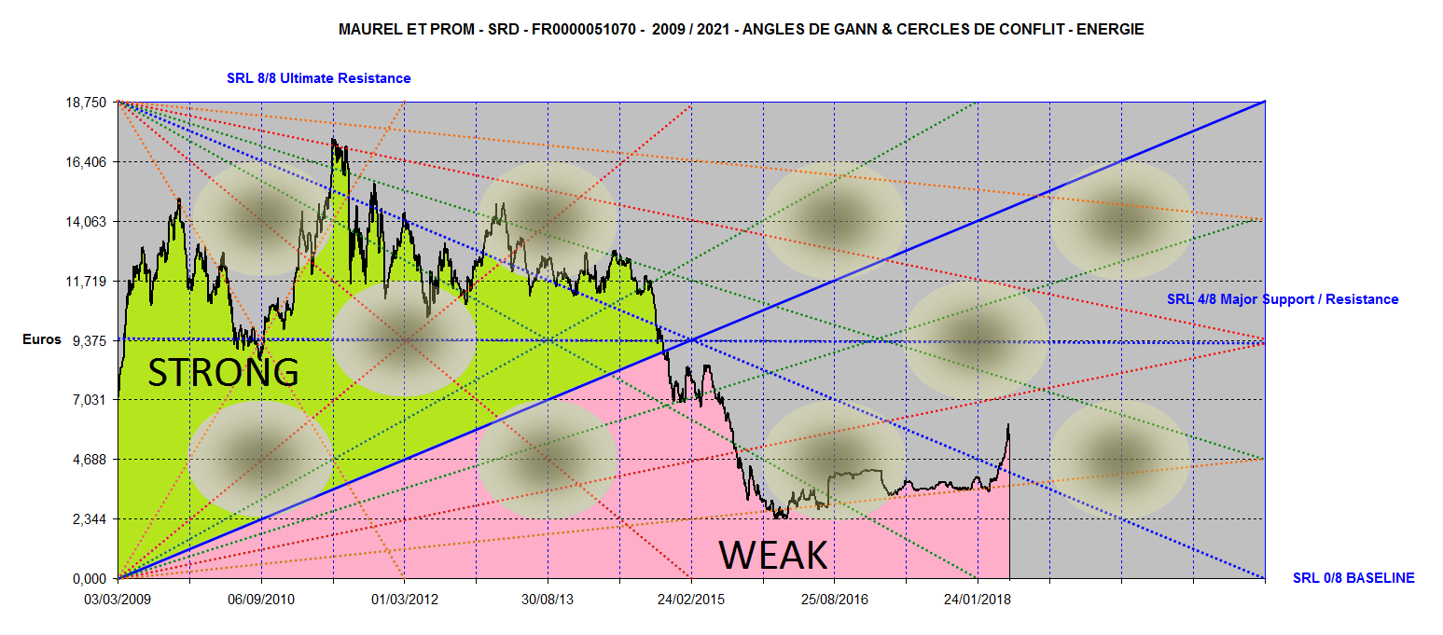
Strength Area / Weakness Area
2009 / 2021

Slide 13
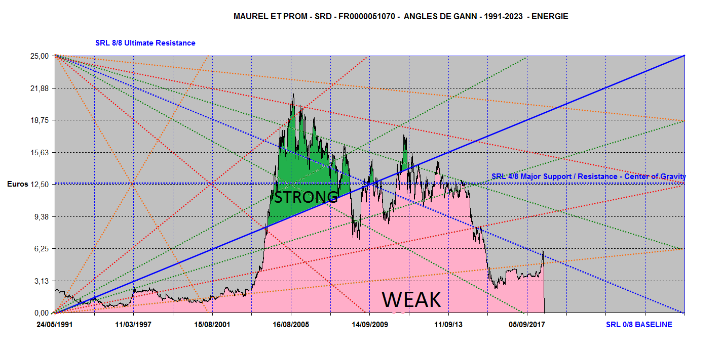
Strength Area/ Weakness Area
1991 / 2023

Slide 14
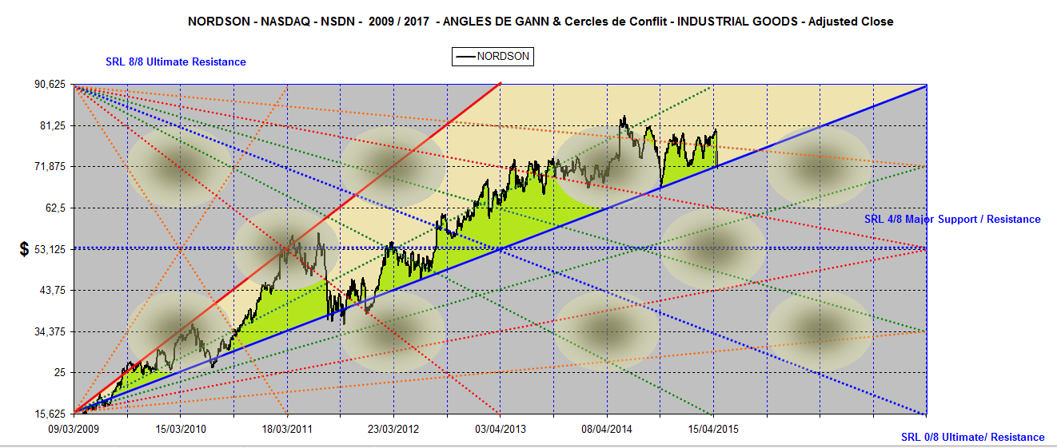
NORDSON is above its (1x1) Angle
2009 / 2021

Slide 15
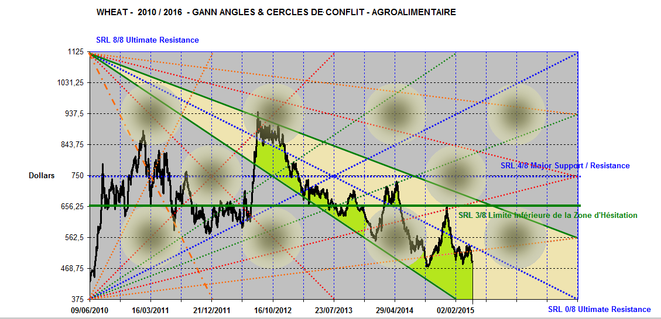
Wheat : 2010 / 2018 follows its Descending Hesitation Zone

Slide 16
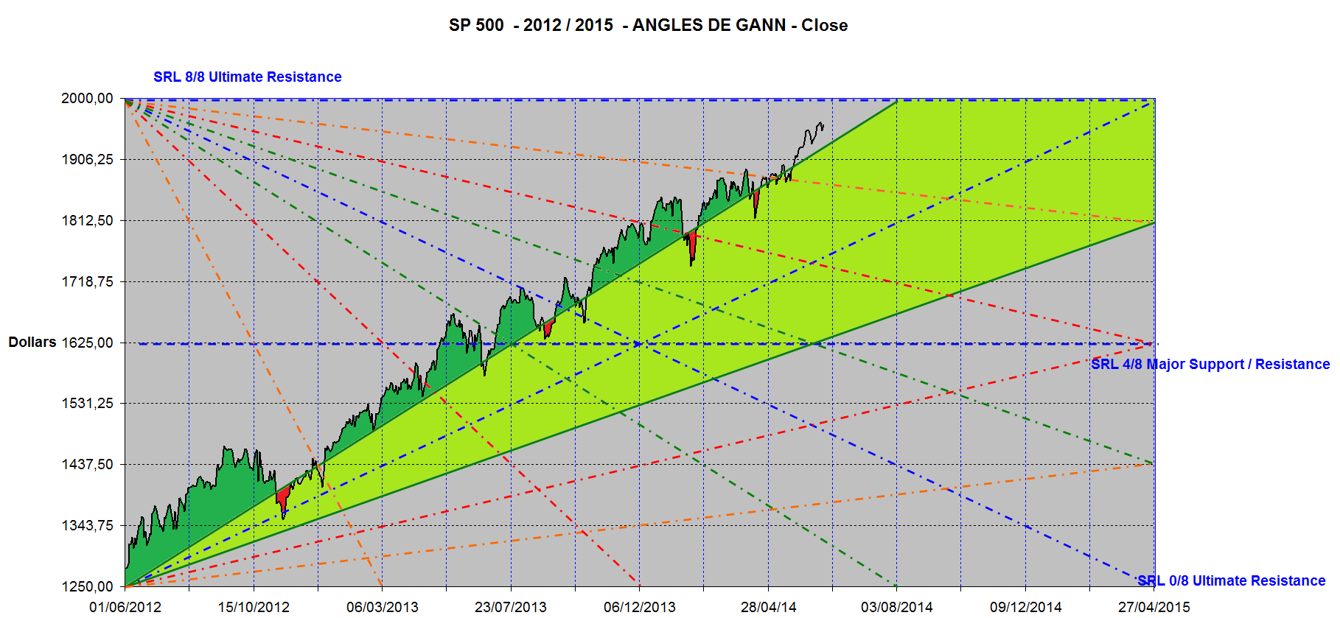
S&P 500 is above its Ascending Hesitation Zone

Slide 17
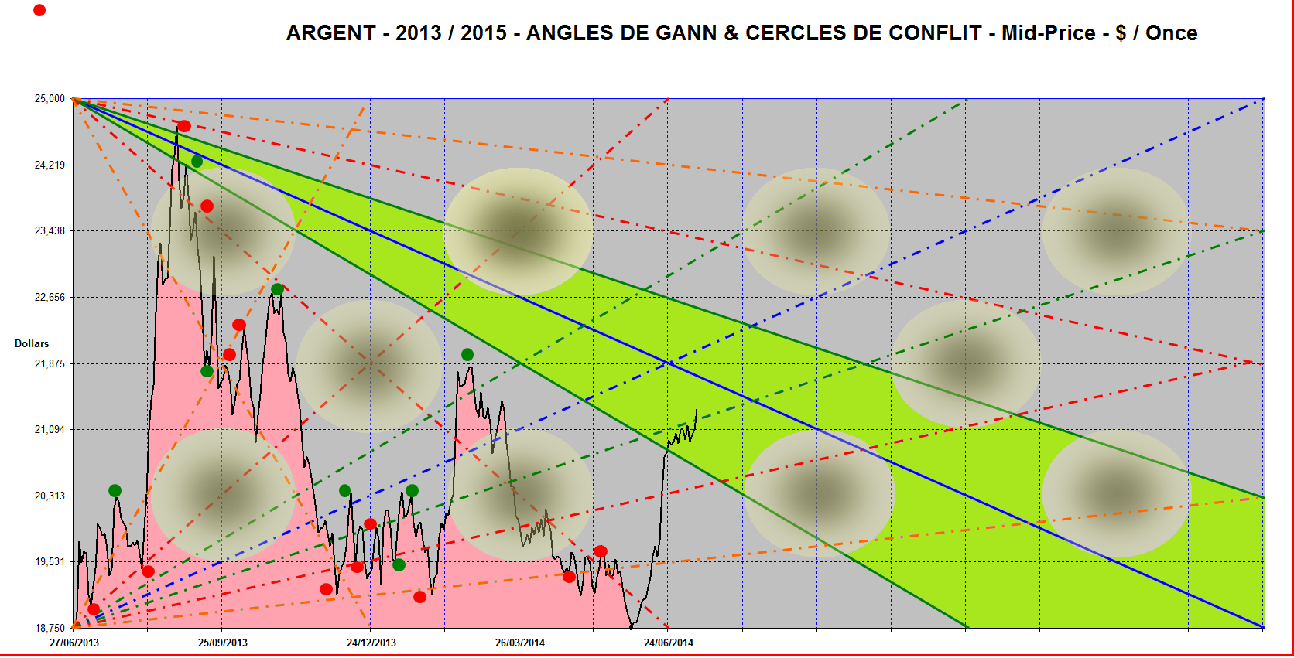
Silver fluctuates under its Descending Hesitation Zone

Slide 18
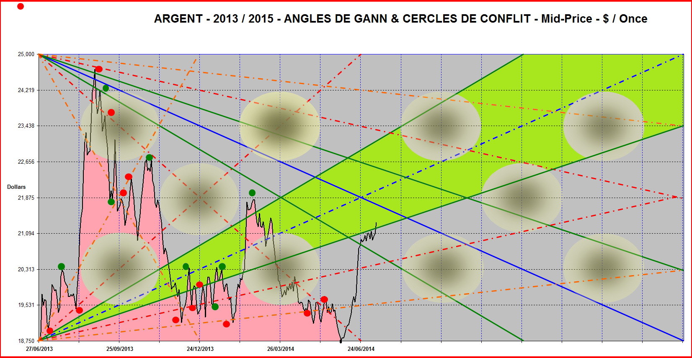
Silver reenters its Ascending Hesitation Zone

Slide 19
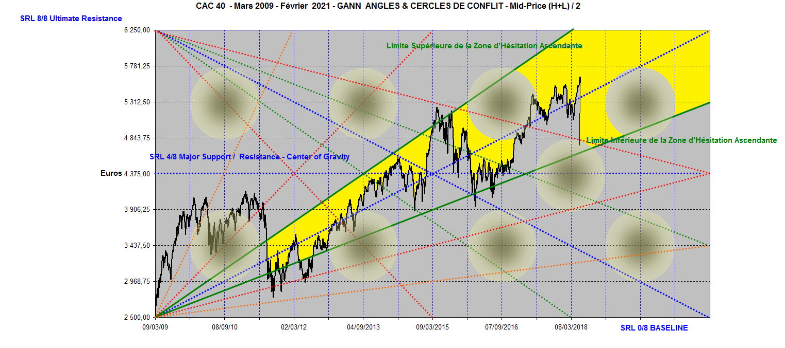
Since the Low of March 2009, french CAC 40 fluctuates within its Ascending Hesitation Zone

Slide 20
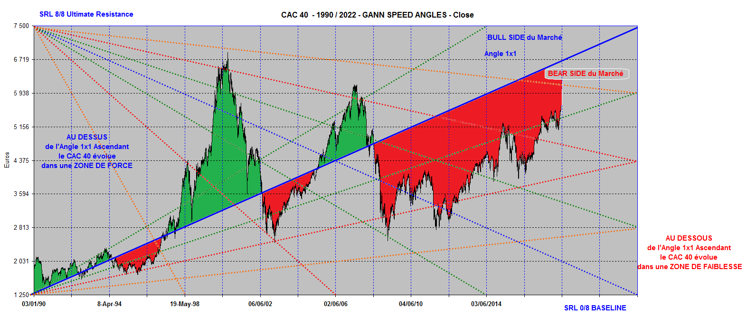
French CAC 40 above and under its Ascending (1x1 ) Angle

Slide 21
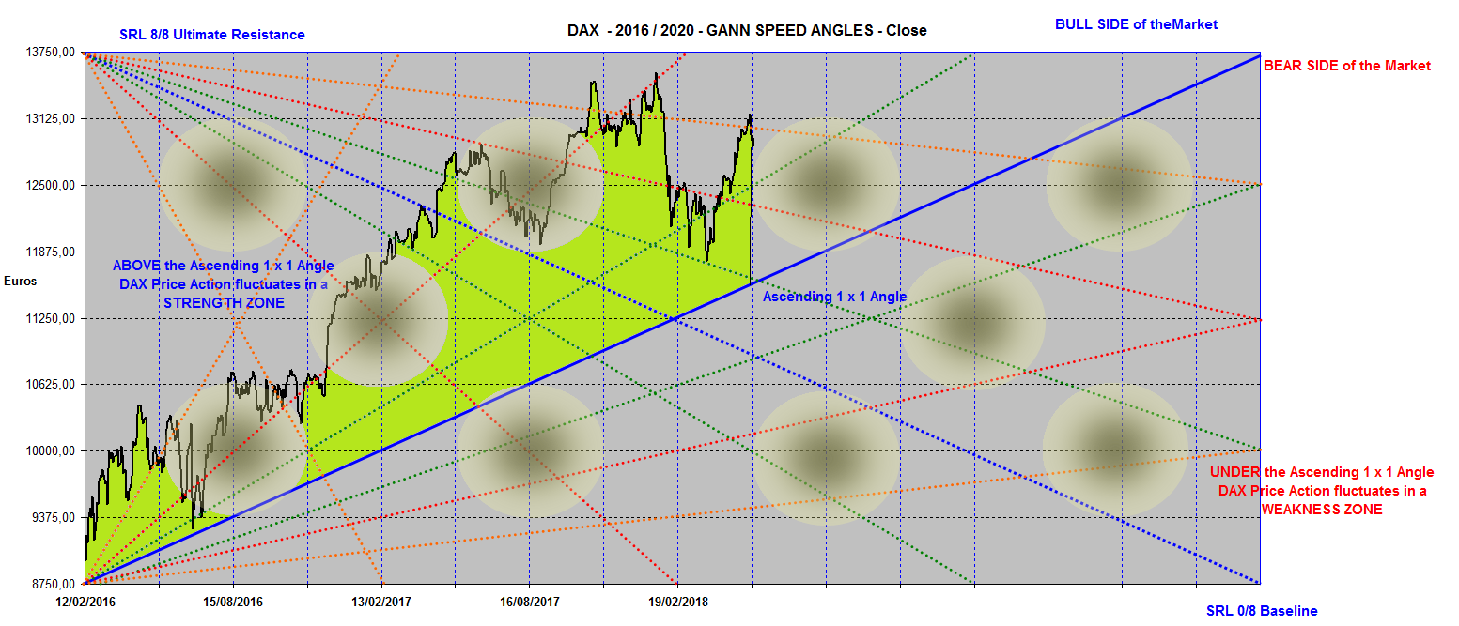
German DAX – 2016 / 2020 above its Ascending (1x1) Angle

Slide 22
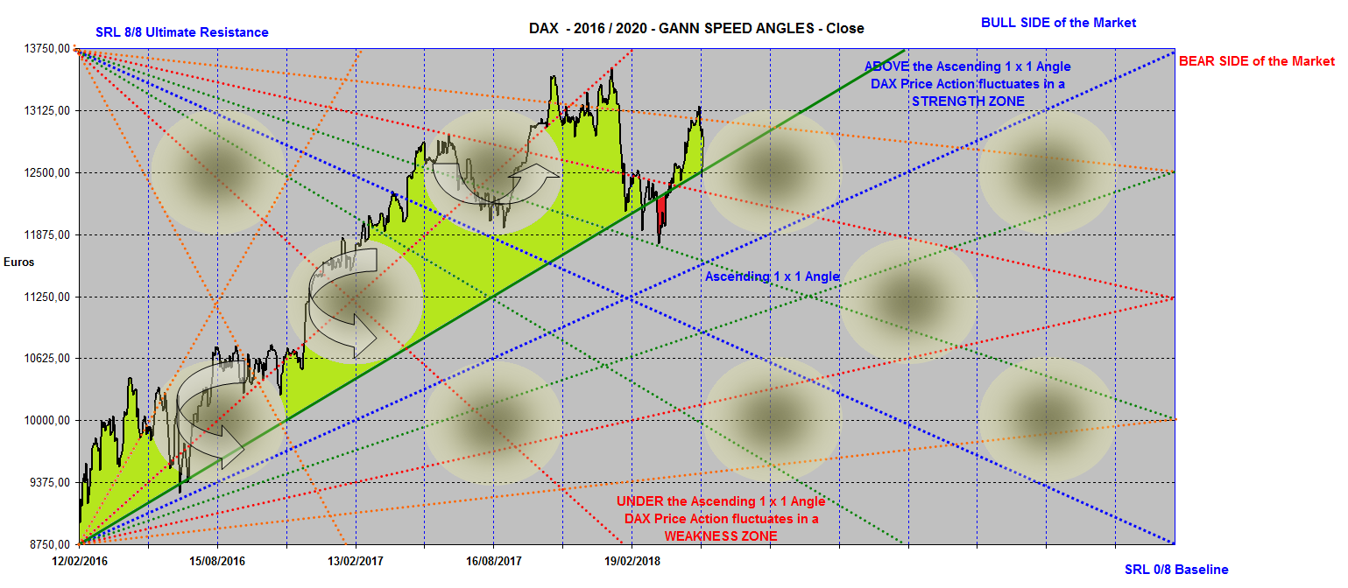
German DAX 2016 / 2020 :
Horizontals, Diagonals, Verticals

