Slide 1
GANN « ANGLES » (DIAGONALS)
According to GANN,
Angle (1x1)
– 1 Price Unit x x 1 Time Unit -
is the most important.

Slide 2
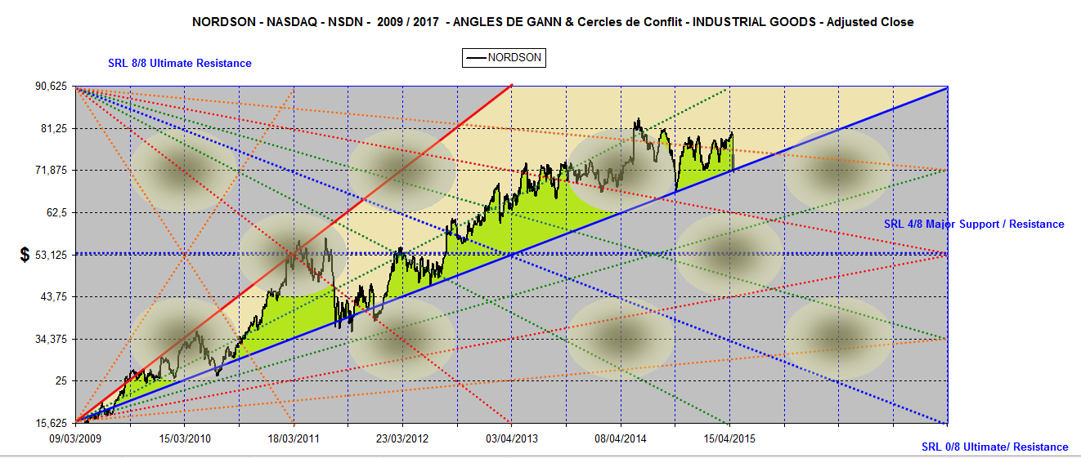
NORDSON is above its (1x1) Angle
2009 / 2021

Slide 3
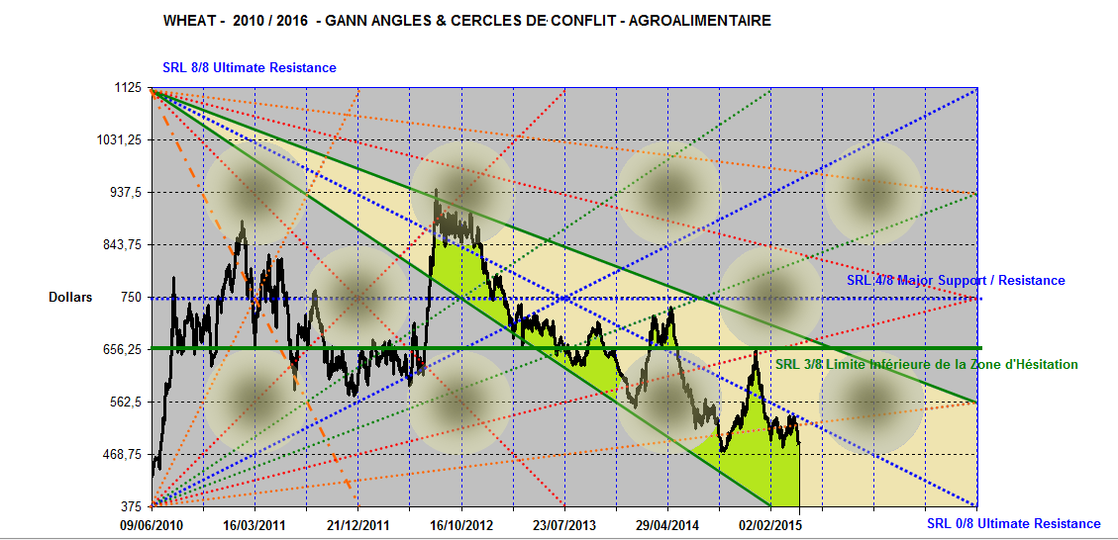
Wheat : 2010 / 2018 follows its Descending Hesitation Zone

Slide 4
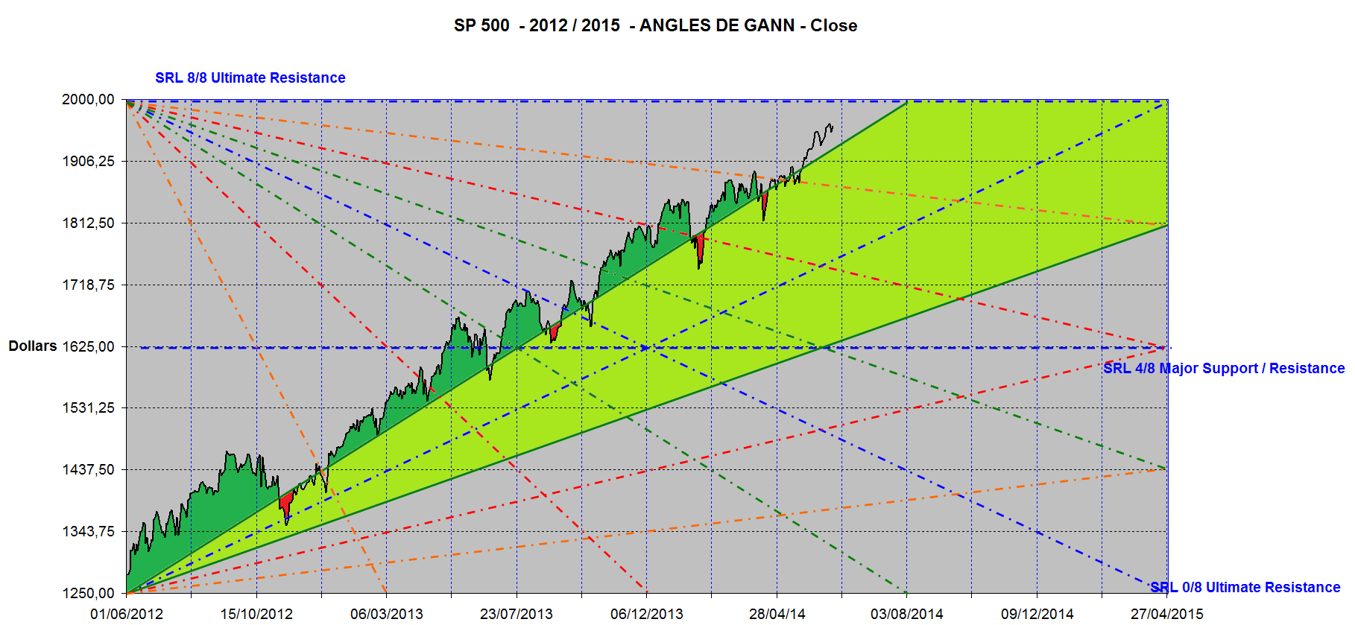
S&P 500 is above its Ascending Hesitation Zone

Slide 5
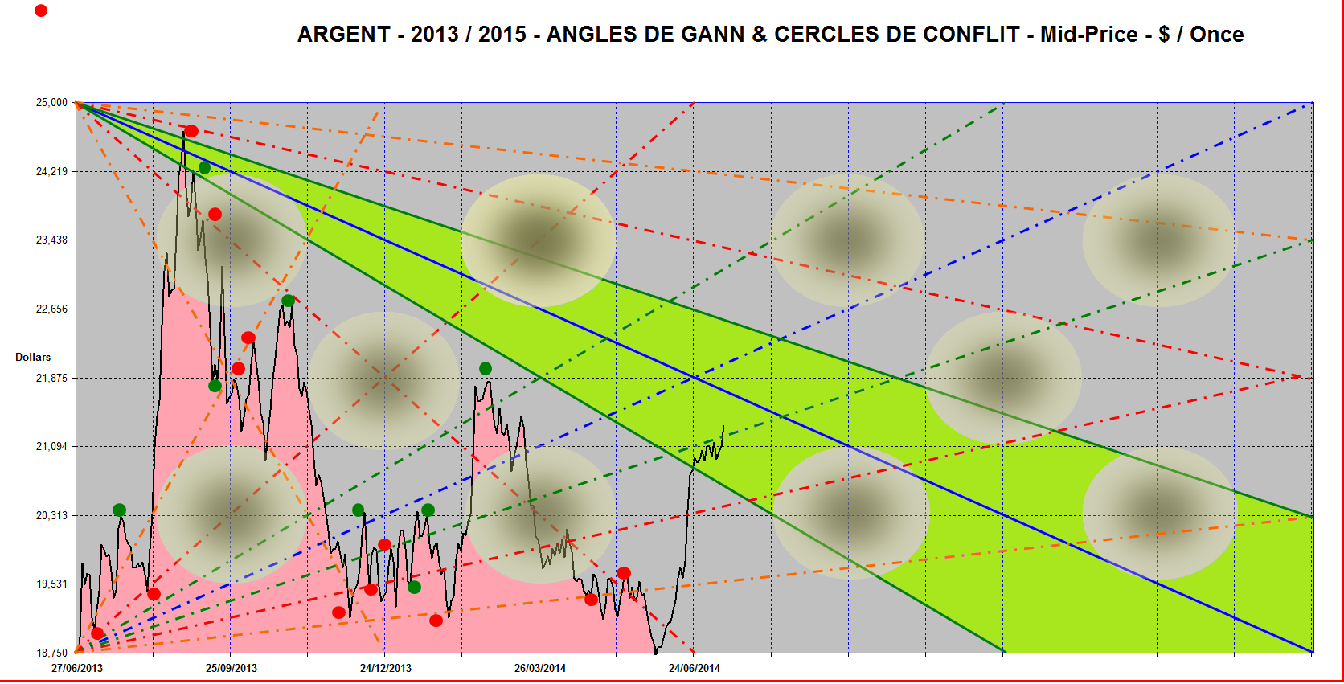
Silver fluctuates under its Descending Hesitation Zone

Slide 6
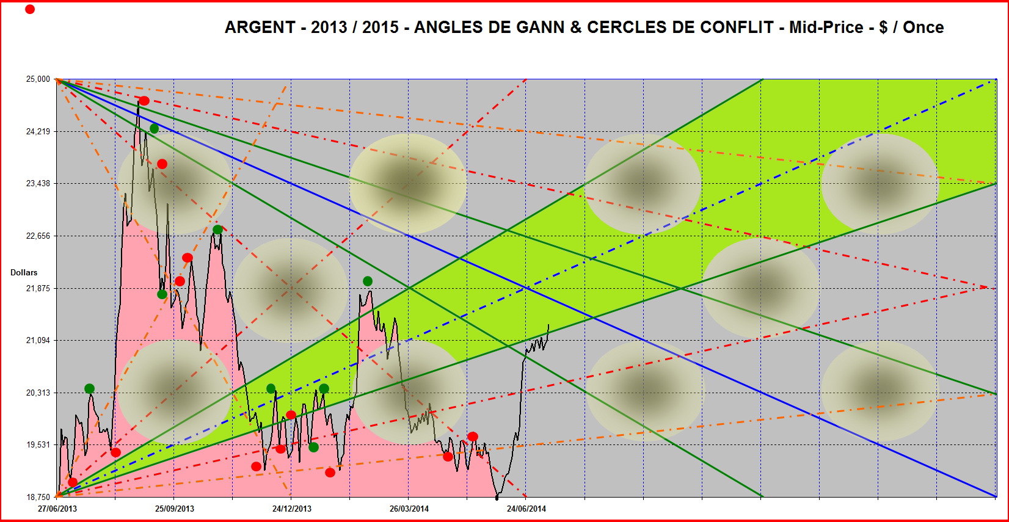
Silver reenters its Ascending Hesitation Zone

Slide 7
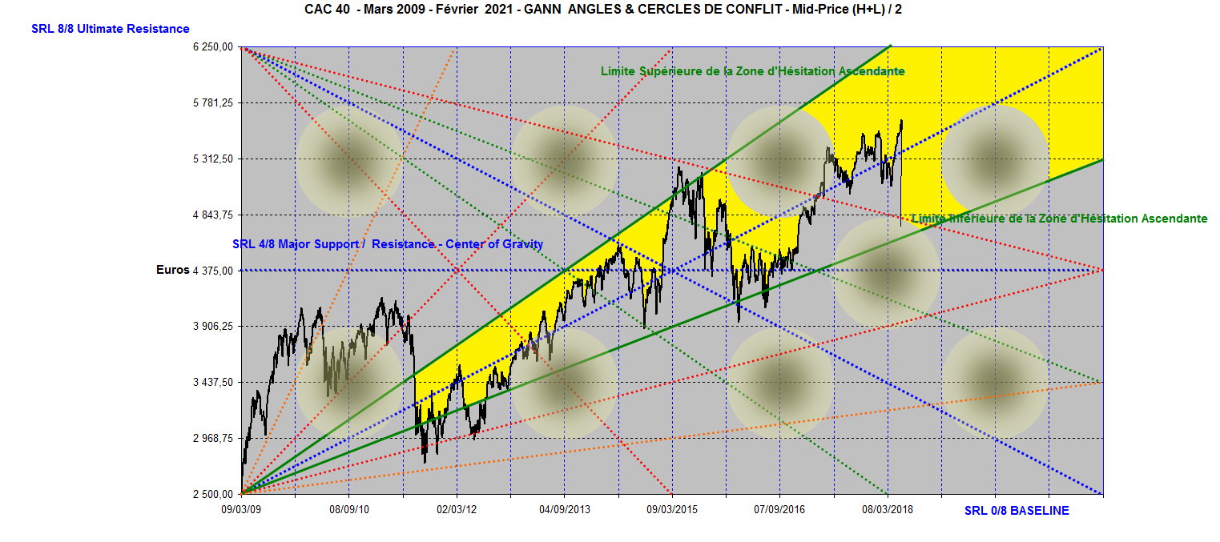
Since the Low of March 2009, french CAC 40 fluctuates within its Ascending Hesitation Zone

Slide 8
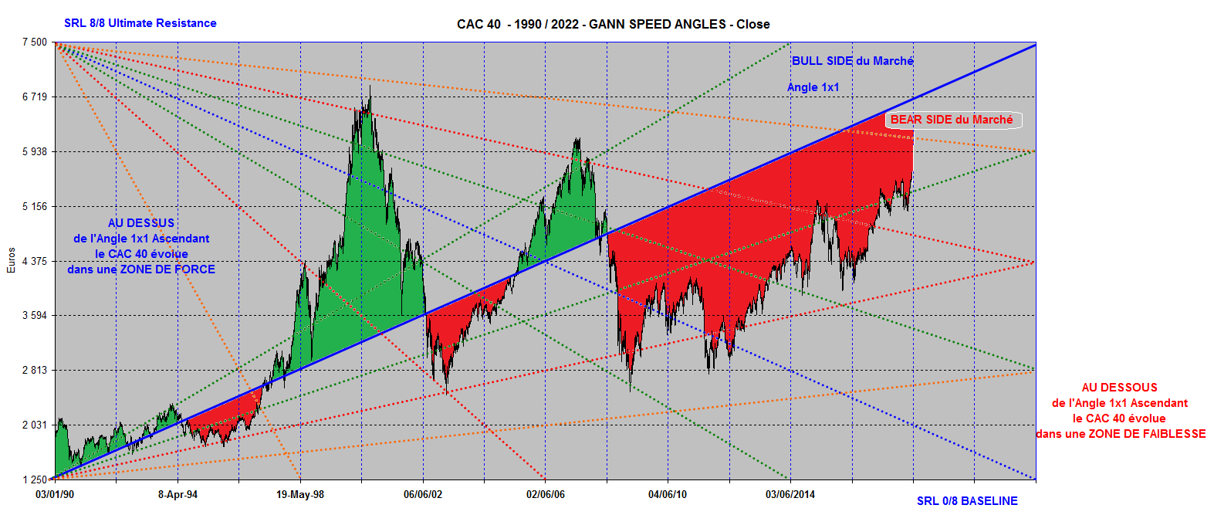
French CAC 40 above and under its Ascending (1x1 ) Angle

Slide 9
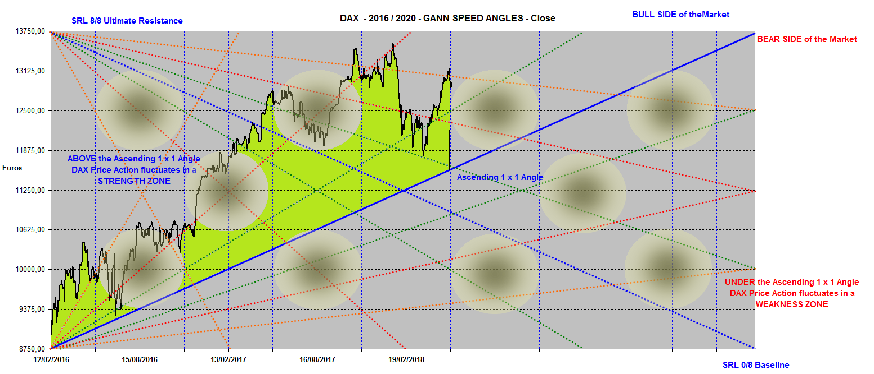
German DAX – 2016 / 2020 above its Ascending (1x1) Angle

Slide 10
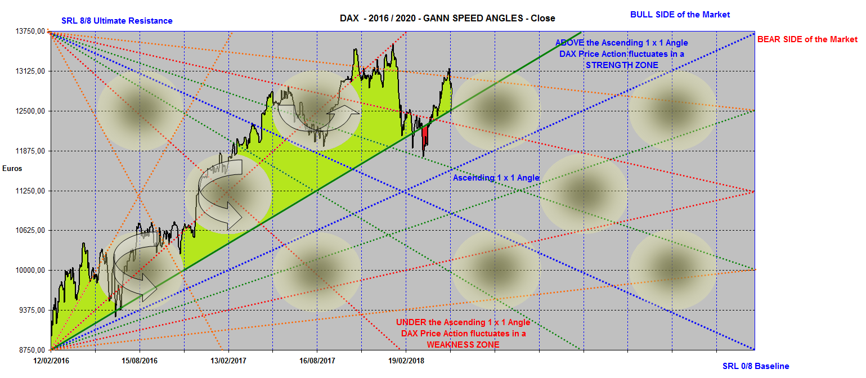
German DAX 2016 / 2020 :
Horizontals, Diagonals, Verticals

Slide 11
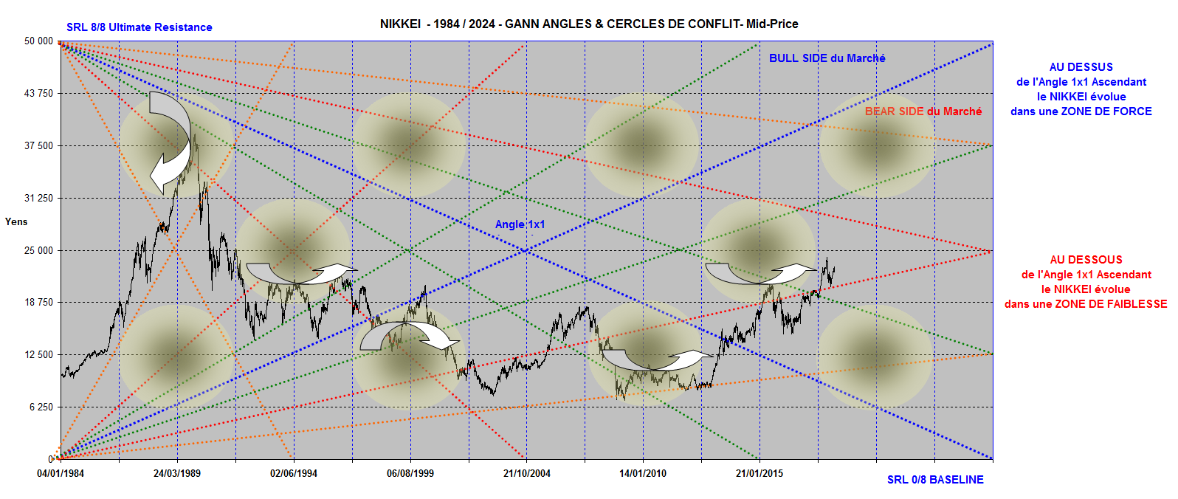
NIKKEI avoids Circles of Conflict

