Slide 1
GANN « ANGLES » (DIAGONALS)
According to GANN,
Angle (1x1)
– 1 Price Unit x x 1 Time Unit -
is the most important.

Slide 2
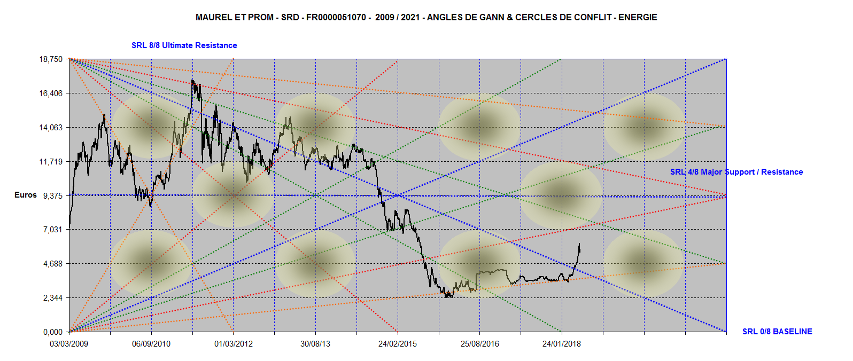
Maurel & Prom, no color, no comments

Slide 3
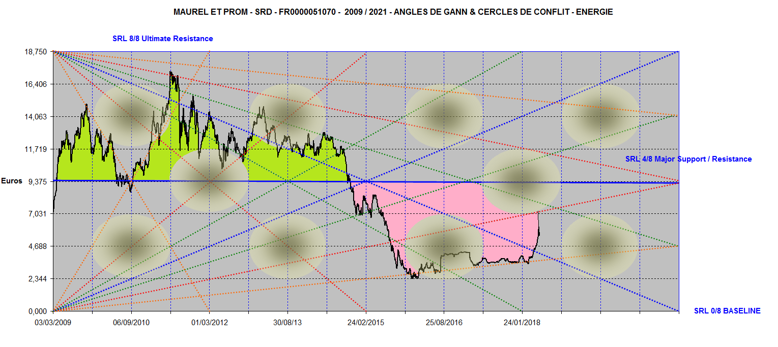
Center of Gravity,
Strength, Weakness
Maurel & Prom 2009 / 2021

Slide 4
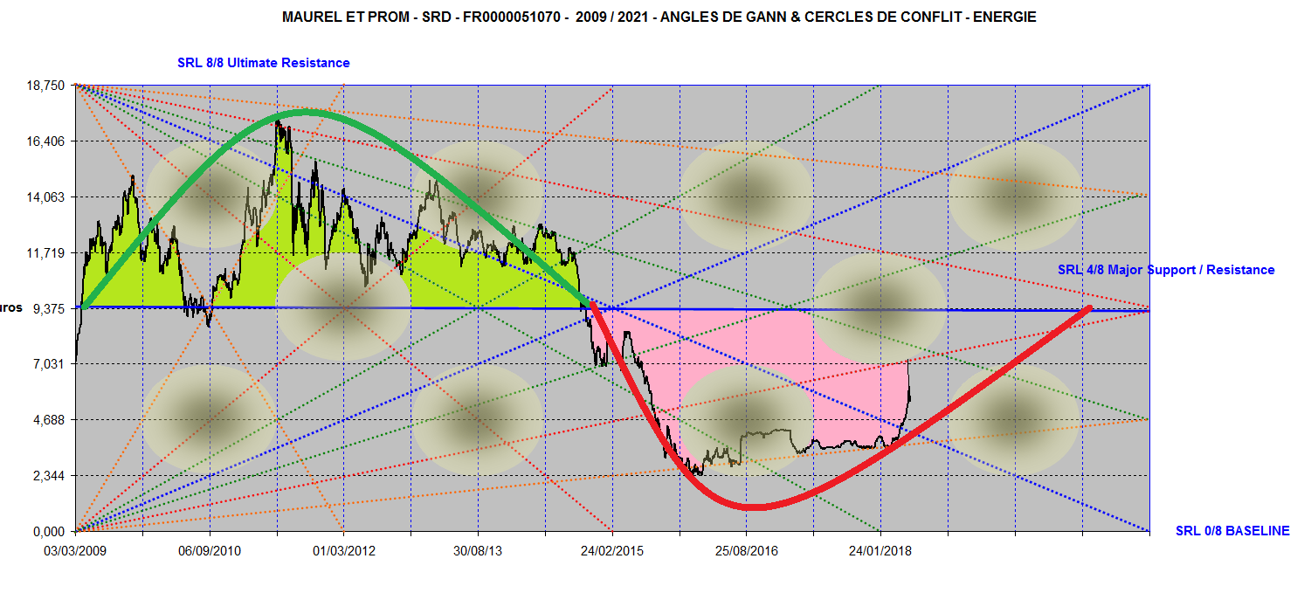
Center of Gravity & Sine Wave
Maurel et Prom 2009 / 2021

Slide 5
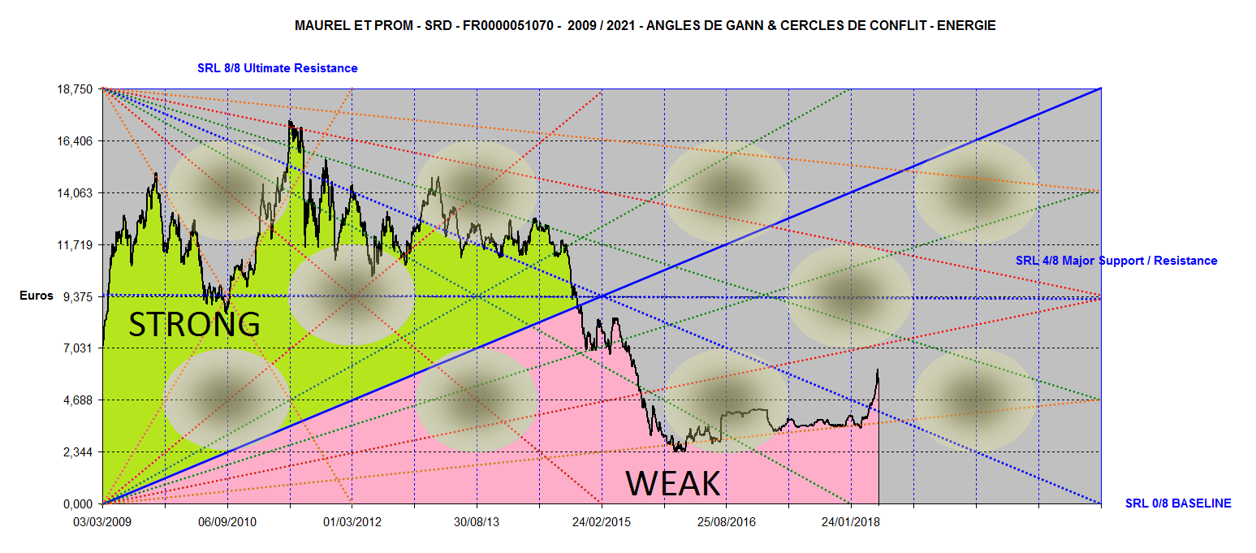
Strength Area / Weakness Area
2009 / 2021

Slide 6
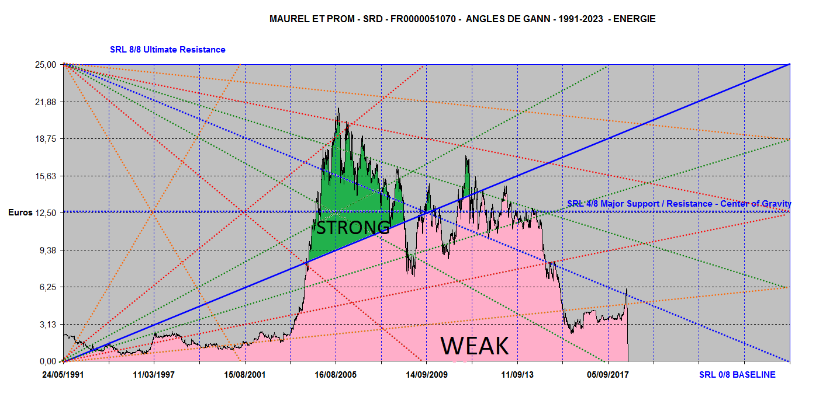
Strength Area/ Weakness Area
1991 / 2023

