Slide 1
Underlying Trend

Slide 2
Definition
According to Jim Hurst
the Underlying Trend is :
the sum
of all Cycles
whose period is greater than
that of the observed cycle

Slide 3
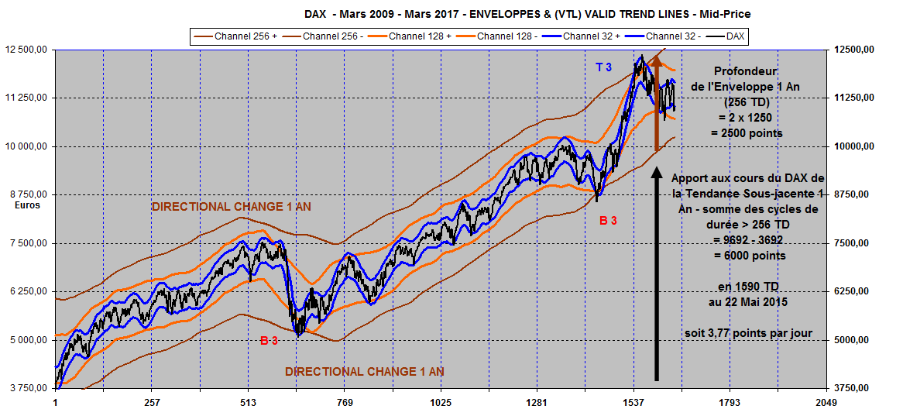
DAX 2009-2017 :
Underlying Trend add 2,5 times more amplitude to the uptrend than the internal swings of Envelope 256 TU

Slide 4
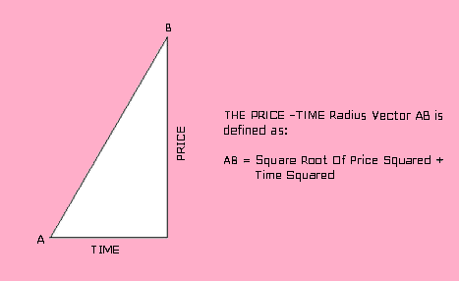
Root Squaring Price & Time

Slide 5
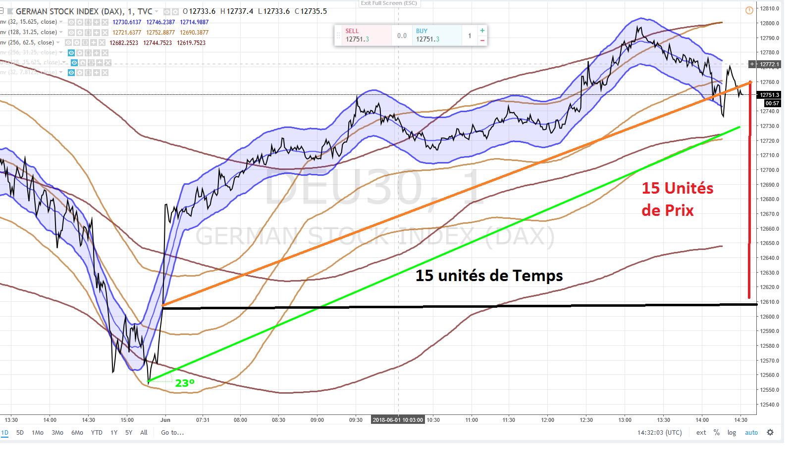
DAX 1 st June 2018
Squaring Price and Time & Return to the Mean

Slide 6
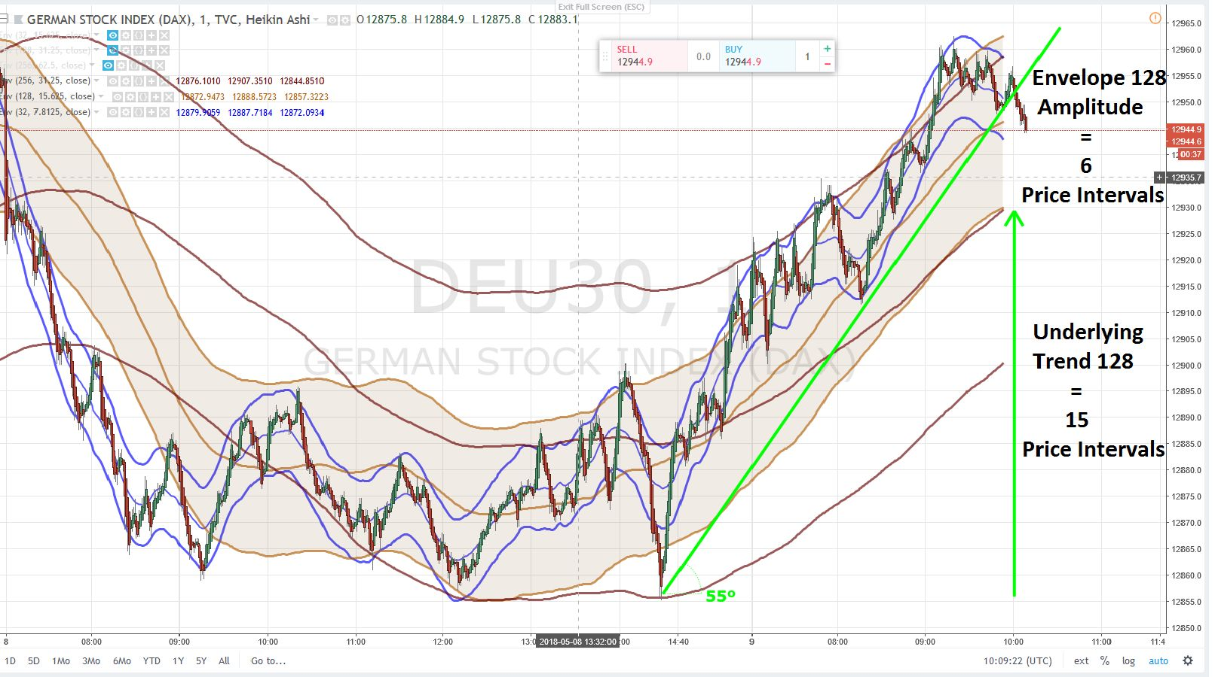
DAX Intraday (1 minute):
Underlying Trend add 2,5 times more amplitude to the uptrend than amplitude swings within Envelope 128 TU

Slide 7
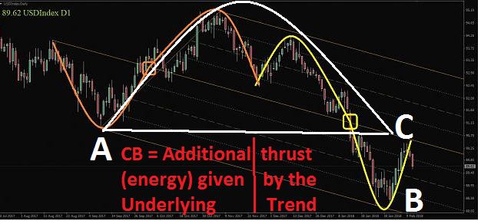
Distance CB = additional thrust consequence of the Underlying DownTrend

Slide 8
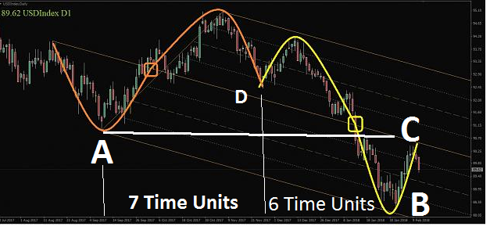
Gann : « Squaring Price & Time »
6 Price Units/ 13 Time Units

Slide 9
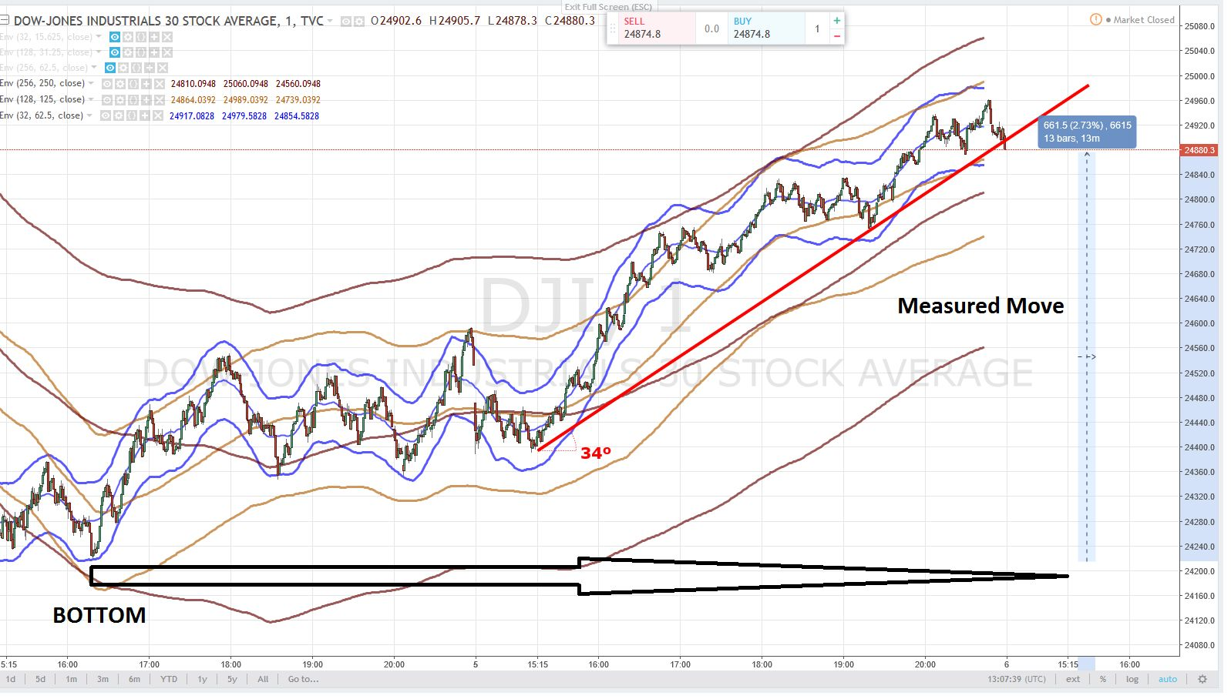
Amplitude of the Envelope 32 TU - blue - = 2 x 62,5 = 125 points, Then Underlying Trend influence on Price Action uptrend (+ 650 points) is roughly 5 times more important than the fluctuations within the Envelope 32 TU (+ 125 points)

Slide 10
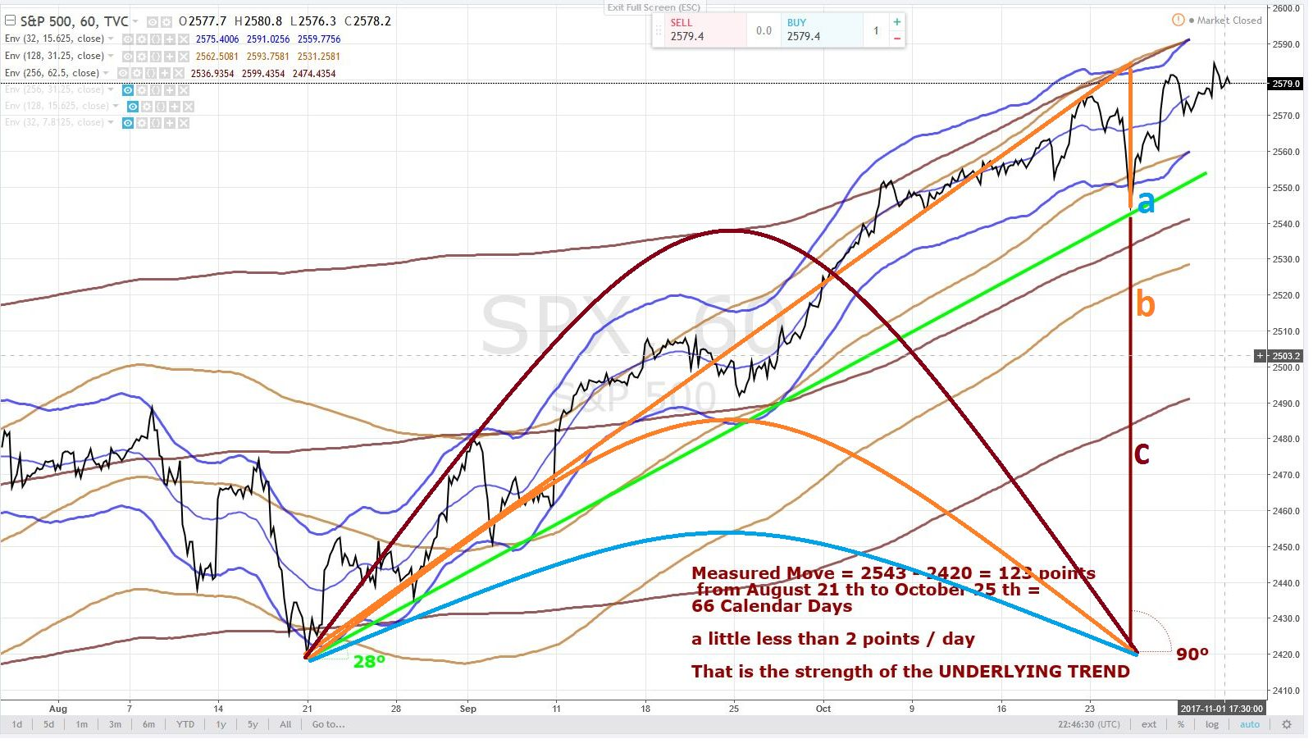
S&P 500 : 2 points / day, the strength of the Underlying Trend

