Slide 1

BOVESPA (brazilian index)
Synthesis

Slide 2
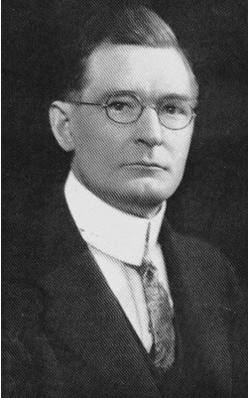
BOVESPA analyzed by Gann

Slide 3
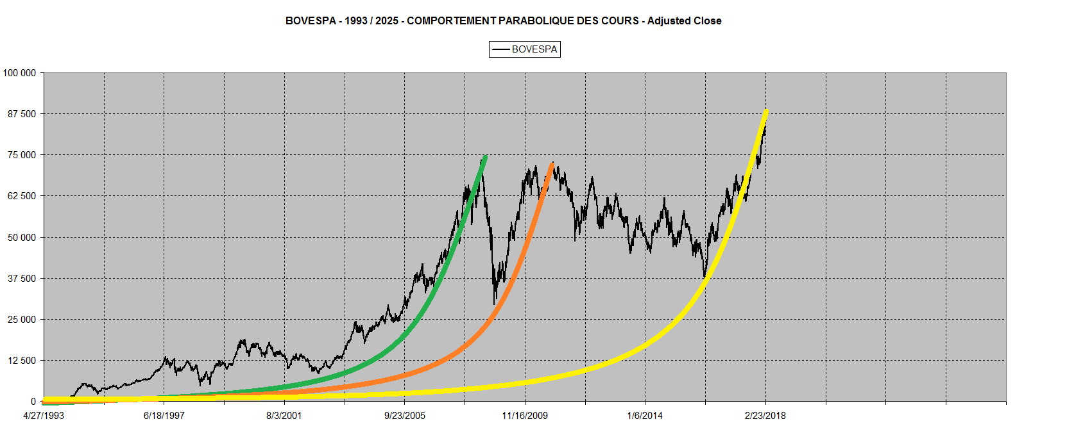
Price Action parabolic behaviour

Slide 4
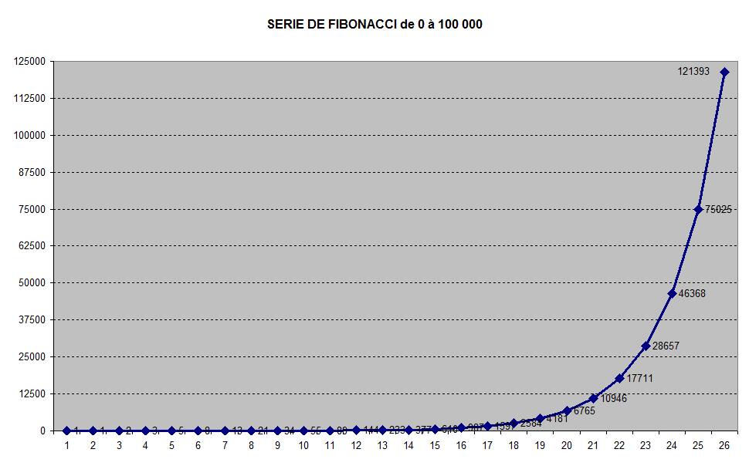
Trading Range 0 – 100 000

Slide 5
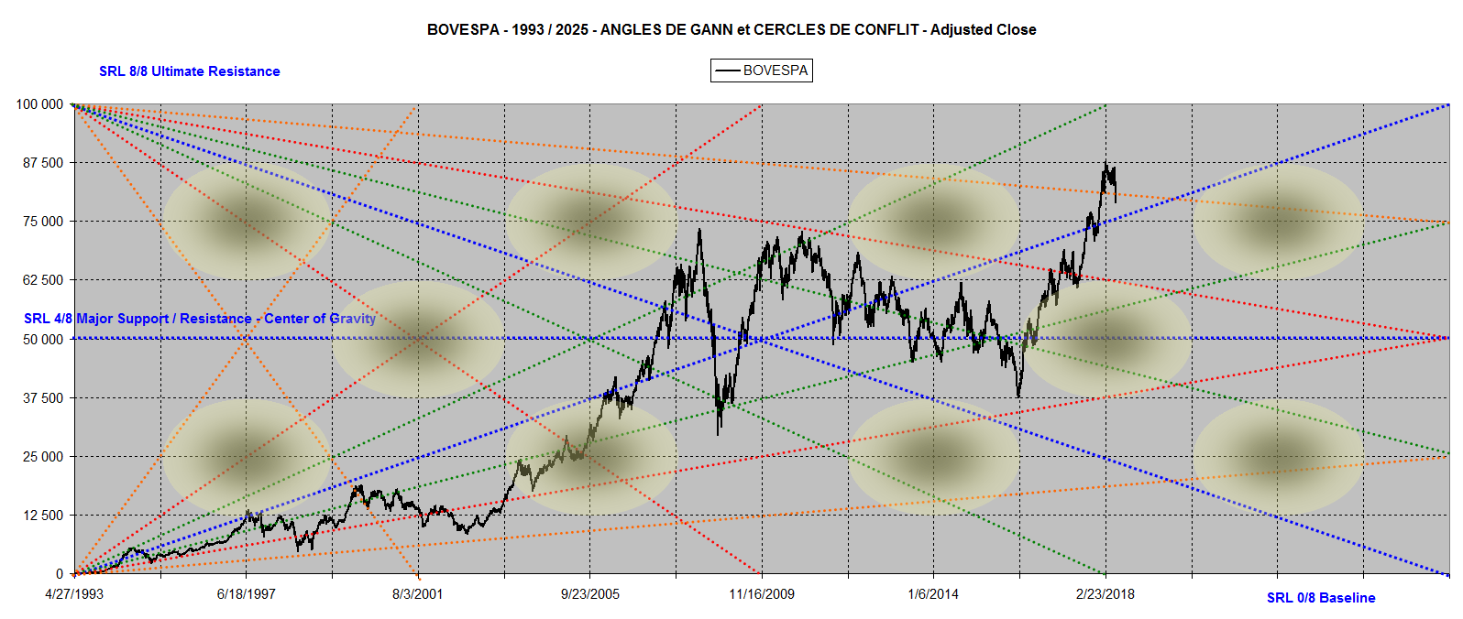
BOVESPA : Angles 1993 / 2025

Slide 6
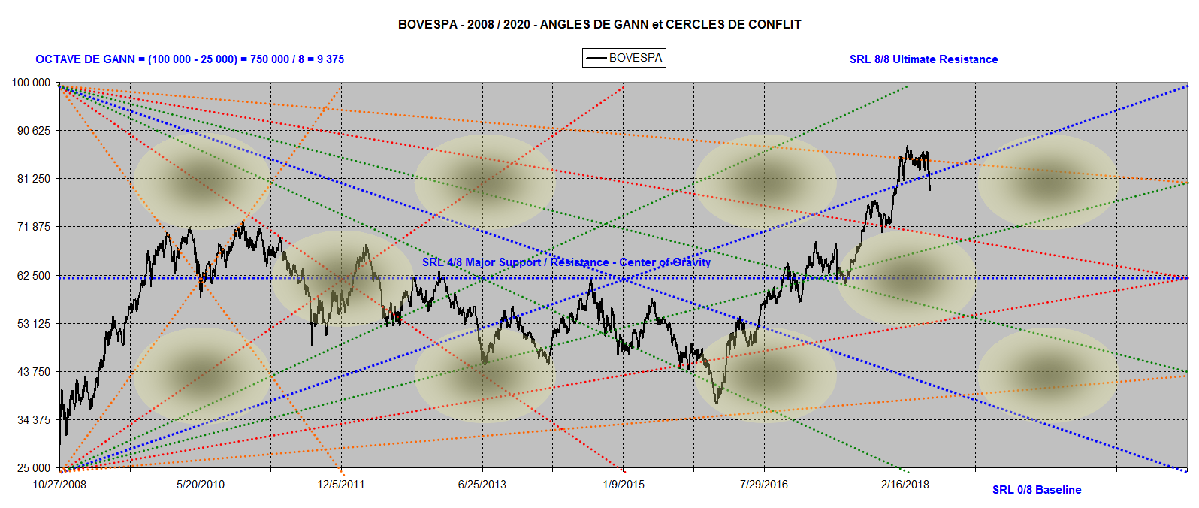
BOVESPA : Angles 2008-2020

Slide 7
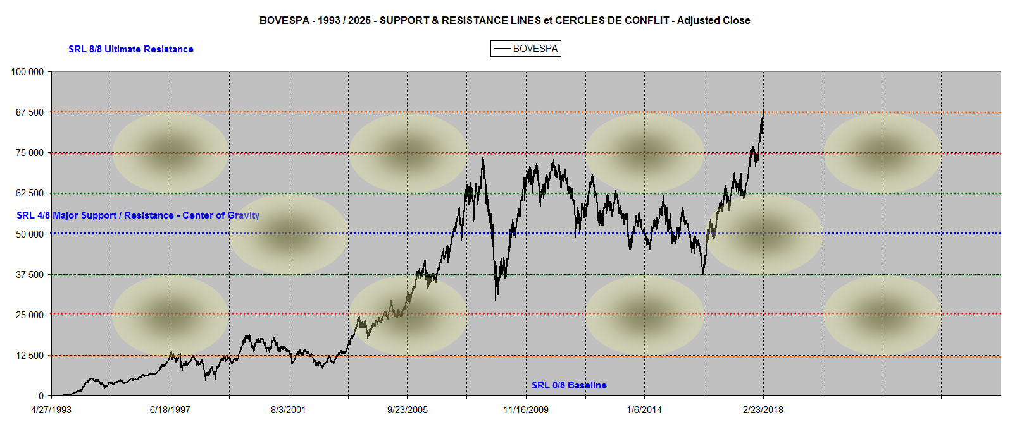
BOVESPA – 0 / 100 000
Support & Resistance Lines (SRL)

Slide 8
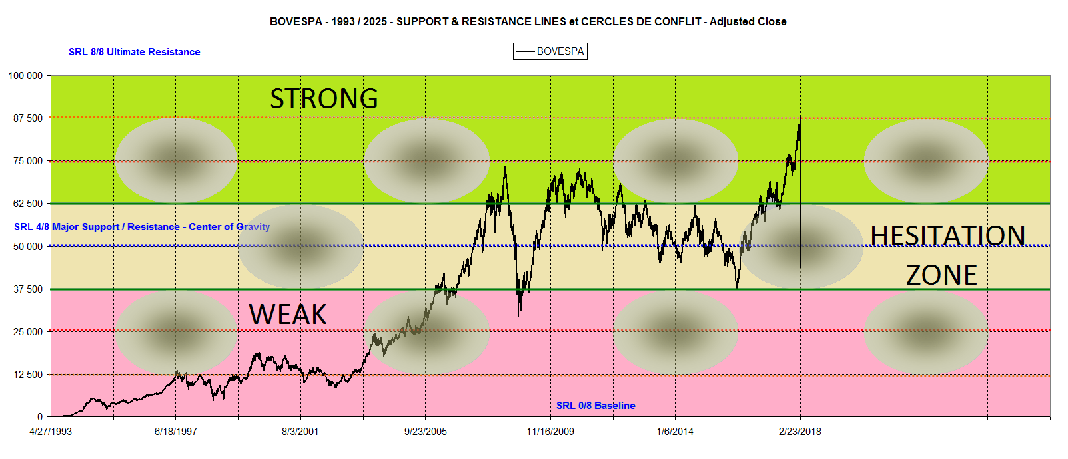
BOVESPA 1993 / 2025
Long Term Price Action Analysis

Slide 9
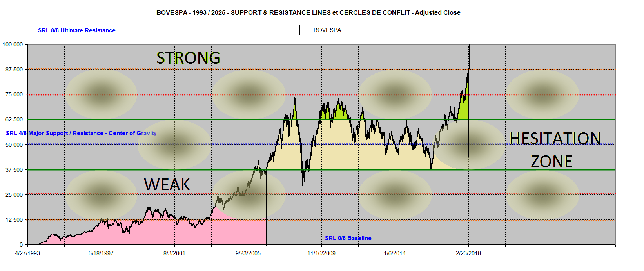
BOVESPA Strength & Weaknesses

Slide 10
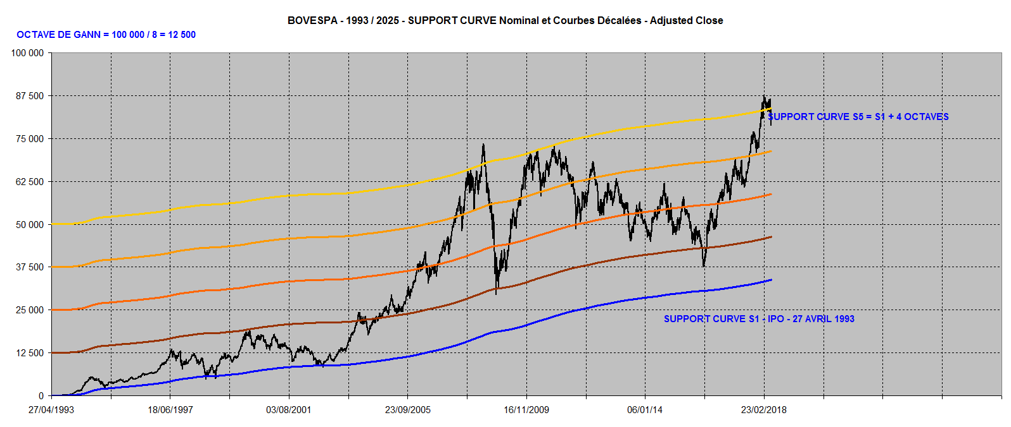
Support Curves 1993-2025

Slide 11
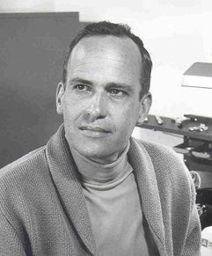
BOVESPA analyzed by Hurst

Slide 12
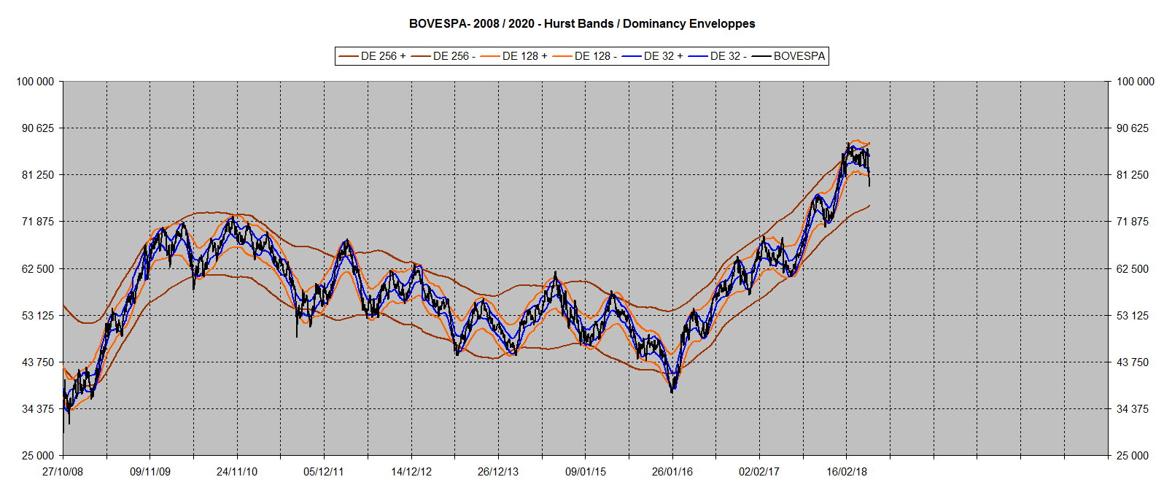
BOVESPA :
Hurst Bands / Dominancy Envelopes

Slide 13
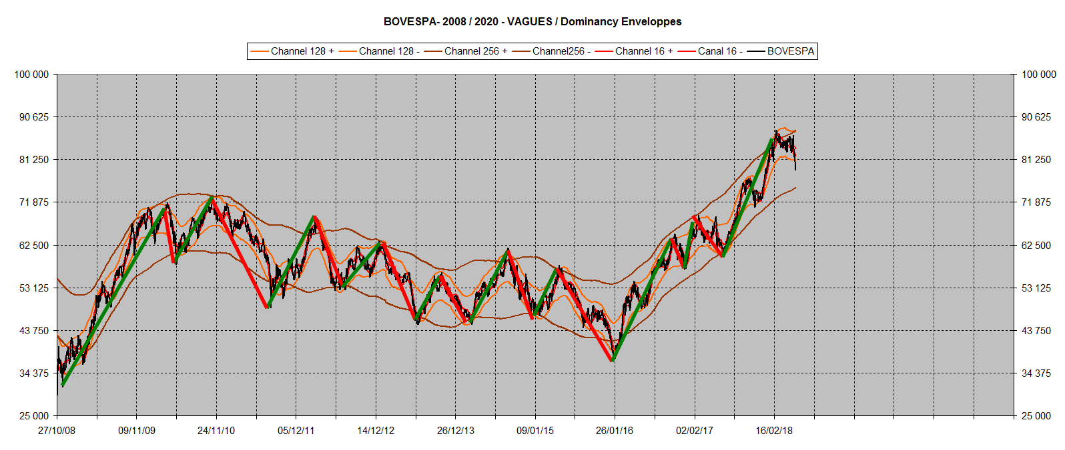
Classifying Waves & Cycles

Slide 14
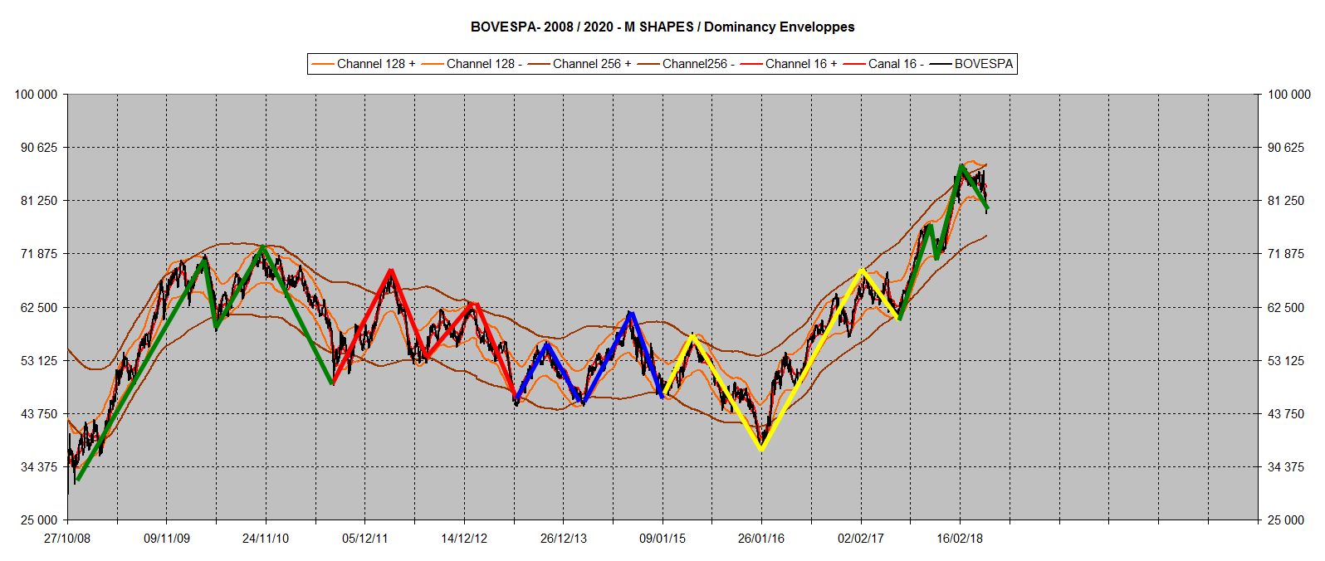
M Patterns

Slide 15
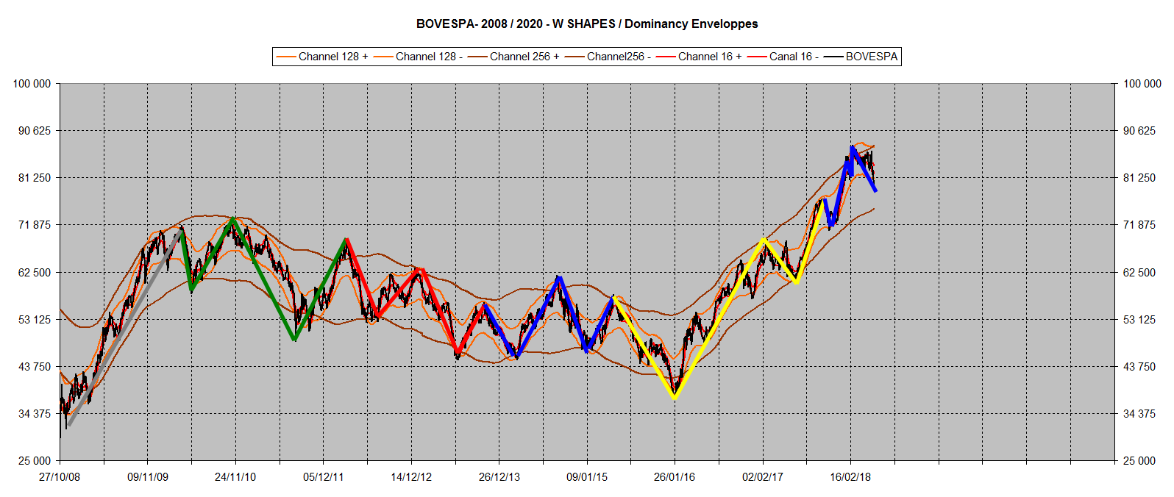
W Patterns

Slide 16
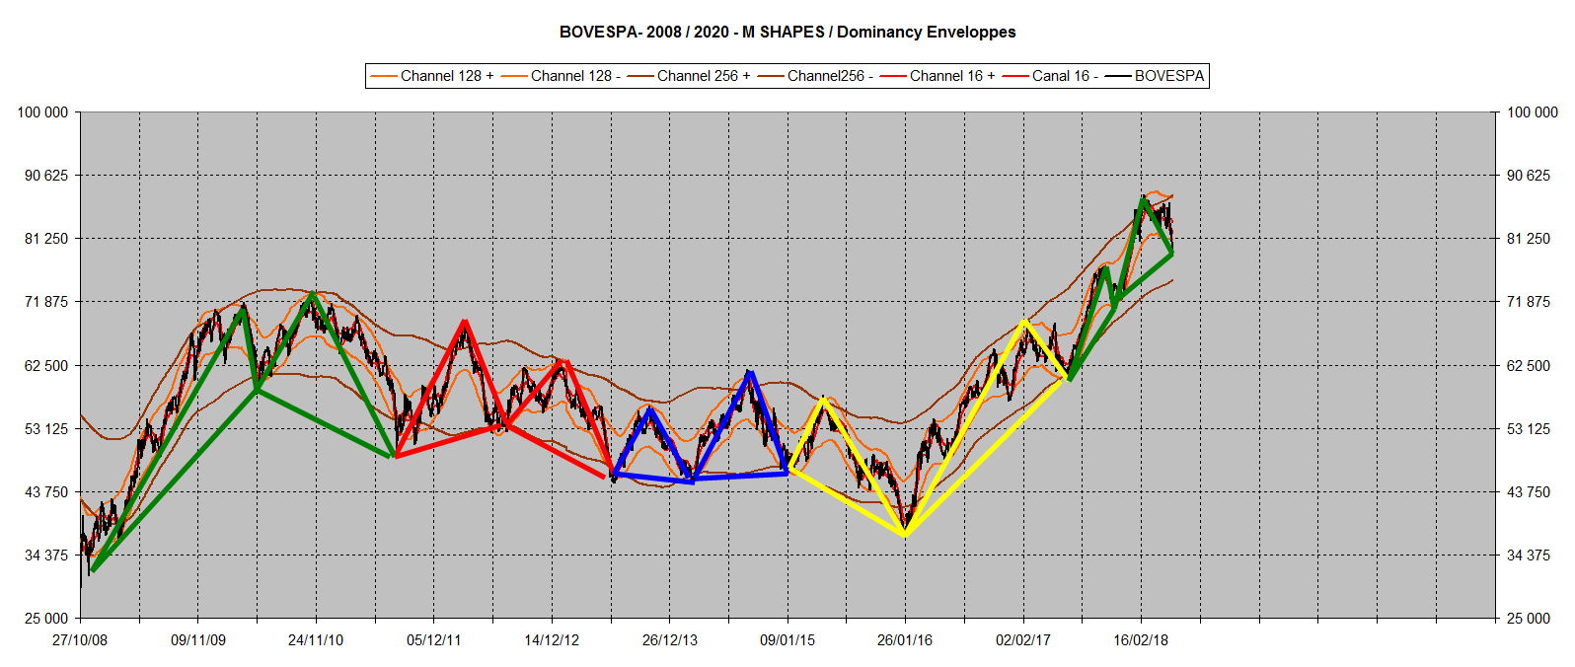
Harmonic Patterns

