Slide 1

Blue Sage Capital
Supply + Large M
Fxdisciple
USD/CAD
Date of Trade (Feb 11 2019)

Slide 2

Goal of the Month
The Goal of the month is to enter my A+ setups. If I can consistently enter my edges then I will consider the month a success. I wont be too heavily concerned with how it is traded, but I want to keep in mind, I need to set a target without undervaluing technical levels and add to positions towards the front end of the trade, while price is moving in the direction of my target.

Slide 3
Intraday Fundamentals
In the previous week, on Friday, a strong Supply edge was hit which drove the price down creating a ‘Friday trap move’. That move in itself was also strong enough to be considered an area to look for more selling.
I had two edges of mine possibly coming to fruition which could also be considered strong (high probability) . A supply zone and a macro M formation.

Slide 4
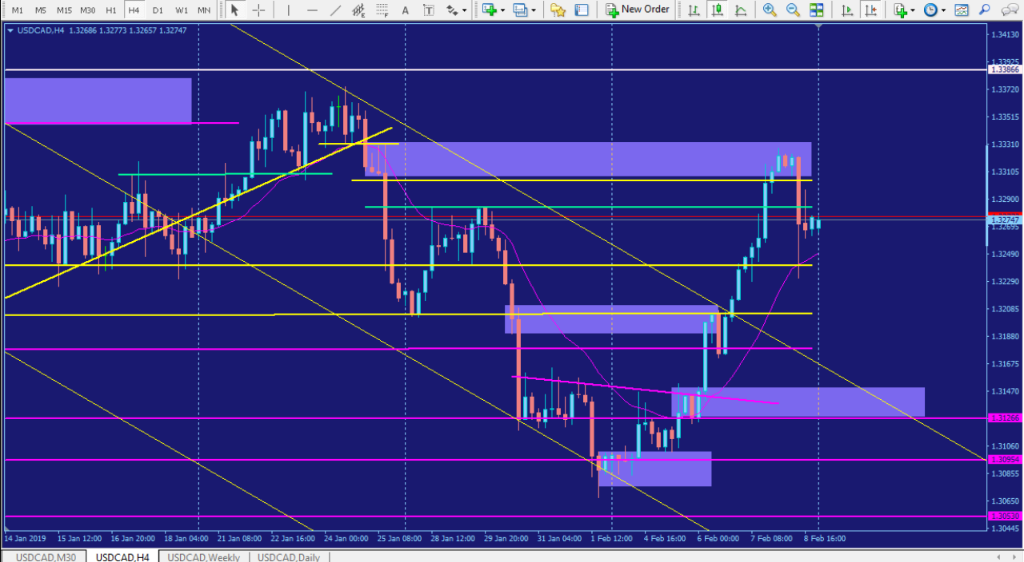
Supply zone creating a Trap Move

Slide 5
Technical Analysis
Price was reacting positively towards both the supply zone made on Friday and the previous days high made on Monday. I didn’t see any strong demand until 1.3200.
The first technical level to be evaluated was around 1.3200 the second around 1.3150. I completely undervalued the first technical level as a target which is something I’ve consistently done.
Since the pair was ranging pretty nicely within the pitchfork, I over extended my target to the second technical level

Slide 6
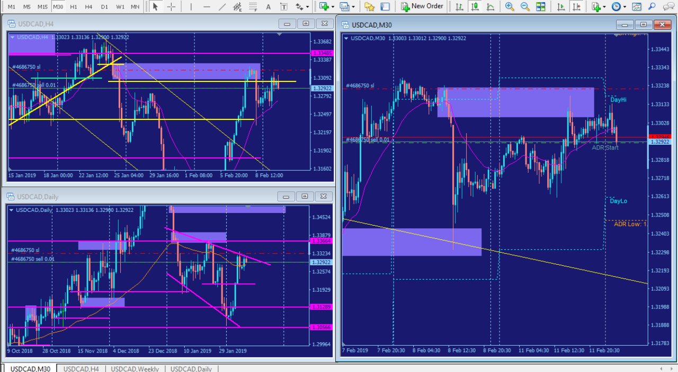
MTF Analysis

Slide 7
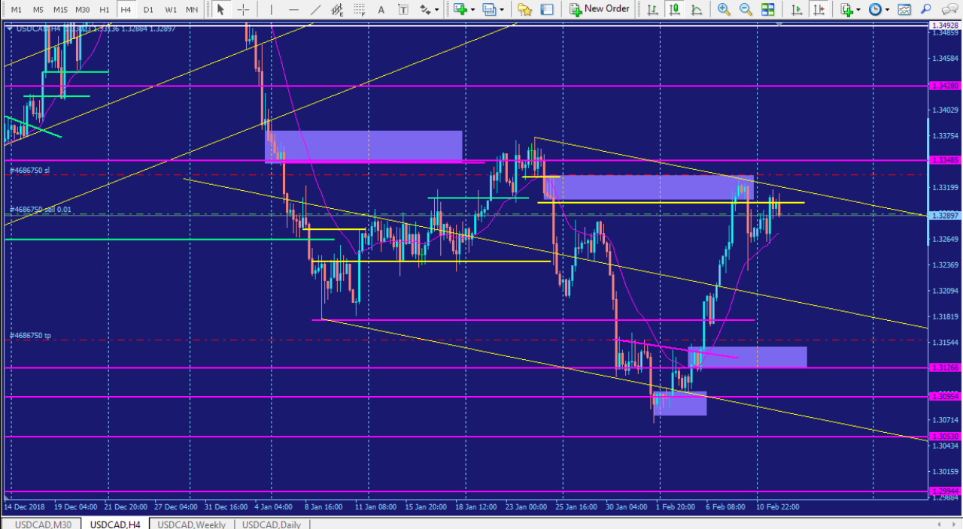
240 chart with pitchfork

Slide 8
Trade Management
Mark up the chart of the trade intraday:
Where would you add size? I would add size on the retracements near the beginning of my trade.
Where was your initial stop? Above supply zone. Did you adjust your stop as the play developed? If so, why did you adjust your stop? I moved my stop to just below a supply zone to lock in profits. My plan says I need to place it above the supply zone though.
Where did you take profits? I took profits after price reacted to the first technical level in US session. How do you pick your profit targets? I set them before the technical level is hit.

Slide 9
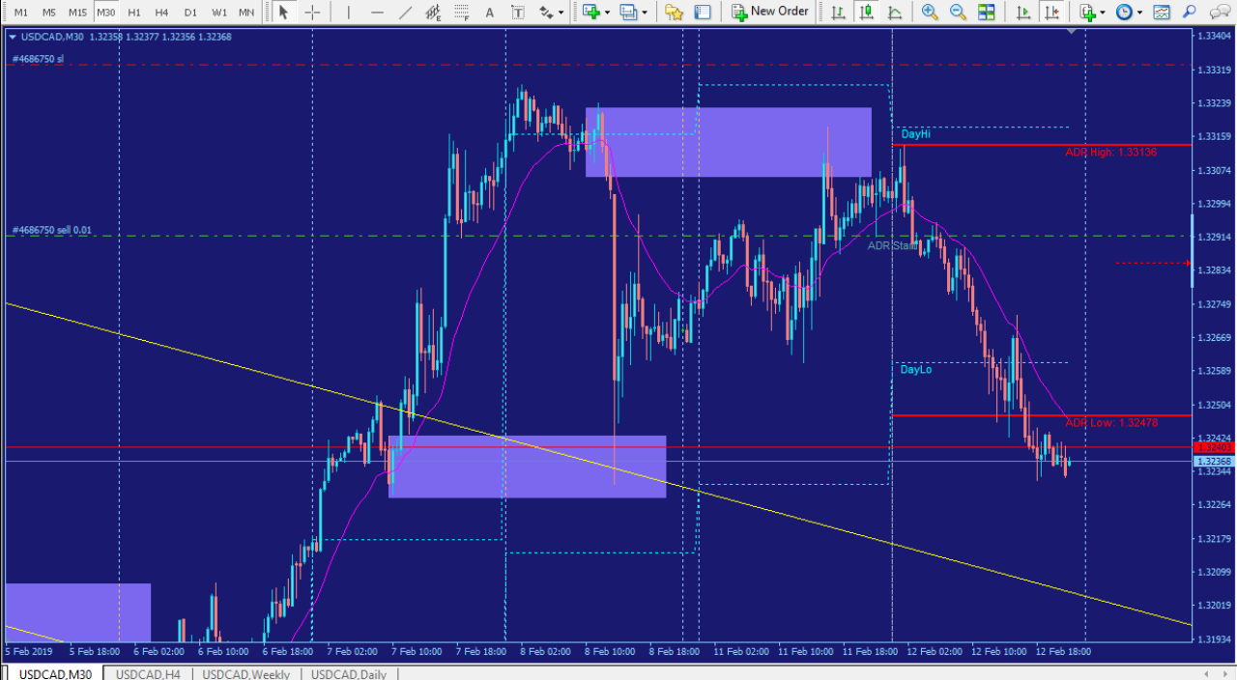
The Real Trade

Slide 10
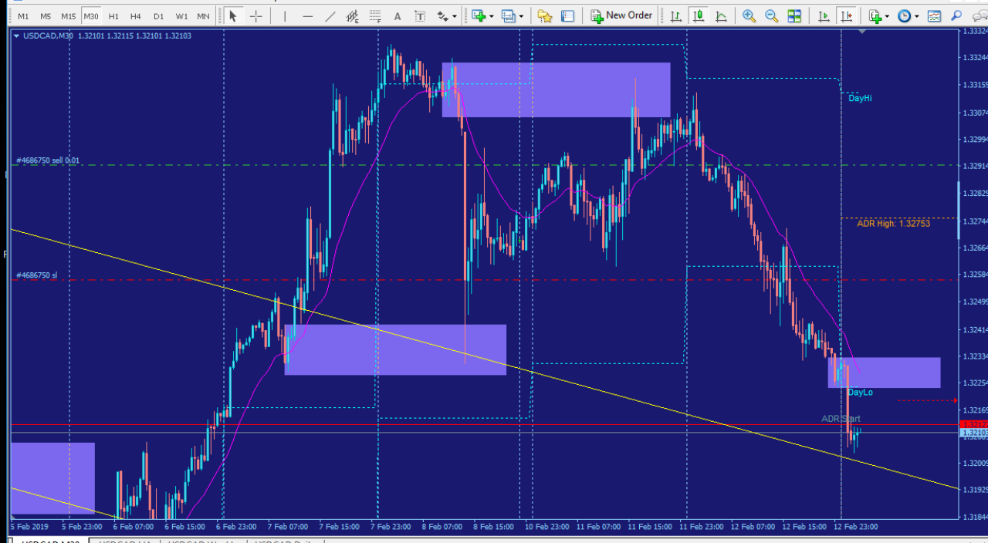
1

Slide 11
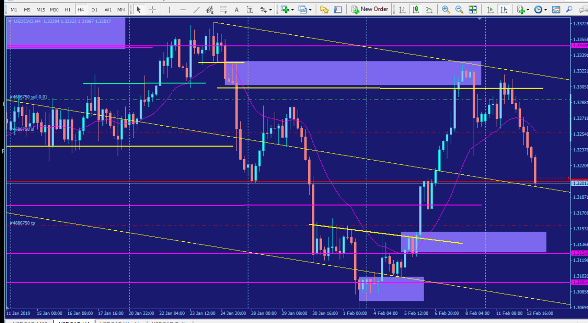
2

Slide 12
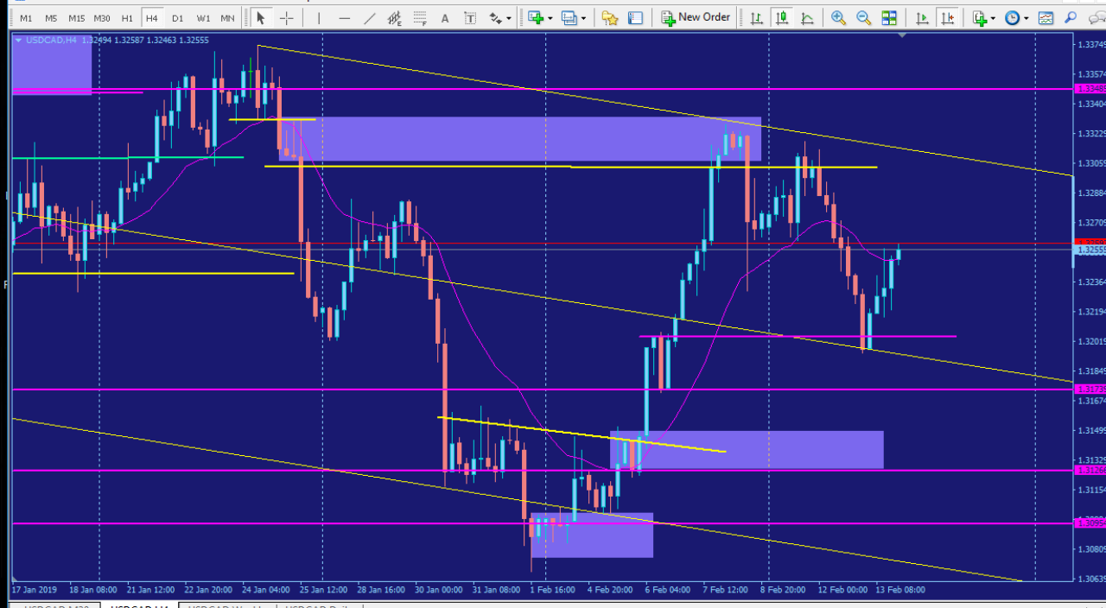
3

Slide 13
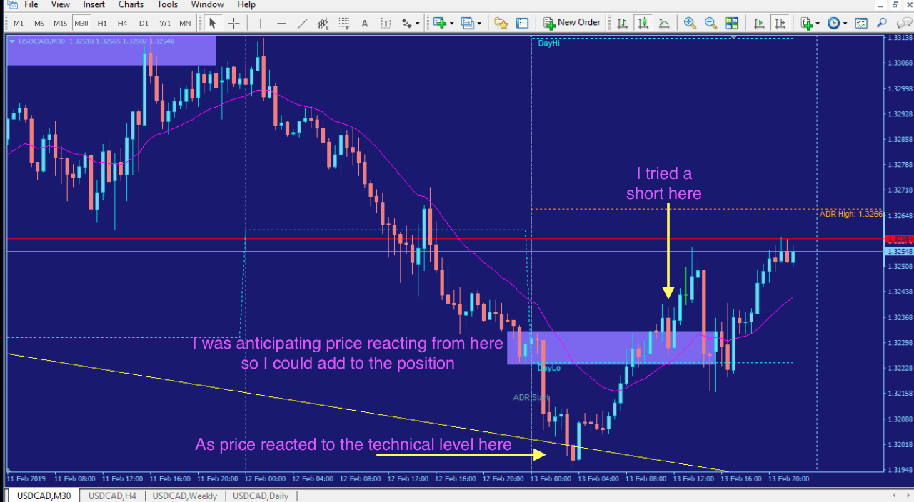
Tried to add into buying pressure…

Slide 14
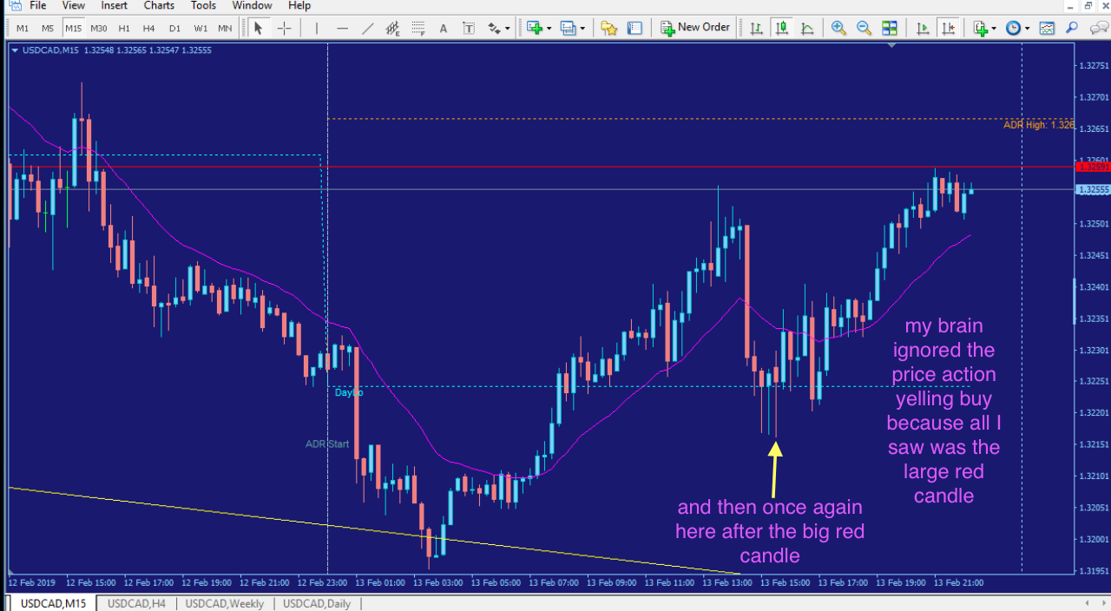
…

Slide 15
Trade Review
What did you learn from this trade? How could you have done better? How would you trade this differently for the next trade?
I learned from this trade is I have an issue with placing my targets at the first significant technical level. I’m looking for larger swing moves and so I place my target to match my bias. (Fuck my bias) Solution: Place your first target at the first technical level no matter what. If you have a second position on, then place another target for your bias until you learn to ignore your bias completely.
I would also have added to the two retracements that appeared near my entry instead of waiting for a large swing retracement to add. You want to add as price is moving in your direction, not against it. Solution: Pre-plan your trade in your daily report card to mentally prepare for the actions you need to take. This will keep the most important aspects of your trading in the forefront of your mind. Starting with your Monthly goal on down
I also need to get better at fundamentals. I have no idea how to apply it to my trading. I’m currently watching two or three people on FF to see if I can gain some insight.

Slide 16
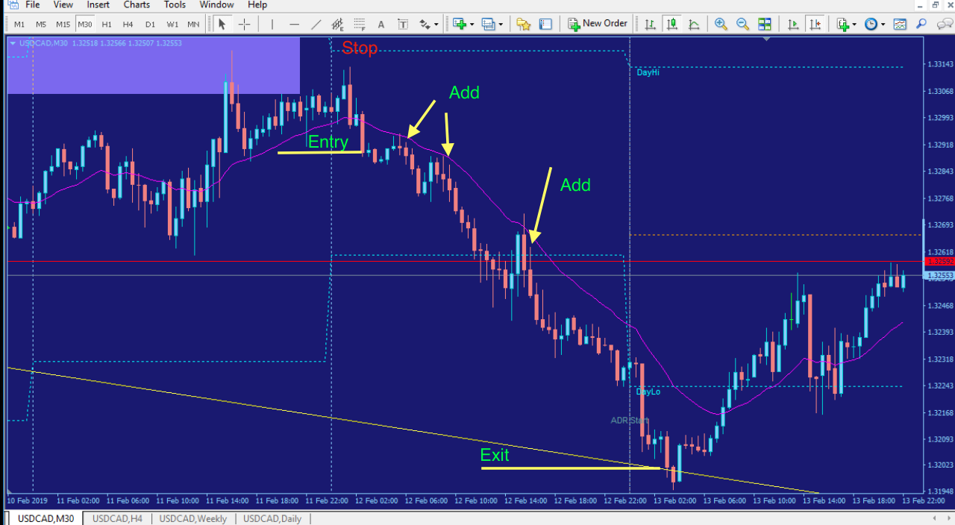
The better trade

Slide 17
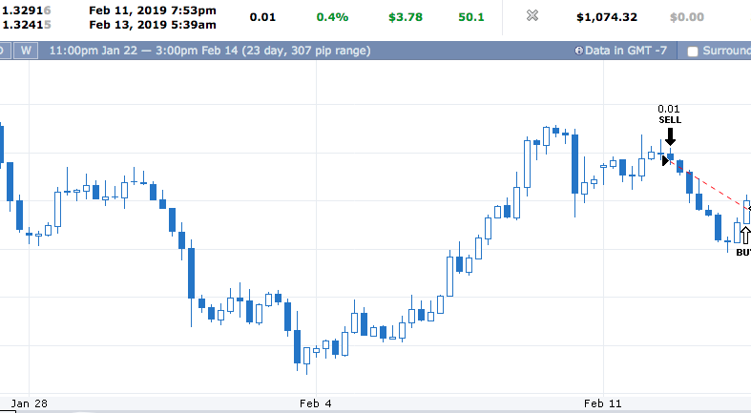
https://www.forexfactory.com/ylk#acct.30-tab.list-ticket.4686750

