Slide 1
How does having a strategy help me?
Vision
Mission
Environmental (Internal & External) scan
Strategic analysis and choice of trade
Long-term objectives
Evaluation
Improves efficiency

Slide 2
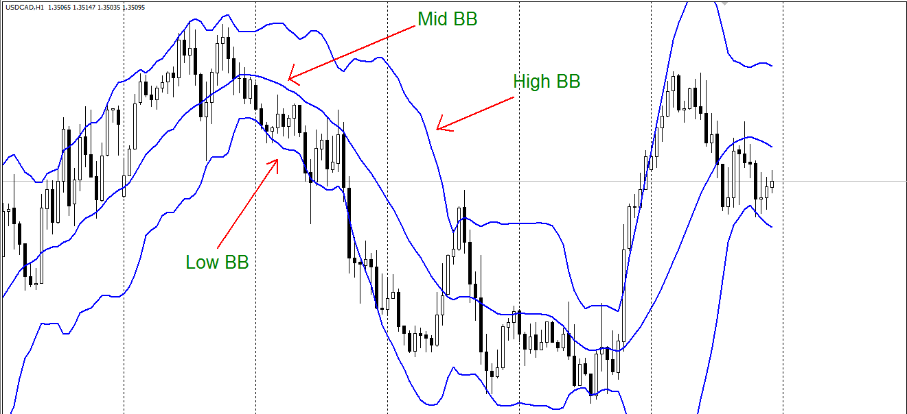
Bollinger Bands

Slide 3
Bollinger Bands Functions
Resistance/High BB – The High BB resist the candles from breaking and going outside of it, if the candles does break the High band and close outside of it, we get a Candlestick Momentum (CSM) – that means the market will continue in that respective direction.
Resistance And Support/Mid BB – This Mid band act as a support when the market is trending up and when trending down its act as a resistance. When candles break the mid BB and close above or below it, we get a Candlestick Direction (CSD) – CSD confirms the direction of the trend.
Support/Low BB- The low BB supports the candles from breaking and going outside of it, if the candles does break the Low band and close outside of it, we get a Candlestick Momentum (CSM) – this means the market will continue in that respective direction.

Slide 4
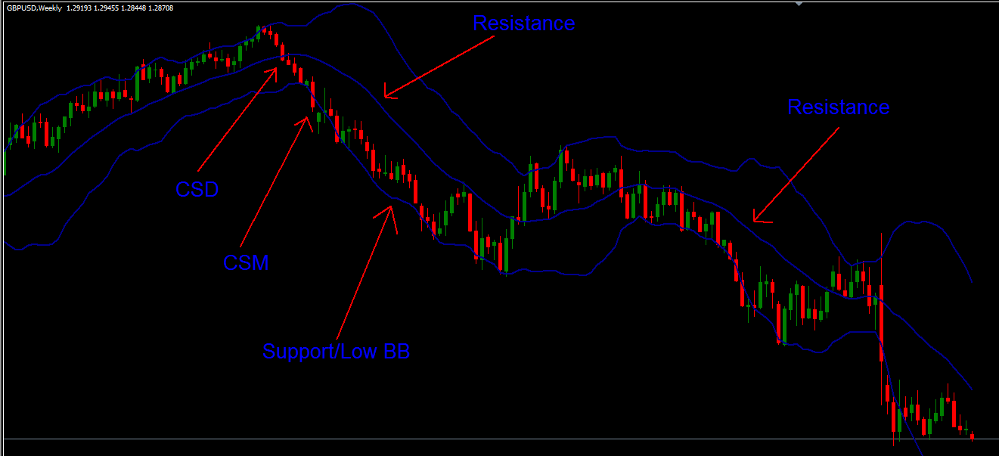
BB – Downtrend

Slide 5
Bollinger Bands - Downtrend
Resistance/Mid BB – when the market is trending downwards, the Mid BB becomes a Resistance, strong downtrend.
Support BB/Low BB – when the market is trending downwards, the Low BB becomes a Support. If the candles break and close outside the low BB, that’s a signal that the market will continue going down.

Slide 6
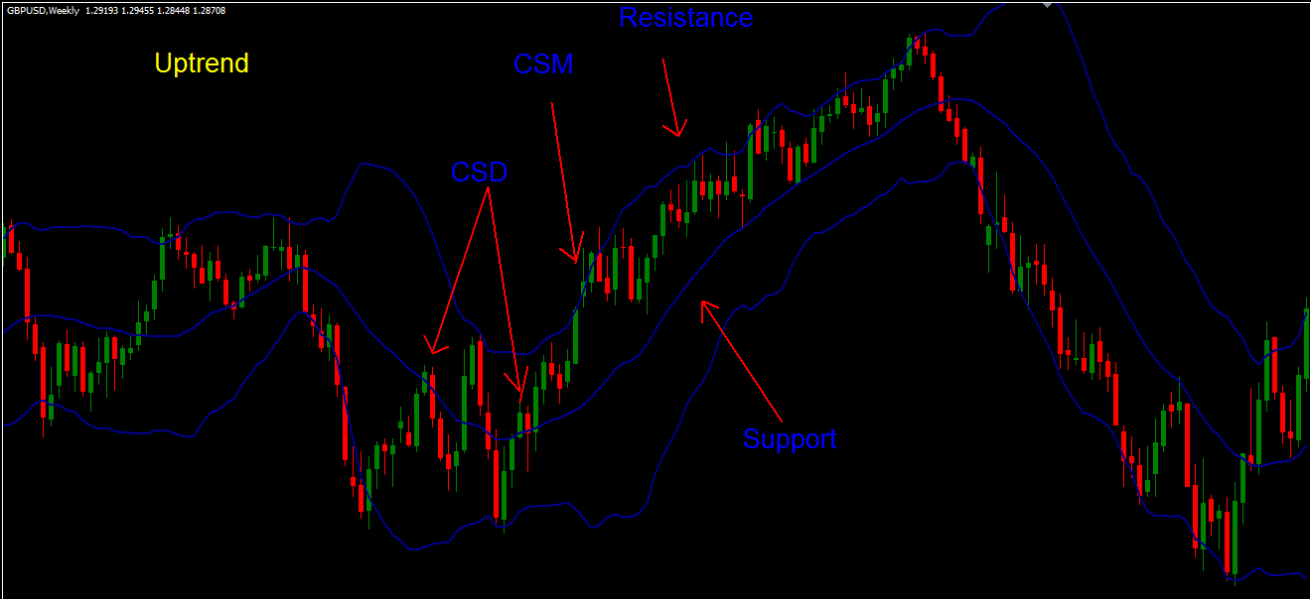
BB - Uptrend

Slide 7
Bollinger Bands
Resistance/High BB – when the market is trending upwards, the High BB becomes a Resistance, if candles break and close above high BB, that means the market will continue going up.
Support/Mid BB – when the market is trending upwards, the Mid BB becomes a Support, strong uptrend.

Slide 8
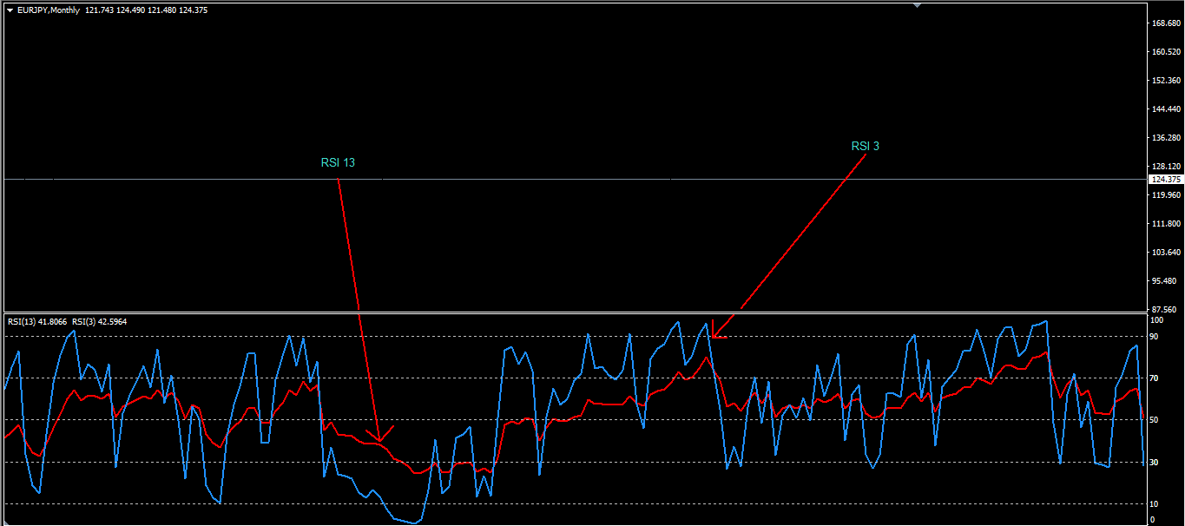
Relative Strength Index (RSI) of 13 and 3

Slide 9
RSI of 13 and 3 Functions
The RSI of 13 helps to spot the trend reversal and continuation.
When this RSI13 cuts level 50 and stays in between 50-70, the trend is said to be heading upwards. But when it cuts level 50 and stays in between 50-30, the trend is said to be heading down wards.
When this RSI13 is between 10-30 (oversold region), the trend is most likely to change direction and starts heading upwards. But when it is between 90-70 (overbought region), the trend is most likely to change direction and starts heading down wards.
When the RSI of 3 is between 0-10, it’s on the Oversold position/extreme zone. But when this RSI is between 100-90, it’s an Overbought position/extreme zone.

Slide 10
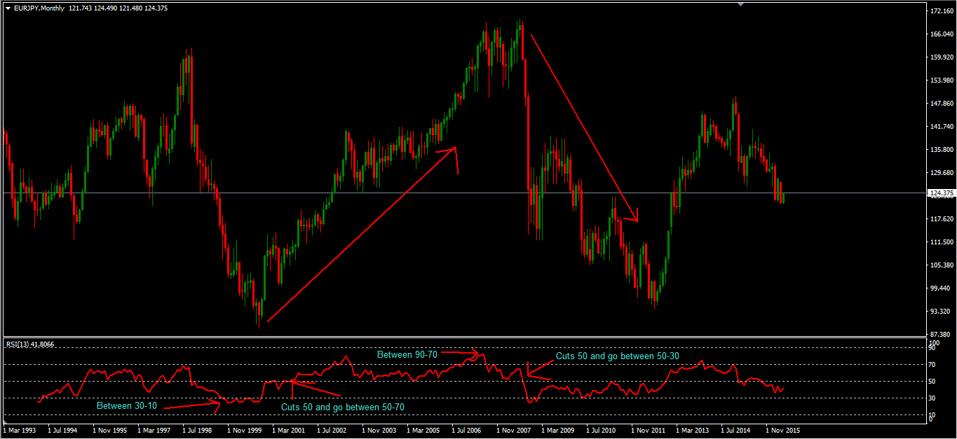
RSI of 13 function

Slide 11
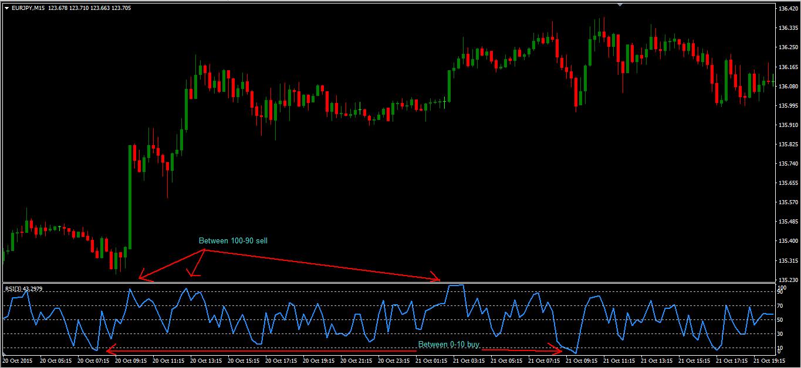
RSI of 3 function

Slide 12
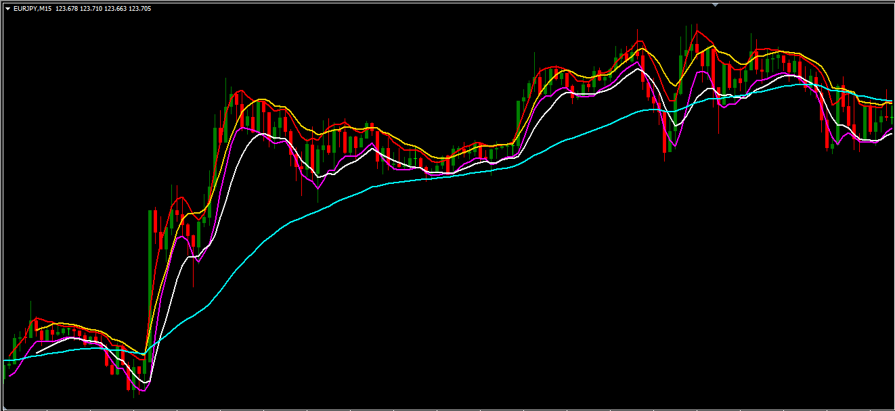
Moving Averages (MA’s) of 5, 10 and 50

Slide 13
MA 5/10 high and low function
All the High MA’s of 5/10 are Resistance and the Low MA’s are Support.
When the market is trending upwards, the Low MA’s are not to be cut and broken by the candles and when the market is trending downwards, the High MA’s are not to be cut and broken by the candles.
When the market is trending downwards, the High MA’s (5/10) will be going on top of the candles and when the market is trending upwards, the Low MA’s (5/10) will be going on the bottom of the candles.
When the market is changing direction, the first candle which is a Signal candle will brake the MA’s (5/10) and close above/below and the second candle that appears is a Confirmation candle that closes in a respective direction. When this happens RSI 13 will cut 50 line, and it is a good chance of going long or short for a Long term trade.

Slide 14
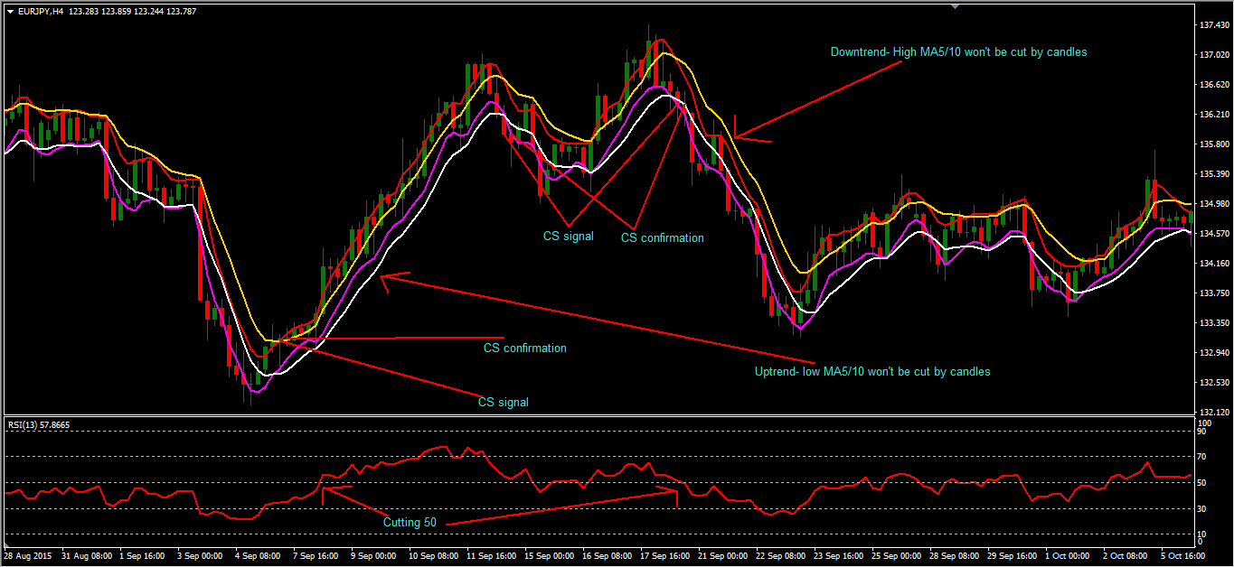
MA 5/10 high and low function

Slide 15
MA 50 function
The Moving Average (MA) of 50 helps to confirm a Major trend
This MA helps us to hold long term trades
When the candles cut this MA and stay above or below, the trend changes direction and also the RSI of 13 will cut 50 line.

Slide 16
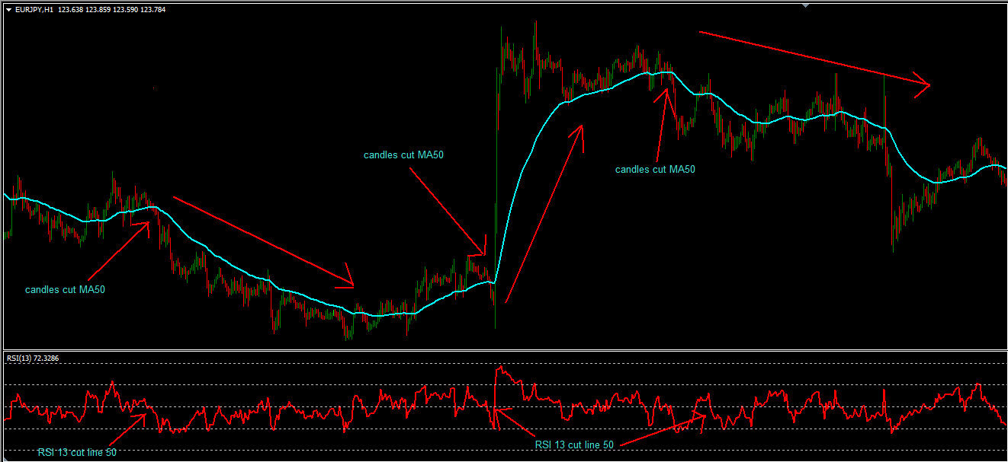
MA 50 function

Slide 17
Signals And Setups – 7 Steps
1. Extreme (Signal) – this is a signal of a change of trend. When MA5 high/low is outside the high/low BB (wait for CS reverse to close inside the BB, CS retest and then you can buy or sell.
2. Compulsory Take Profit – this is when the candles touches both your MA5/10 high or low, or sometimes touches MA5/10 and Mid BB, it’s COMPULSORY to take profit.
3. Market Lost Volume (Setup) – this is when the market comes back and try to retest the previous high. Sell/buy.
4. Candlestick Direction (Signal) – this is when the candles breaks both MA5/10 including Mid bb and close below (downtrend) or above(uptrend).
5. Re-entry (Setup) – this is when the candles retest MA5/10 high/low and then you can sell or buy.
6. Candlestick Momentum (Signal) – if candlesticks break and close outside of the high/low BB, this means the market will continue in that respective direction.
7. Re-entry (Setup) – this is when the candles retest MA5/10 high/low and then you can sell or buy.

Slide 18
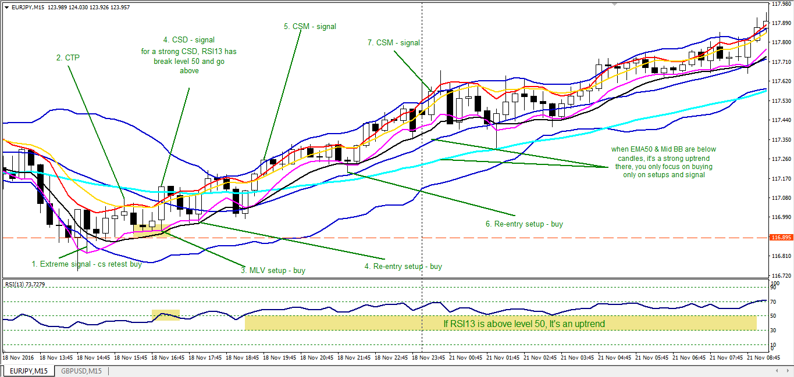
Buy Example of the 7 steps

Slide 19
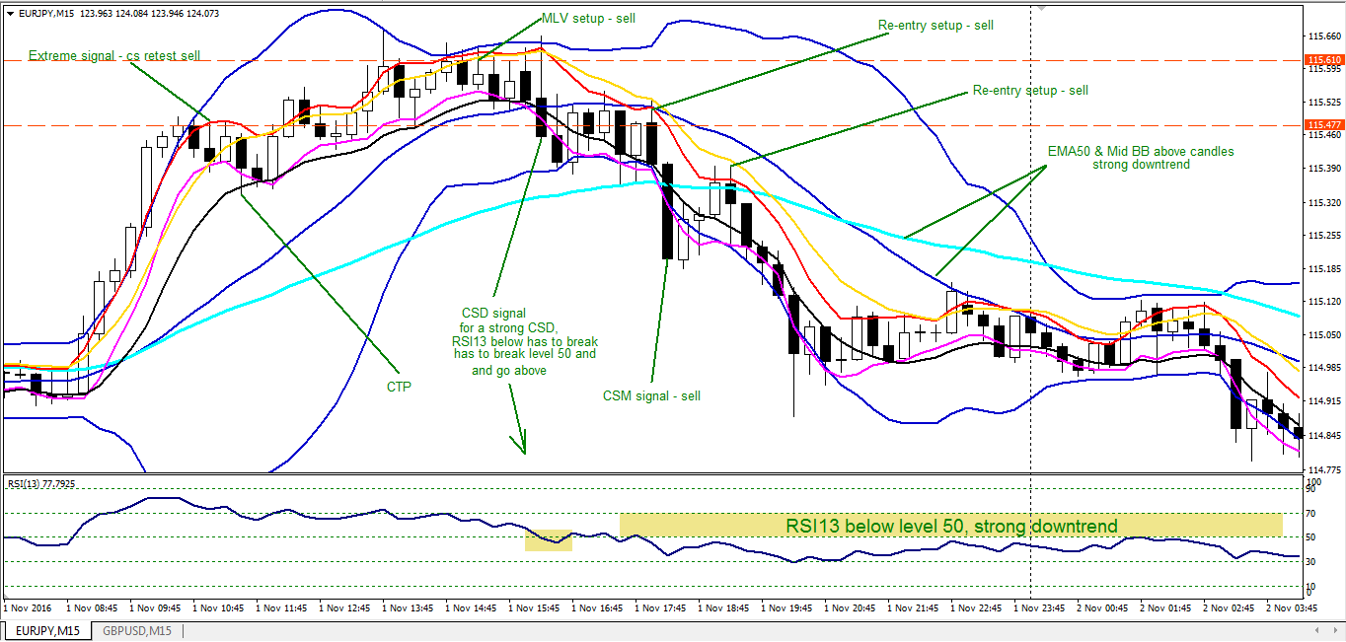
Sell Example of the 7 Steps

Slide 20
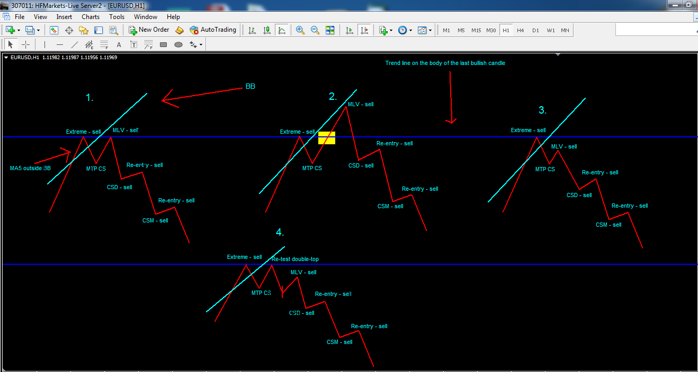
Four Patterns of how the market moves

Slide 21
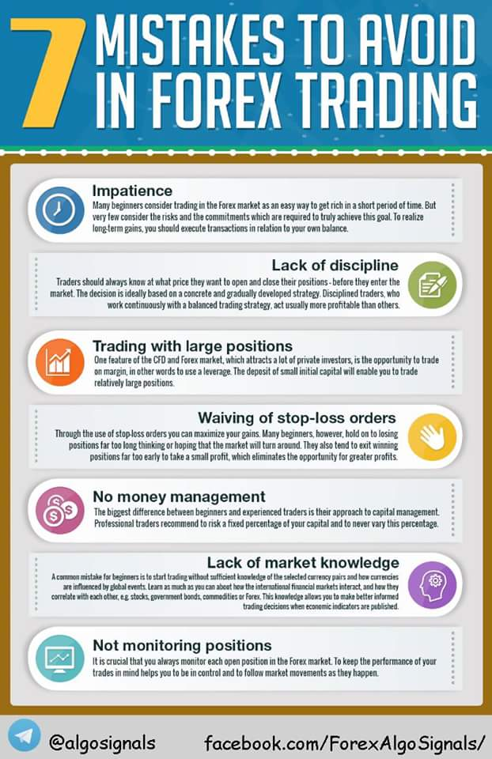
What to take note of when trading

