Slide 1
DISCLAIMER
THIS PRESENTATION IS PURELY FOR EDUCATIONAL PURPOSES ONLY
You should be aware of all the risks associated with foreign exchange trading, and seek advice from an independent financial advisor if you have any doubts.
No representation is being made that any account OR trader will or is likely to achieve profits or losses similar to those that may be shown. Past performance is not indicative of future results. Individual results vary and no representation is made that you will or are likely to achieve profits or incur losses comparable to those that may be shown or suggested.
The views expressed in this meeting do not represent a solicitation to buy or sell any currency pair/asset class.
Again, to reiterate, The trade ideas and set-ups are merely shown for educational purposes only.
Use of any of this information is entirely at your own risk, I will NOT be liable. I do not provide any warranty or guarantee as to the accuracy, timeliness, performance, completeness or suitability of the information and content found or offered in the material for any particular purpose.
You acknowledge that such information and materials may contain inaccuracies or errors and I expressly exclude liability for any such inaccuracies or errors to the fullest extent permitted by law. All information exists for nothing other than entertainment and general educational purposes. Please note, I am not a registered trading advisor.

Slide 2
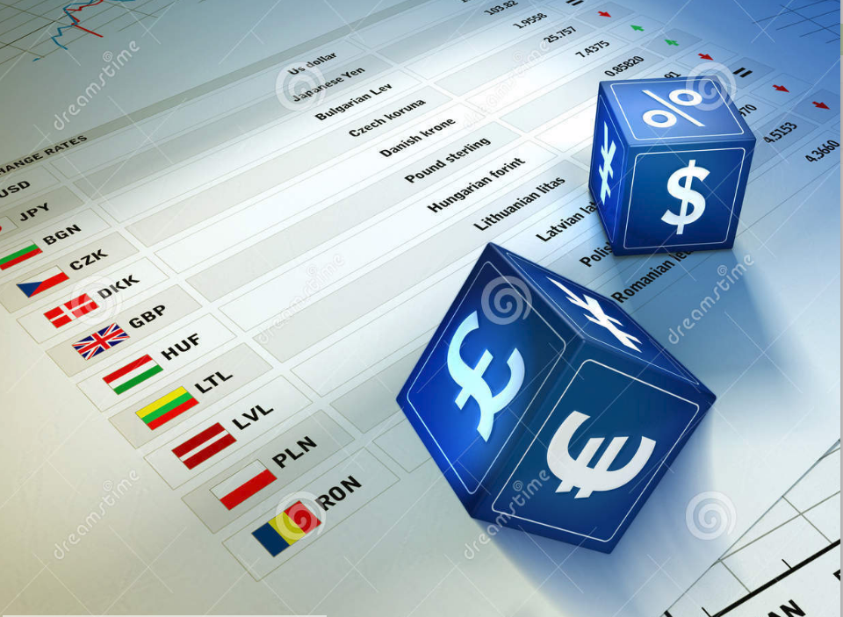
Principles
THE S.A.D WAY
Mind, Method, Money Management

Slide 3
Principles
THE S.A.D WAY
Method

Slide 4
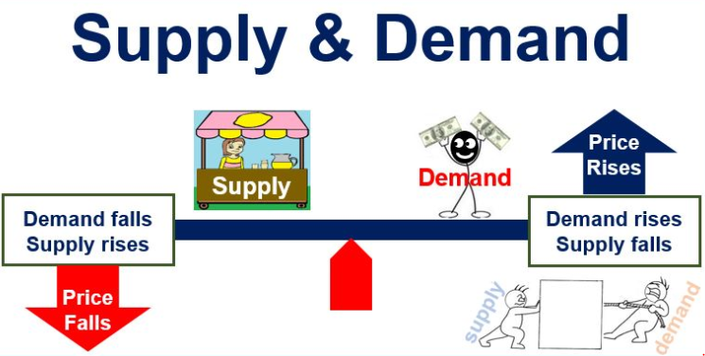

Slide 5


Slide 6
Principles – Determinants of S.A.D
Fundamental data – researchable but hard to make sense of for most
Fundamental data releases – whilst outcomes can be predicted, the market’s reaction is usually unpredictable
Market Sentiment – unmeasurable usually, would require knowing the mind of every single market participant, their investment outlook and the time frame of their investment.

Slide 7
Principles
Markets are dominated by institutions
Markets turn at price levels where institutional supply and institutional demand are out of balance.
Institutions are the ones who create the imbalances with the size of orders they bring to the markets

Slide 8
Principles
Supply and Demand is universal to markets.
Supply and Demand are the only two forces that move the price of any asset.
When demand exceeds supply, prices rise.
When supply exceeds demand, prices fall.

Slide 9
Principles
ORDER FLOW
SUPPLY DEMAND
Order flow is driven by supply and demand, which is in turn influenced by people’s perceived value, their fear and their greed
PERCEIVED VALUE, FEAR, GREED

Slide 10
Principles - Definitions
Demand
A price level where only willing institutional buy orders are left as all willing institutional sell orders have been completely absorbed, evidenced by a rally in price from the level
Supply
A price level where only willing institutional sell orders are left as all willing institutional buy orders have been completely absorbed, evidenced by a drop in price from the level

Slide 11
Zone theory
S.A.D traders use Price zones to identify trading opportunities.
These zones are considered the lowest risk, highest reward and highest probability entry points into a market, whether selling or buying.
The zones represent price levels where there are imbalances between supply and demand.
Find the imbalance, then find the zone.

Slide 12
Zone theory
FIND THE BIG MOVE – THESE ARE THE INSTITUTIONS
LOOK UP (FOR SUPPLY)
LOOK DOWN (FOR DEMAND)
LOOKING FOR THE ORIGIN OF THE LARGE MOVES (I.E. WHERE ONE SIDE OF THE S.D EQUATION BECAME ZERO)
THIS IS THE BASE – WHERE THE UNFILLED ORDERS ARE.

Slide 13
Zone theory
S.A.D zones only have 3 parts to a zone.
Zones have one thing in common, “THE BASE” – unfilled orders

Slide 14
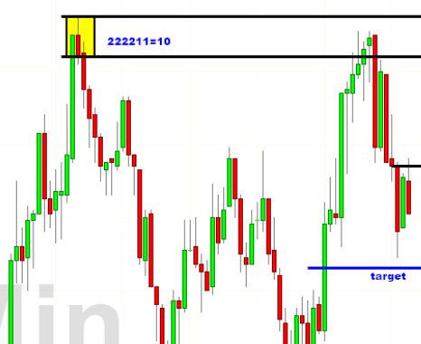
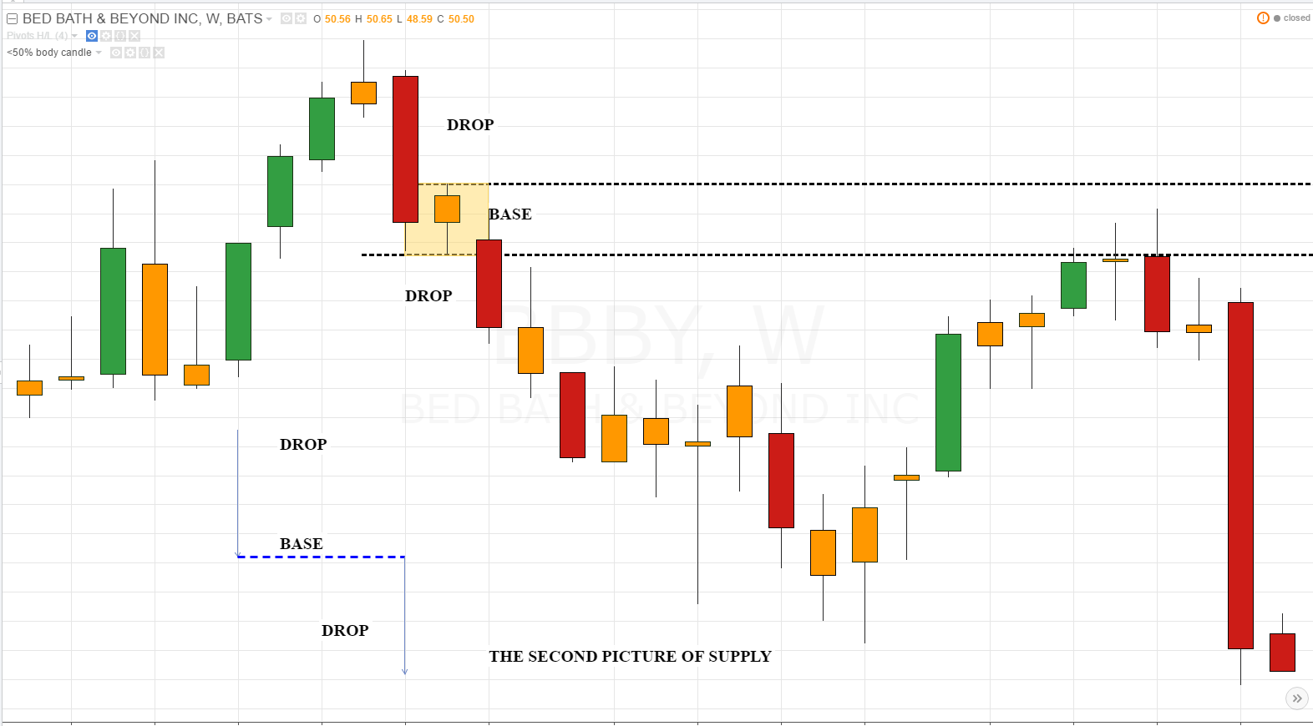
Supply Zones
The Rally-Base-Drop The Drop-Base-Drop

Slide 15
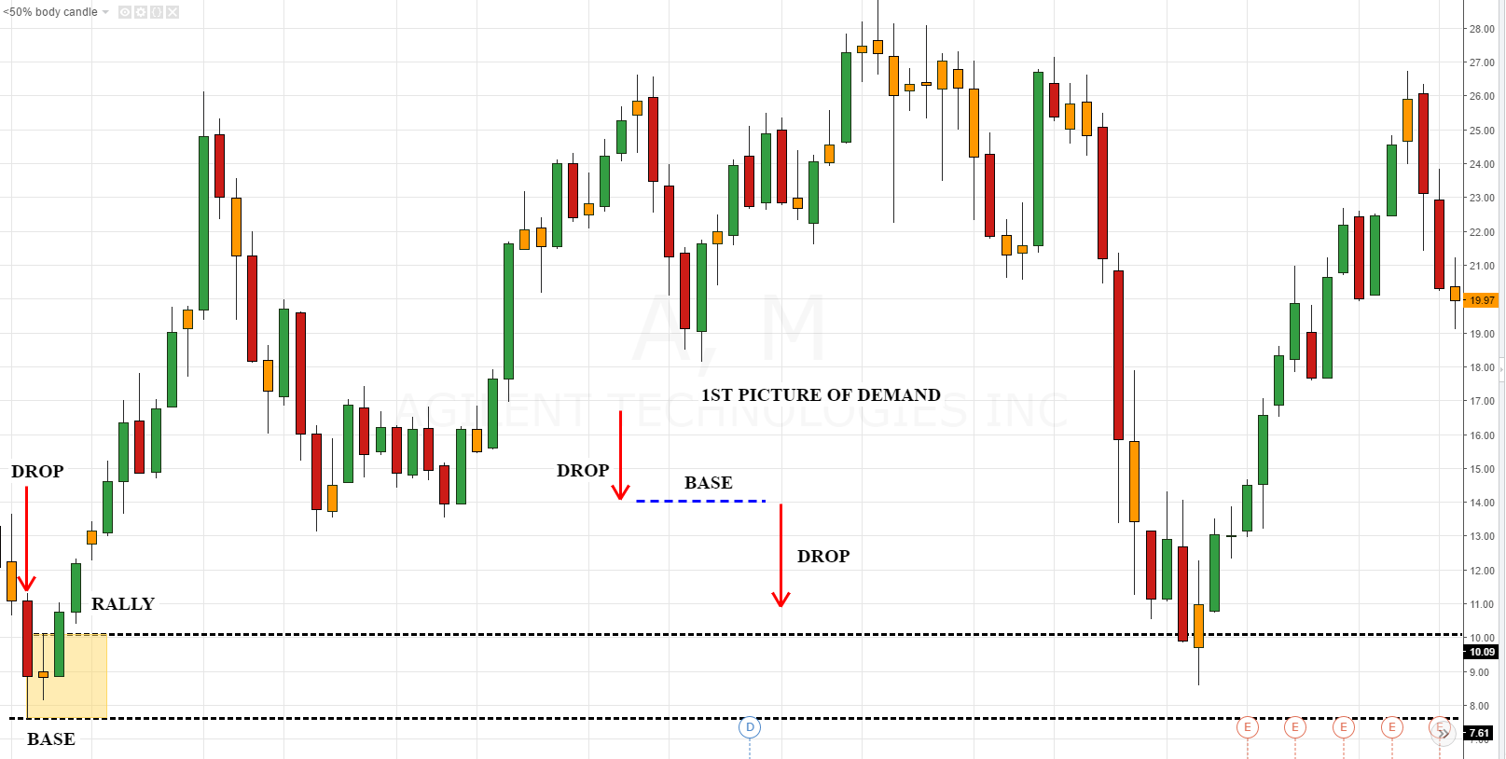
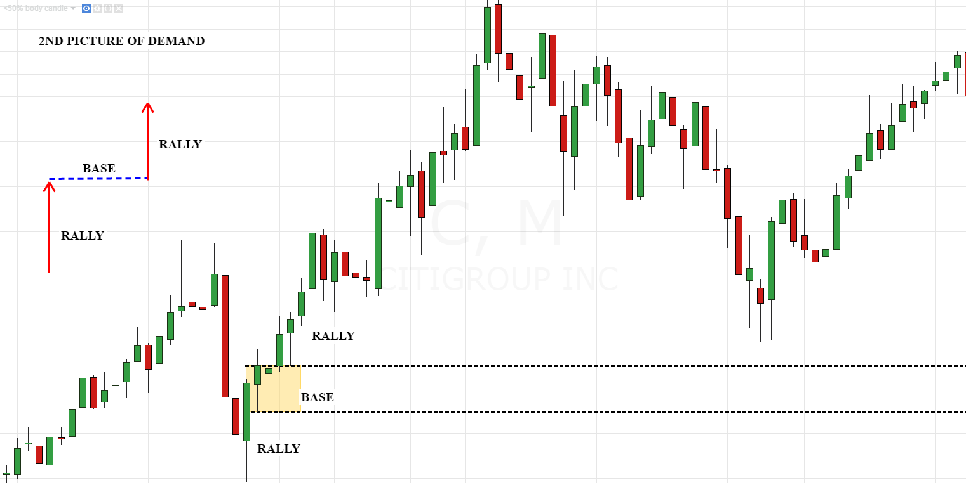
Demand Zones
The Drop-Base-Rally The Rally-Base-Rally

Slide 16
METHODOLOGY
Components
- Curve Analysis
- Trend Analysis
- S.A.D Zone Analysis
- RISK Analysis & Proper Position Sizing
- S. E. T.
- Risk Management

