Slide 1
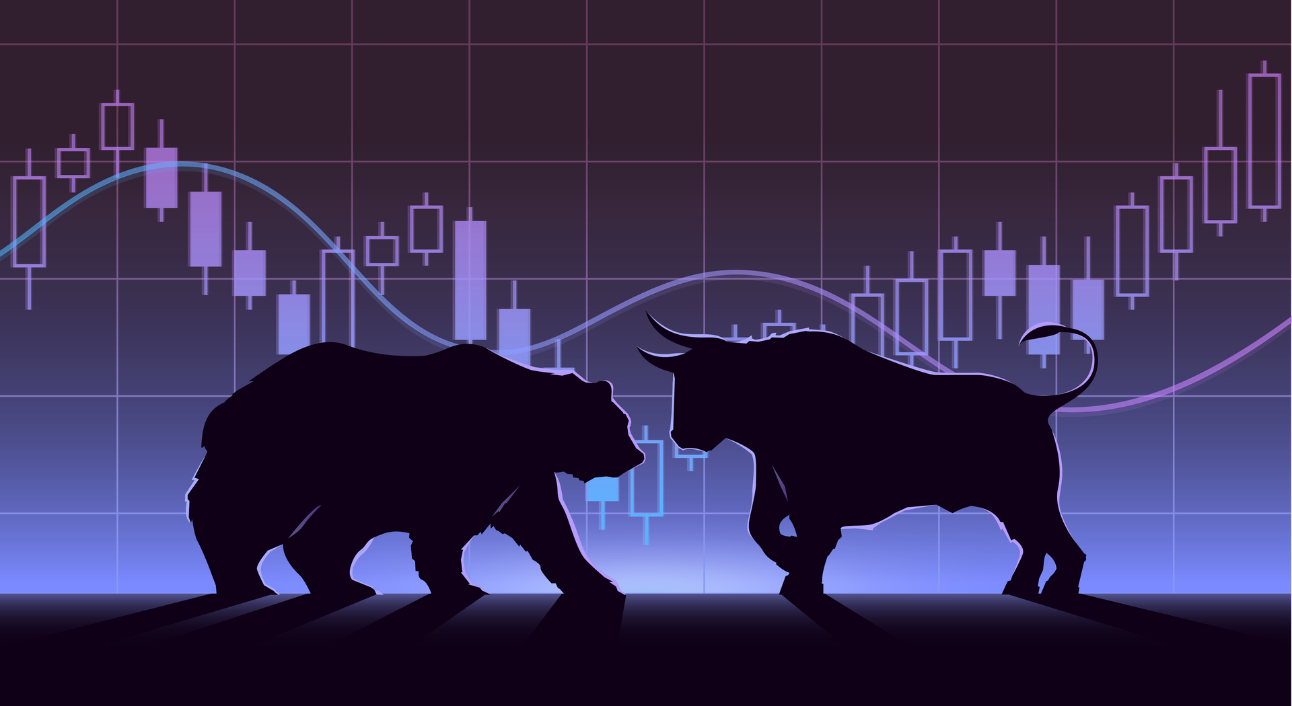
BEST FOREX CALCULATOR APP
“A Premier Forex Tool”

Slide 2

BEST FOREX CALCULATOR APP
Who made it?
  Pablo Izak Panther (PIP)
  Pablo is a maverick Forex Trader, whose meticulous approach to the Forex Market,
  defies conventional logic. His ardent interest in the
  Forex market, gave birth to an arduous research process which culminated in FXPIPSTRADER- which has a success rate of over 90%, a fitting fruit of a scholarly endeavor.

Slide 3
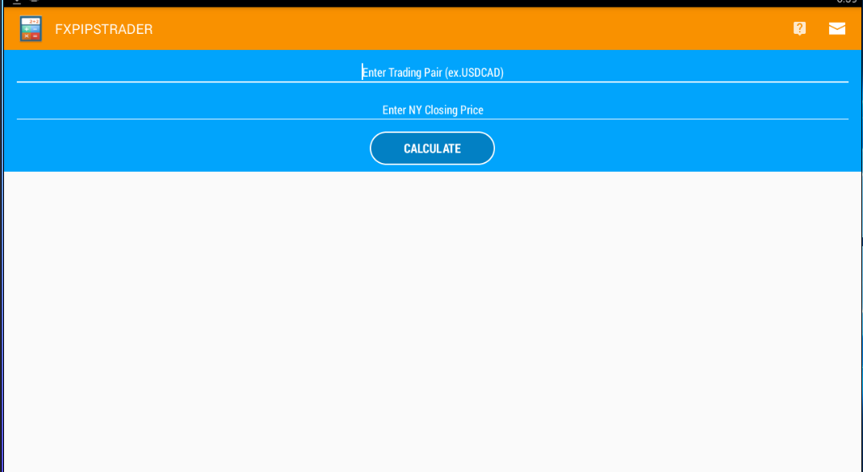
BEST FOREX CALCULATOR APP
How do you use it?
CHOOSE THE PAIR YOU WANT TO TRADE

Slide 4
BEST FOREX CALCULATOR APP
How do you use it?
INSERT NY DAILY CLOSE PRICE NO
DECIMAL POINT
PRESS CALCULATE

Slide 5
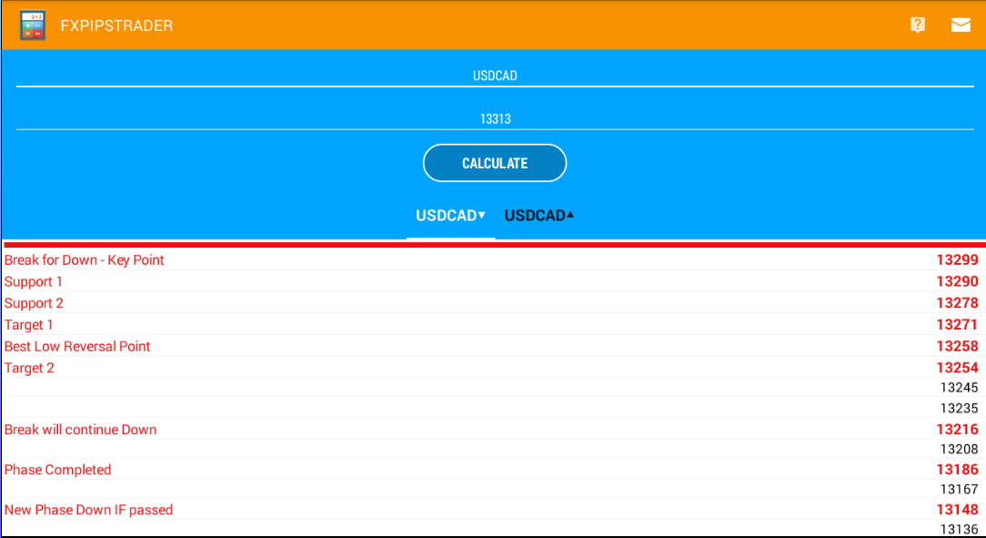
BEST FOREX CALCULATOR APP
How do you use it?
The results look like this :

Slide 6
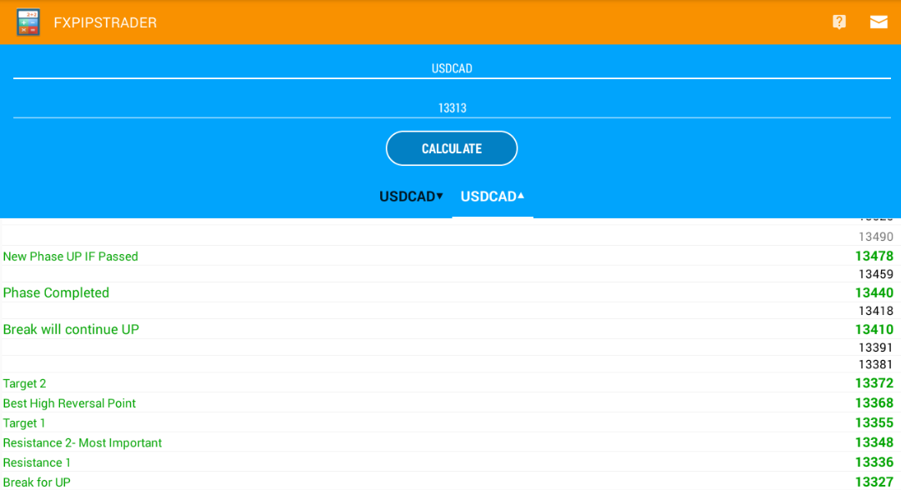
BEST FOREX CALCULATOR APP
How do you use it?
The results look like this :

Slide 7
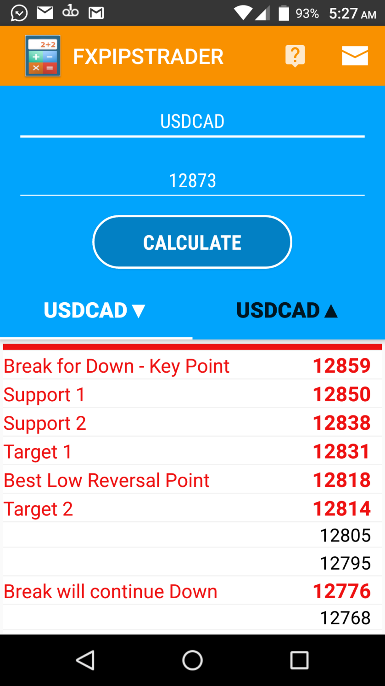
BEST FOREX CALCULATOR APP
Lets see it in action..
MAY 31st - Bank of Canada GDP m/m (High Impact News)
NY Close Price : 1.2873
FXPIPSTRADER : Buy 1.2818 (Market Reversed @BLR)
FXPIPSTRADER Prices:
LETS SEE THE CHART

Slide 8

BEST FOREX CALCULATOR APP

Slide 9
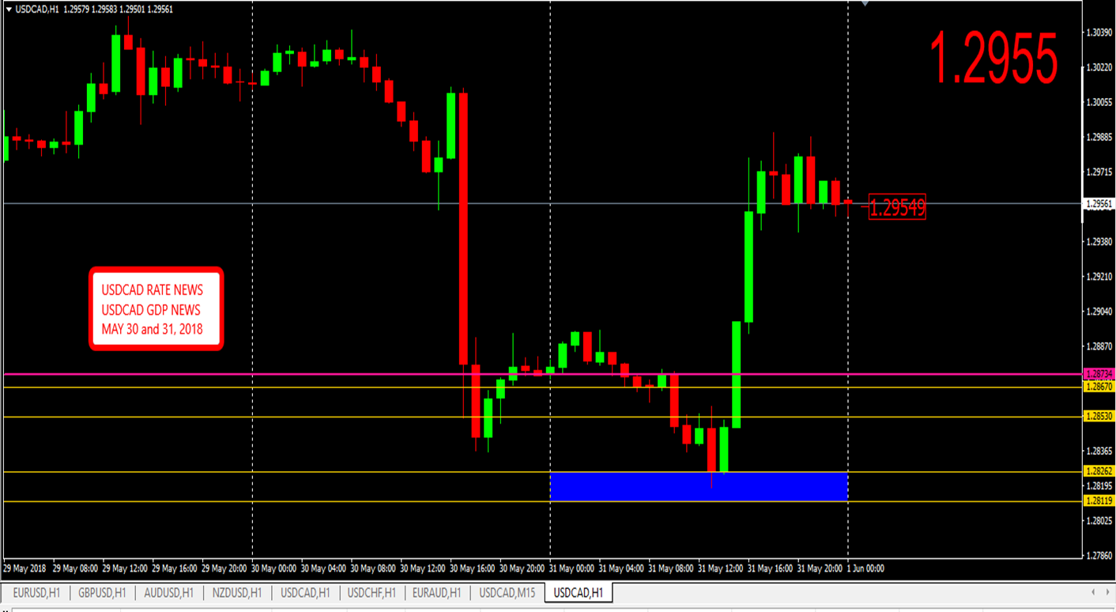
BEST FOREX CALCULATOR APP
PRICE CAME TO BLR

Slide 10
BEST FOREX CALCULATOR APP
Have some Questions?
Continue to the FAQ section

Slide 11
BEST FOREX CALCULATOR APP
FREQUENTLY ASKED QUESTIONS
What do the abbreviations mean?
Which levels do I use?
When do I calculate the levels?
Can I trade any pair?
Can I trade any Session?
What happens if price reaches “New Monthly High”?
Any additional Tips/Rules?

Slide 12
BEST FOREX CALCULATOR APP
What do the abbreviations mean..
BEST BUY ENTRIES BEST SELL ENTRIES
KPt - Key Point
S1 - Support 1
BLR - Best Low Reversal
BCD - Break Continue Down
PCD - Phase Completed Down
NPD - New Phase Down
R1 - Resistance 1
VIP - Very Important Point
BHR - Best High Reversal
BCU - Break Continue Up
PCU - Phase Completed Up
NPU - New Phase Down
BACK TO FAQ

Slide 13
BEST FOREX CALCULATOR APP
Which level do I use..
Market price levels with NY Close price as a baseline determine the
markets overall direction. With that in mind assess how price reaches and reacts
to the key levels. All levels require 14 pips to determine if it still holds. If broken,
proceed to next level.
BACK TO FAQ

Slide 14
BEST FOREX CALCULATOR APP
When do I calculate the levels..
Market levels are calculated as soon as NY Session closes.
NB. Calculate using NY Close price.
BACK TO FAQ

Slide 15
BEST FOREX CALCULATOR APP
Can I trade any pair..
Suggested pairs are:
EURUSD NZDUSD
GBPUSD USDCAD
AUDUSD USDCHF
EURAUD USDJPY
GBPJPY EURJPY
ANY OF YOUR FAVORITE PAIRS OR CROSSES.
BACK TO FAQ

Slide 16
BEST FOREX CALCULATOR APP
Can I trade any Session ..
Suggested sessions are London and USA. Avoid Asian sessions and trades
before 6 GMT. (Exception High Impact News AUD or NZD)
BACK TO FAQ

Slide 17
BEST FOREX CALCULATOR APP
What happens if price reaches “new monthly high” ..
Recalculate using this price in the calculator, for adjusted levels.
BACK TO FAQ

Slide 18
BEST FOREX CALCULATOR APP
ADDITIONAL INFO…
FXPIPSTRADER is great for trading High Impact News.
Best Low Reversal & Best High Reversal are high probability levels.
Seek to identify pinbar candlestick formation at key levels on 1HR timeframes,
BLR and BHR provide high reward set-ups.
NY Close Price is extremely important.
.
BACK TO FAQ

Slide 19
BEST FOREX CALCULATOR APP
ADDITIONAL INFO…
Market must pass NY Close Price up or down to determine market direction.
Market must Break for UP or Break for Down (by 14 pips) to
determine whether it will move lower or higher respectively.
Failure to break any Support or Resistance (by 14 pips) will lead to reversal.
BACK TO FAQ

Slide 20
BEST FOREX CALCULATOR APP
What is it?
  FXPIPSTRADER is a fool-proof calculator, that automatically predicts key critical levels in the Market. It calculates best possible Entries and Exits both for Buy and Sell Trades. Stop Loss can be 7-21 pips when Entries are decisively taken.

Slide 21
BEST FOREX CALCULATOR APP
This is an extremely versatile tool in your Forex arsenal. Test Drive It and see.
For further info:
Check out “xxxxxxx.com” for more details or email: earlroy63@gmail.com

Slide 22
BEST FOREX CALCULATOR APP
THE
END

