Slide 1




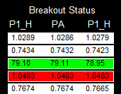
Entry Rules
Buy signal of a particular pair will be generated once all the selected indicators agree in up (if pair is selected). (Refer to screenshot2,3)
    Up day-trend (price>daily open)
    Candle size of mother bar should be within P2 ceiling limit and P2 floor limit
      eg: ceiling limit=100; floor limit=20, then 20 < P2_Size < 100
    Candle size of inside bar should be within P1 ceiling limit and P1 floor limit; inside bar high<mother bar high; inside bar low>inside bar low
    Price up crosses inside bar high
Sell signal of a particular pair will be generated once all the selected indicators agree in down (if pair is selected). (Refer to screenshot2,3)
    Down day-trend (price<daily open)
    Candle size of mother bar should be within P2 ceiling limit and P2 floor limit
      eg: ceiling limit=100; floor limit=20, then 20 < P2_Size < 100
    Candle size of inside bar should be within P1 ceiling limit and P1 floor limit; inside bar high<mother bar high; inside bar low>inside bar low
    Price down crosses inside bar low

Slide 2
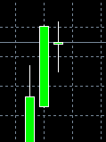
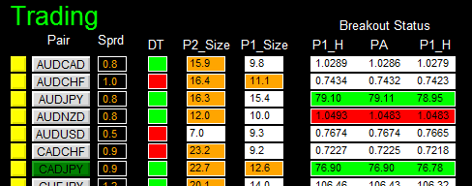
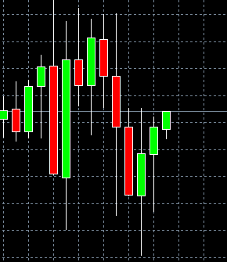
Daily Chart
1 Up day trend
2 Mother bar size is within limit
Mother Bar
3 Inside bar size is within limit and inside bar
is inside mother bar
4 Price up crosses inside bar high
Inside Bar

Slide 3
Take Profit and Stop Loss
Take profit is place at (x* take-profit_multiplier)
Pips away from buy price
X * take-profit_multiplier pips
Buy Price
X pips
Stop loss is place at inside bar low + spread
(for buy order)

Slide 4
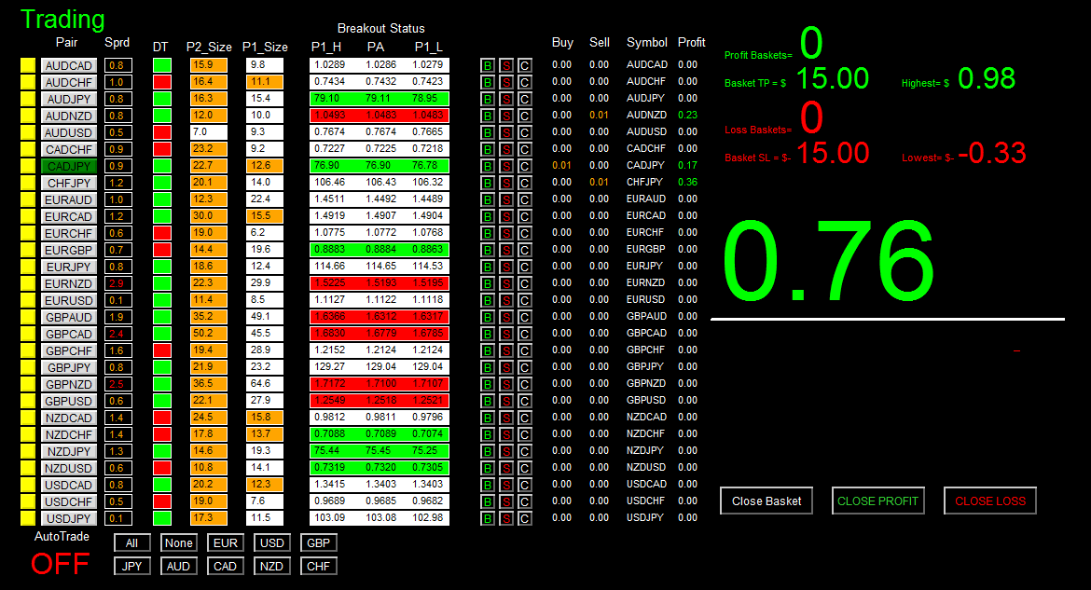

Slide 5

1 Pair Tick Button
4 Day Trend Status Panel
5 Mother Bar Size Status Panel
2 Pair Symbol Button
6 Inside Bar Size Status Panel
3 Spread Column

Slide 6
Current Price
Inside Bar High
Inside Bar Low
7 Price Breakout Status Panel

Slide 7
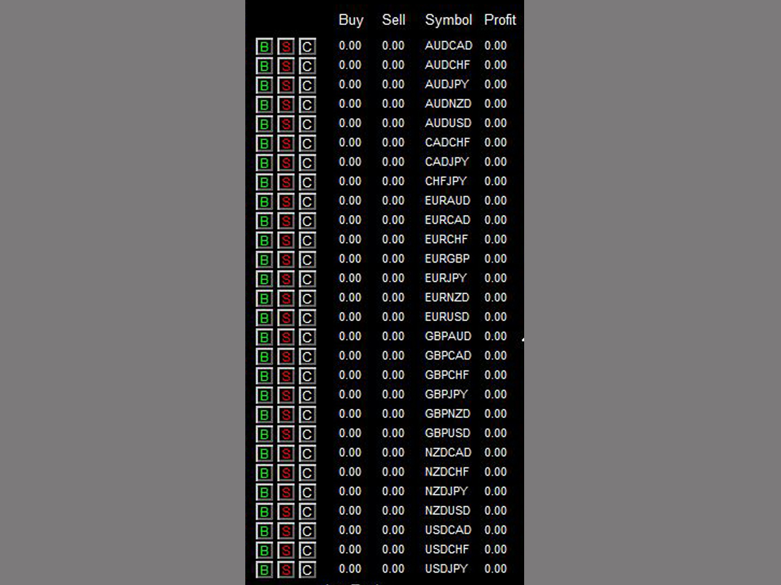
8 Buy Button
11 Buy Volume Column
12 Sell Volume Column
9 Sell Button
13 Symbol Column
10 Close Button
14 Profit Column
Autotrade will open at most 1 position per pair based on signal generated. If signal occurs but position already exists for a particular pair, no order will be sent. However, you can manually click on ‘B’ and/or ‘S’ button to any number of positions you want (click once send one order).

Slide 8
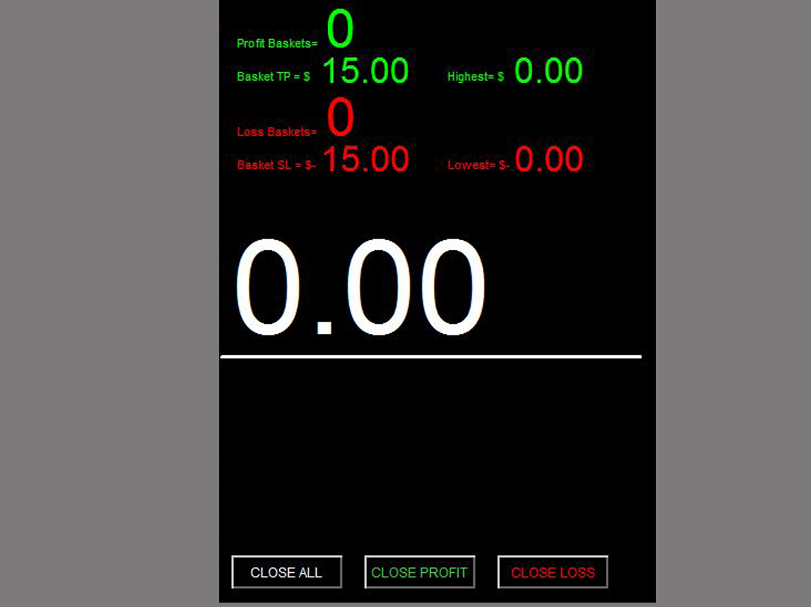
15 Profit Baskets
16 Basket TP
17 Basket Highest
18 Loss Baskets
19 Basket SL
20 Basket Lowest
21 Current Basket
Profit
23 Close Profit
22 Close All
24 Close Loss

Slide 9
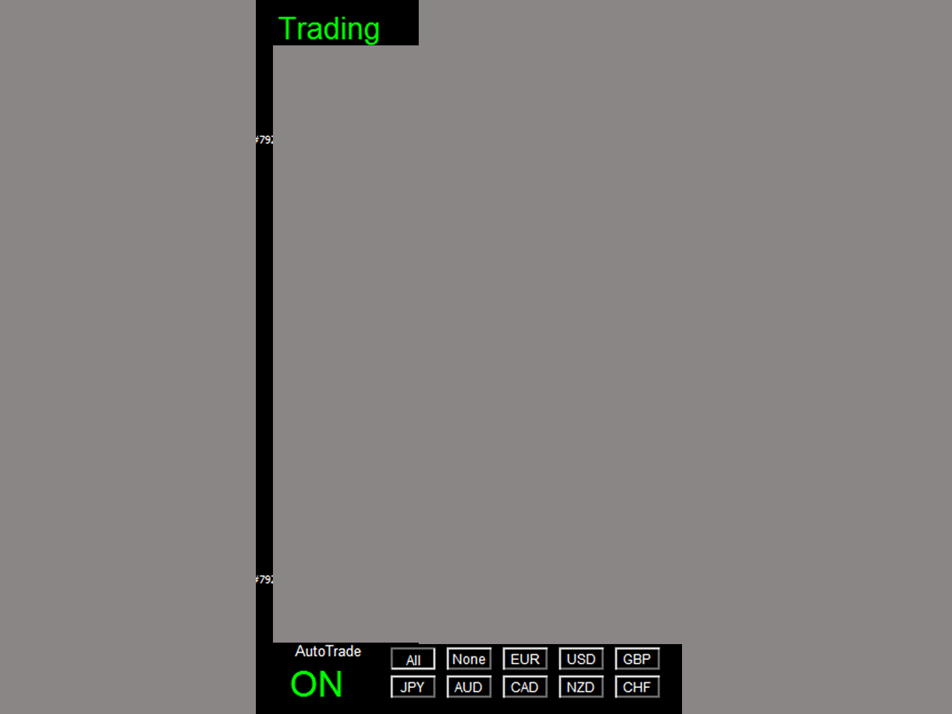
25 Session Monitor Panel
26 AutoTrade Monitor Panel
27 Pair/Currency Selection Button

Slide 10
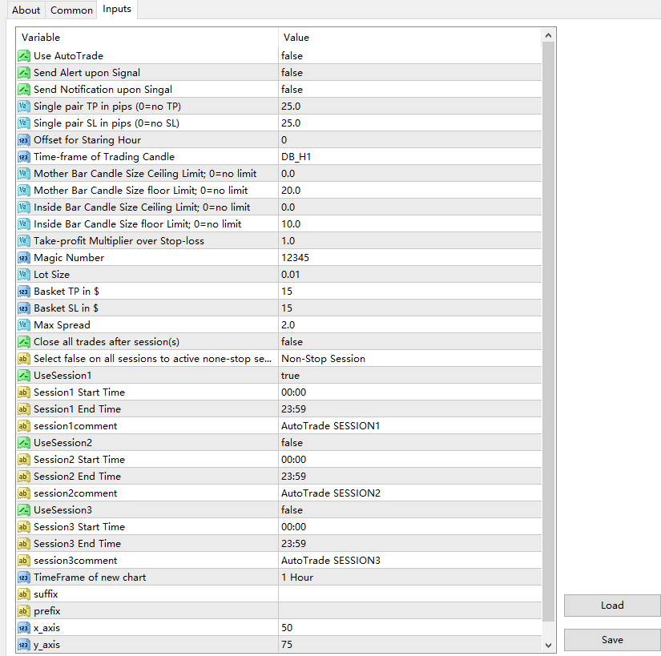
Once alert/notification of a particular pair has been sent, the next alert/notification of that pair will be sent after 5 minutes upon signal.
Basket means all active (open) positions opened by this dashboard with the same magic number. The basket profit is the total profit of all these active positions

