Slide 1
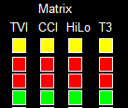


Entry Rules
Buy signal of a particular pair will be generated once all the selected indicators agree in up (if pair is selected). (Refer to screenshot2,3)
    Four Genesis Indicator are in green
    Stochastic (Optional) 1 and 2 are in green
    Current HA open is above EMA5 (Optional); panel is in green
Sell signal of a particular pair will be generated once all the selected indicators agree in down (if pair is selected). (Refer to screenshot2,3)
    Four Genesis Indicator are in red
    Stochastic (Optional) 1 and 2 are in red
    Current HA open is below EMA5 (Optional); panel is in red

Slide 2
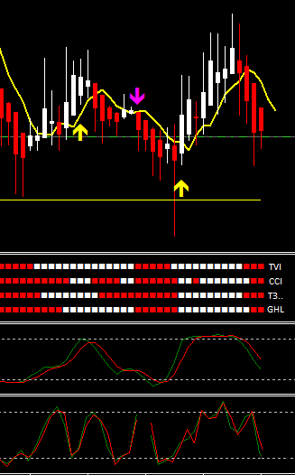
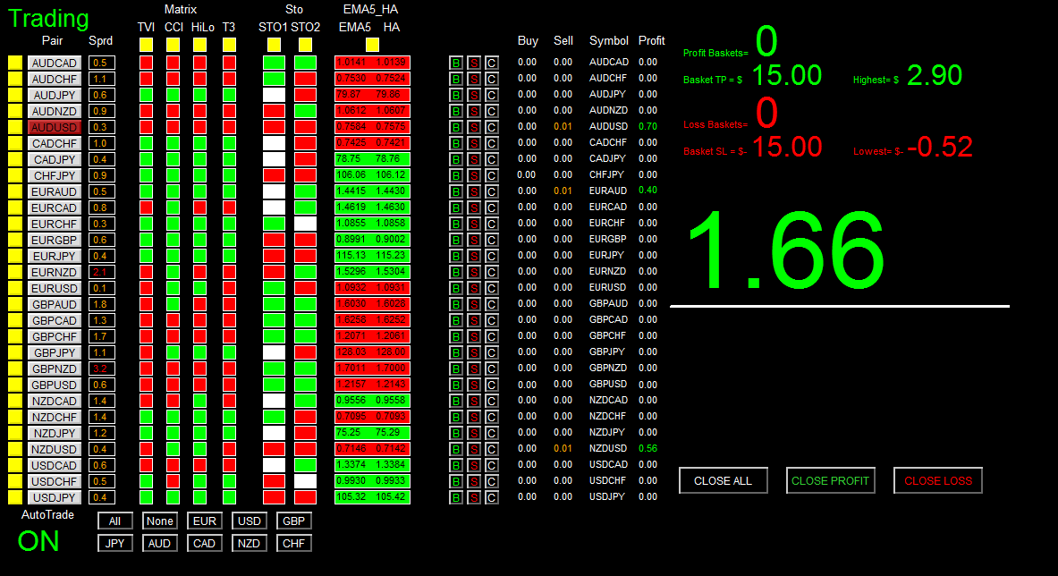
EMA5
Current HA open is below EMA5
Genesis Indi all agree in red
STO1 and 2 all agree in red (downwards)
STO M15
STO M5

Slide 4
4 Indicator Tick Status Panel
1 Pair Tick Button
5 Genesis Indicators
Status Panel
2 Pair Symbol Button
3 Spread Column

Slide 5
6 Stochastic Status Panel
7 EMA5-HA Signal Panel

Slide 6
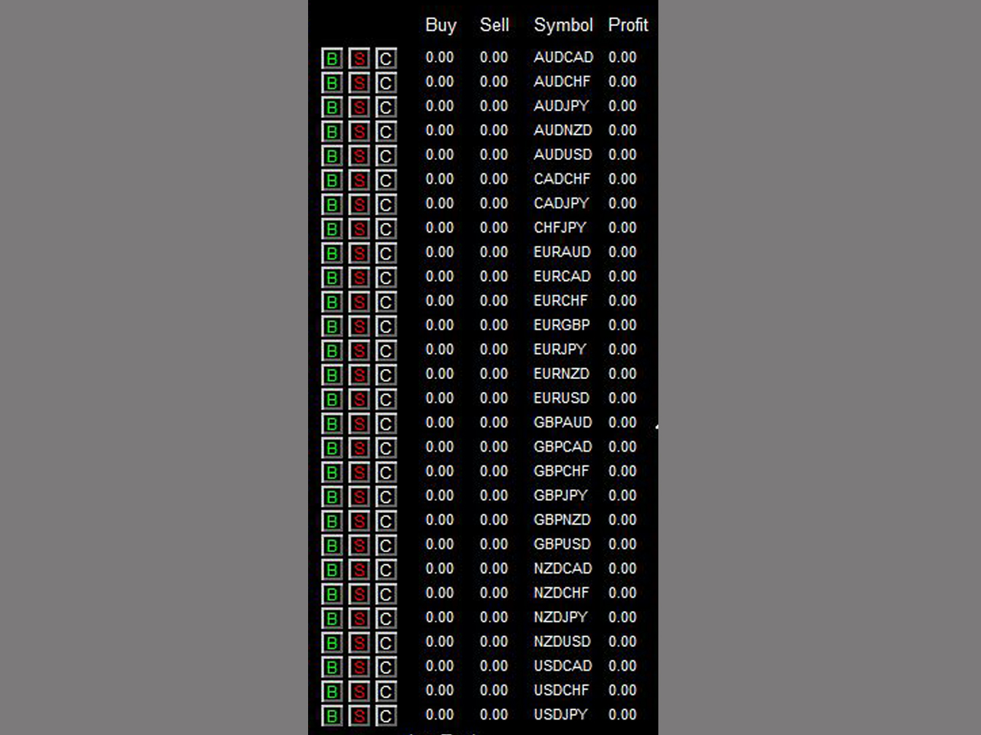
8 Buy Button
11 Buy Volume Column
12 Sell Volume Column
9 Sell Button
13 Symbol Column
10 Close Button
14 Profit Column
Autotrade will open at most 1 position per pair based on signal generated. If signal occurs but position already exists for a particular pair, no order will be sent. However, you can manually click on ‘B’ and/or ‘S’ button to any number of positions you want (click once send one order).

Slide 7
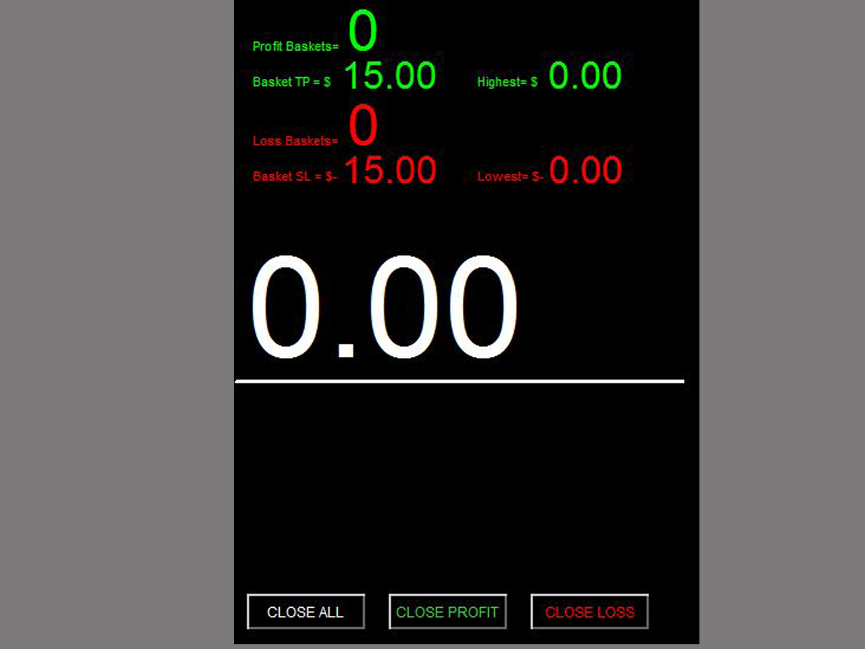
15 Profit Baskets
16 Basket TP
17 Basket Highest
18 Loss Baskets
19 Basket SL
20 Basket Lowest
21 Current Basket
Profit
23 Close Profit
22 Close All
24 Close Loss

Slide 8
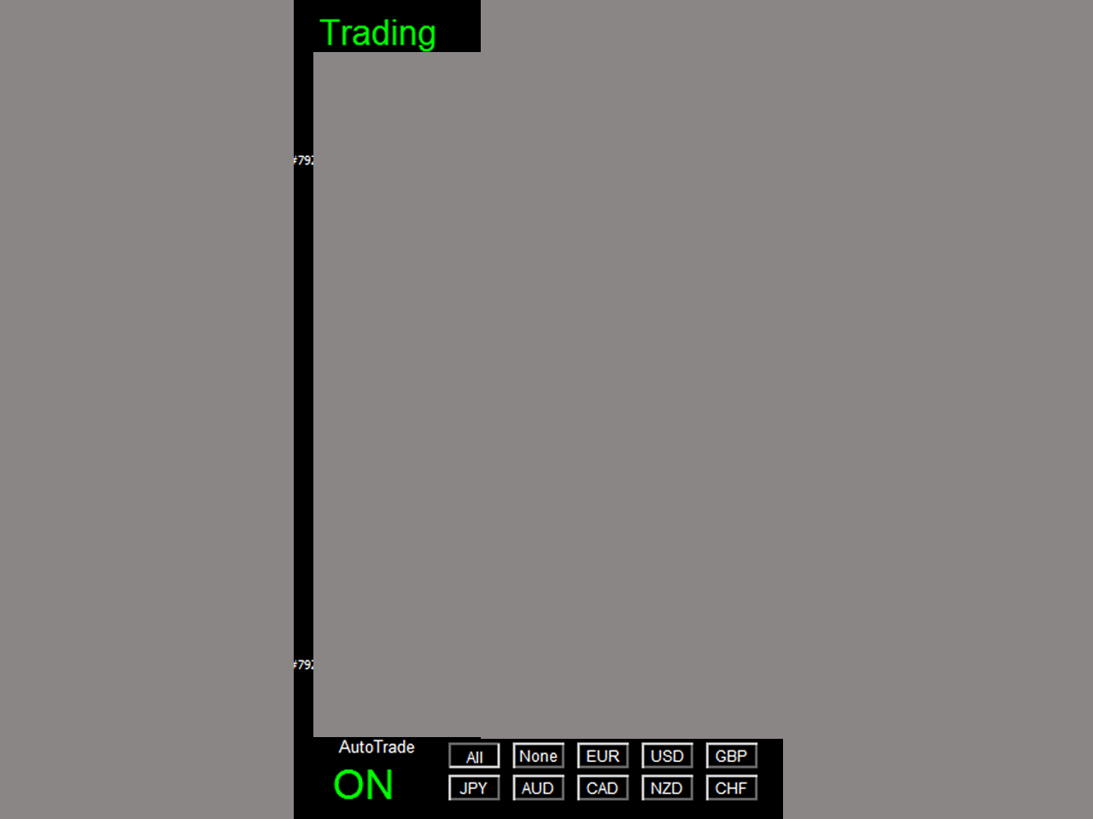
25 Session Monitor Panel
26 AutoTrade Monitor Panel
27 Pair/Currency Selection Button

Slide 9
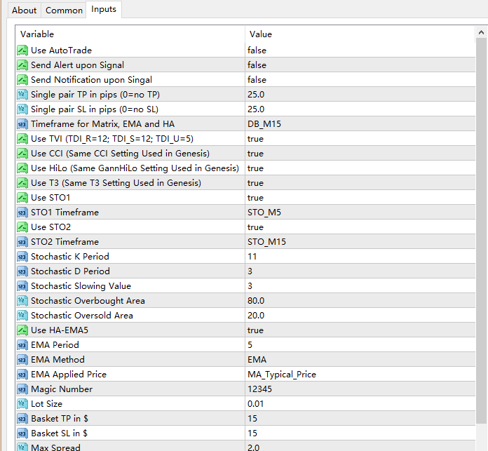
Once alert/notification of a particular pair has been sent, the next alert/notification of that pair will be sent after 5 minutes upon signal.
Basket means all active (open) positions opened by this dashboard with the same magic number. The basket profit is the total profit of all these active positions

