Slide 1

Entry Rules
Buy signal of a particular pair will be generated once all the following indicators agree (if pair is selected). (Refer to screenshot3,4,5)
  TDI
    Price line (green) up crosses signal line (red) ->
    TDI point to 12-2 direction ->TDI momentum (TG) is larger than about 1.5->
      TG=TDI_Price_Current – TDI_Price_Previous
    TDI Price Value (TV) should be less than 68 (overbought limit) ->
  Stochastic
    Current Sto value is larger than previous Sto value ->
    Current Sto value is less than Sto overbought limit ->
  HA Candle
    Current green candle should be the 1st or 2nd reversal candle ->
      You can set the limit at HA Reversal Candle Index Limit
    Current candle size is larger than HA candle size threshold ->

Slide 2

Entry Rules
Sell signal of a particular pair will be generated once all the following indicators agree (if pair is selected). (Refer to screenshot3,4,5)
  TDI
    Price line (green) down crosses signal line (red)->
    TDI point to 4-6 direction -> TDI momentum (TG) is less than about -1.5->
      TG=TDI_Price_Current – TDI_Price_Previous
    TDI Price Value(TV) should be larger than 32 (oversold limit) ->
  Stochastic
    Current Sto value is less than previous Sto value ->
    Current Sto value is larger than Sto oversold limit ->
  HA Candle
    Current red candle should be the 1st or 2nd reversal candle ->
      You can set the limit at HA Reversal Candle Index Limit
    Current candle size is larger than HA candle size threshold ->

Slide 3
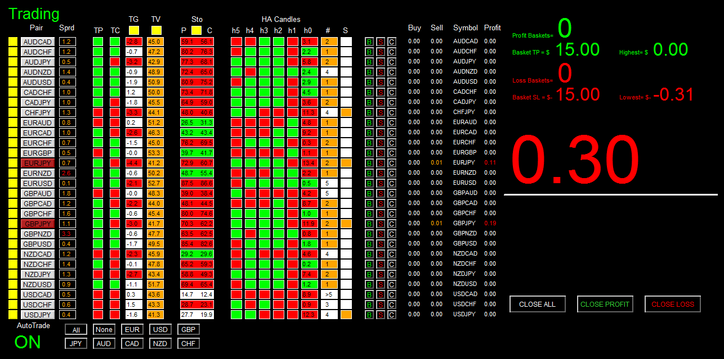
2 TDI Momentum and Value
1 TDI Cross
3 Sto Confirmation
4 HA Candle Confirmation
Screenshot5

Slide 4
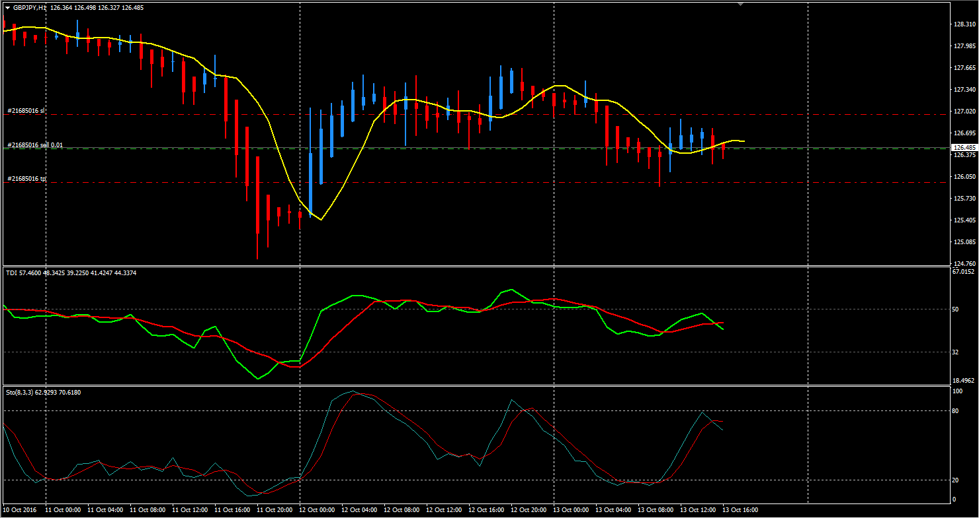
Current candle is 2nd Candle &
Current candle size > 10
TDI Cross &
4-6 Direction &
TDI is greater than 32
Sto direction downwards &
Sto is greater than 20

Slide 5
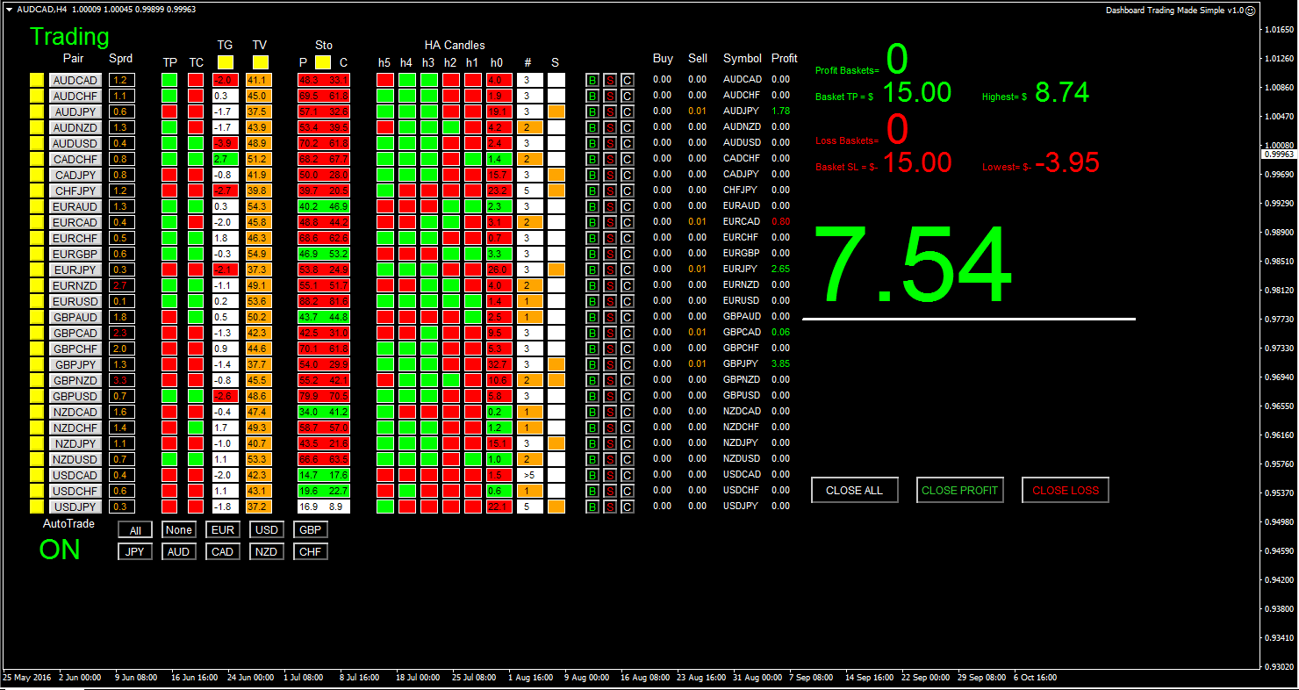

Slide 6
4 Current and Previous
TDI green vs red status
Panel
5 Indicator Status
Panel
6 TDI Momentum
Panel
1 Pair Tick Button
7 TDI Price Value
Panel
2 Pair Symbol Button
8 Sto Panel
3 Spread Column
9 HA Candle0-6
Status Panel
10 Rev Candle
Index Panel
11 Current HA Candle
Size Panel

Slide 7
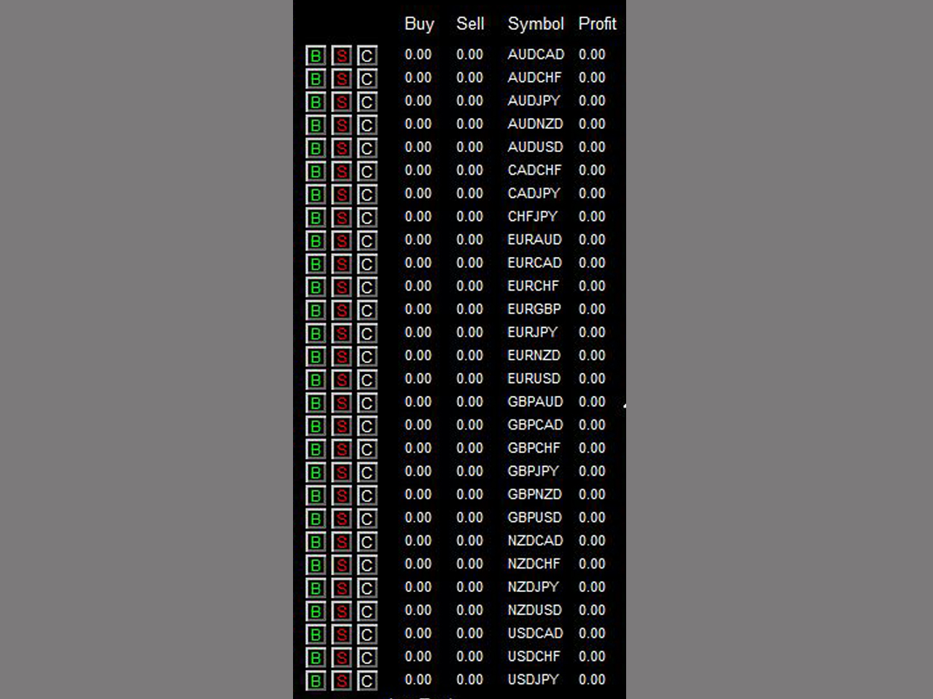
12 Buy Button
15 Buy Volume Column
16 Sell Volume Column
13 Sell Button
17 Symbol Column
14 Close Button
18 Profit Column
Autotrade will open at most 1 position per pair based on signal generated. If signal occurs but position already exists for a particular pair, no order will be sent. However, you can manually click on ‘B’ and/or ‘S’ button to any number of positions you want (click once send one order).

Slide 8
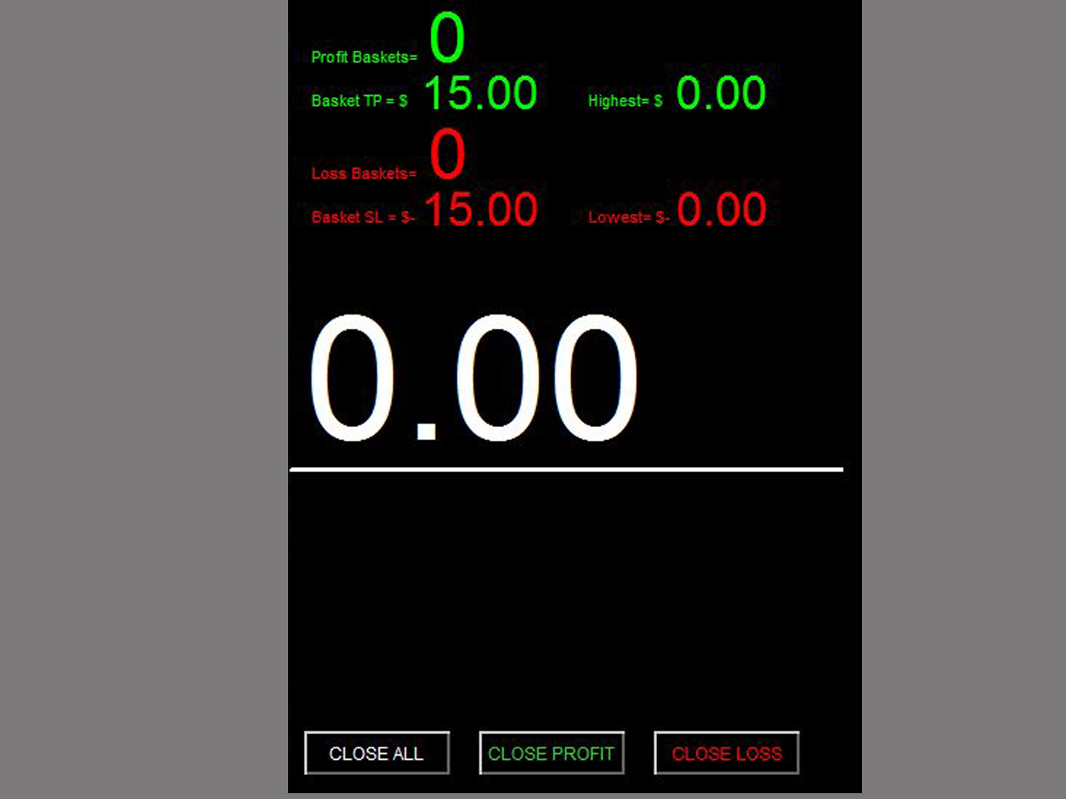
19 Profit Baskets
20 Basket TP
21 Basket Highest
22 Loss Baskets
23 Basket SL
24 Basket Lowest
25 Current Basket
Profit
27 Close Profit
26 Close All
28 Close Loss

Slide 9
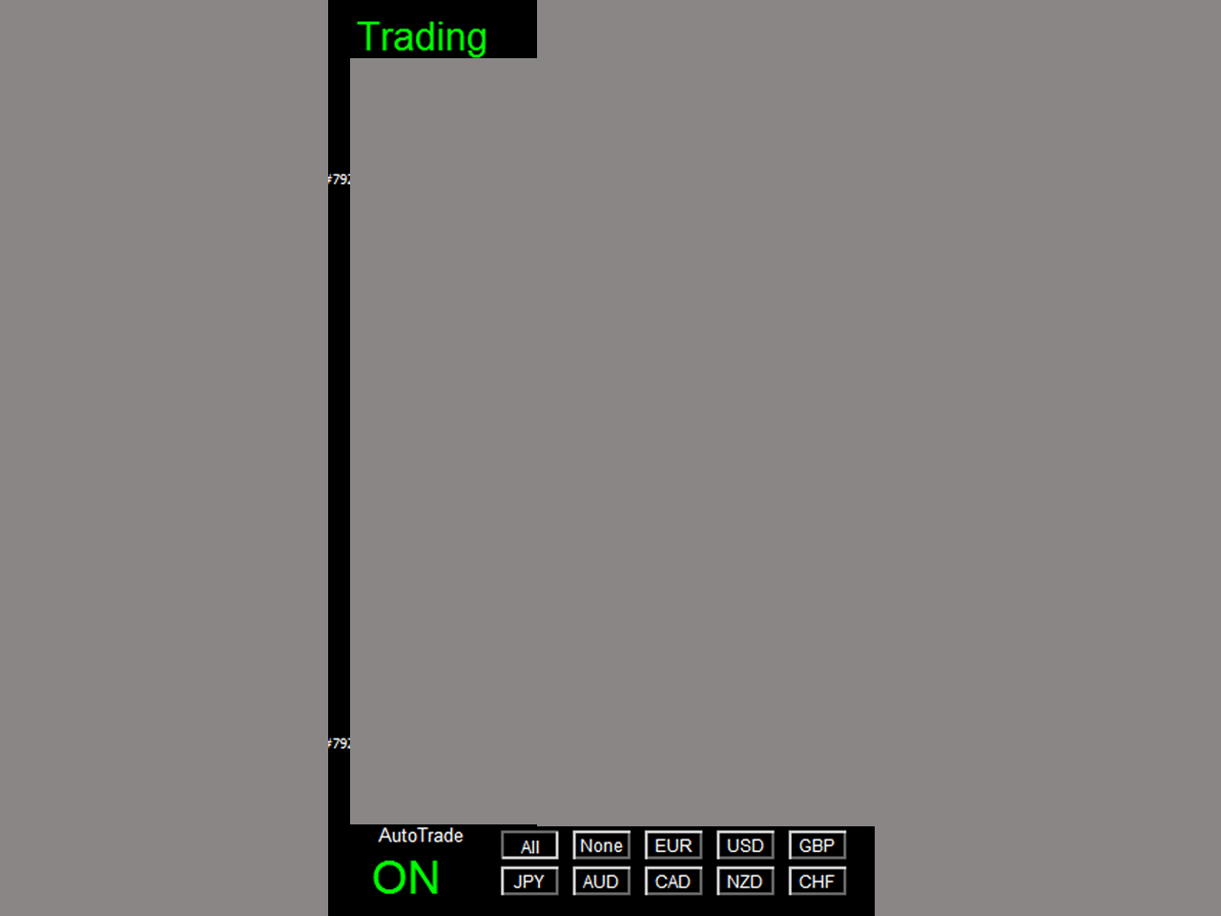
29 Session Monitor Panel
30 AutoTrade Monitor Panel
31 Pair/Currency Selection Button

Slide 10
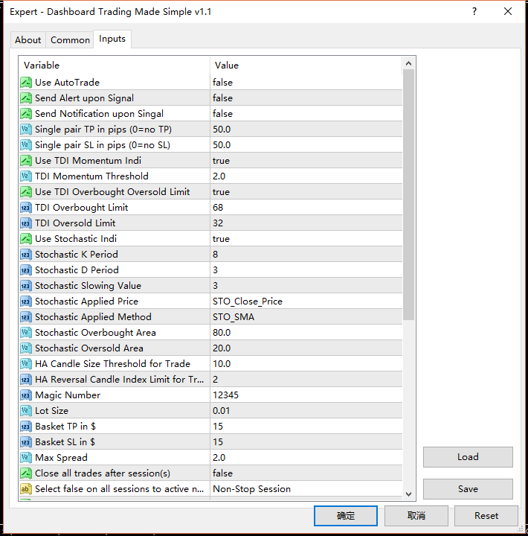
Once alert/notification of a particular pair has been sent, the next alert/notification of that pair will be sent after 5 minutes upon signal.
The value is calculated by
(current TDI green – previous TDI green)
No buy when TDI>limit
No sell when TDI<limit

Slide 11
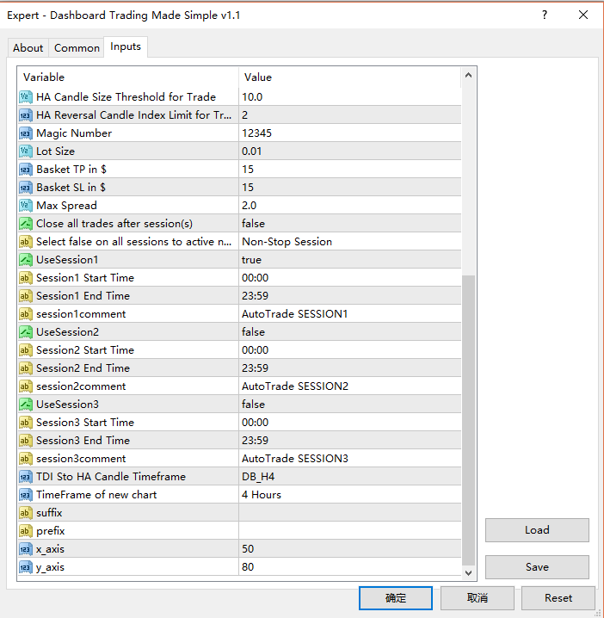
Basket means all active (open) positions opened by this dashboard with the same magic number. The basket profit is the total profit of all these active positions

