Slide 1
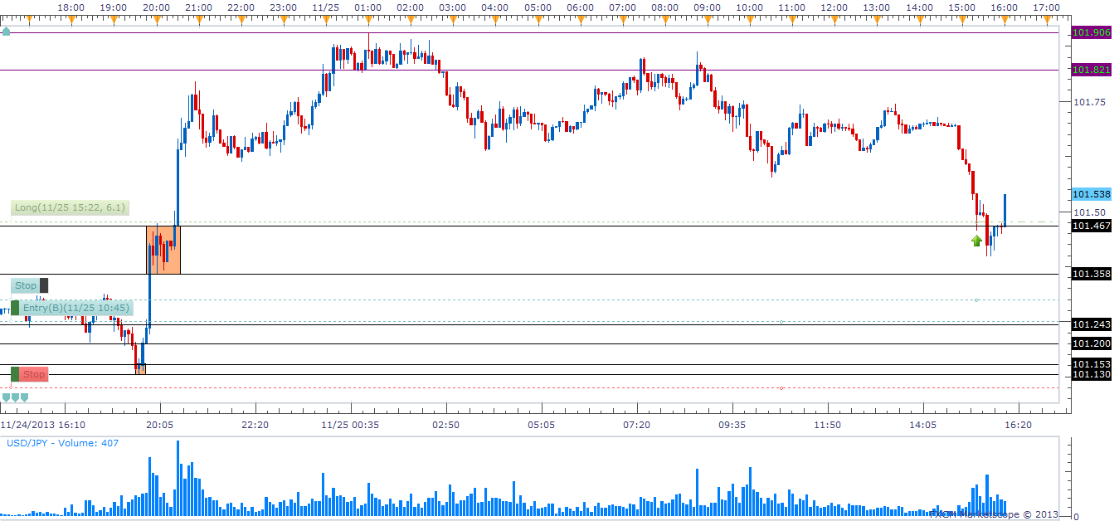
Example of Taking a Three Way Scale in on a Wider Zone 11/25/2013u/j

Slide 2
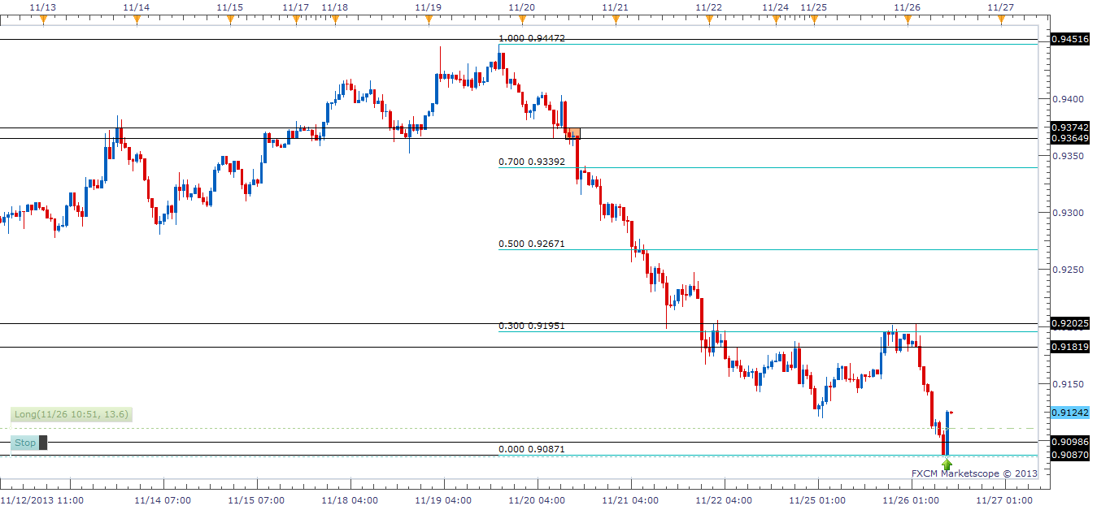
First Example of Entry in a Low Curve Zone 11/26/2013a/u

Slide 3
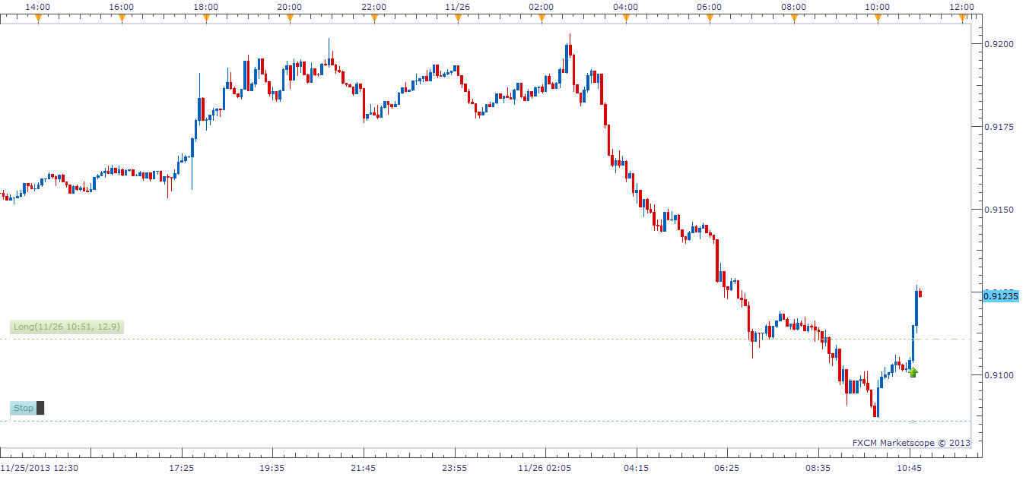
Second Example of Entry in a Low Curve Zone 11/26/2013a/u

Slide 4
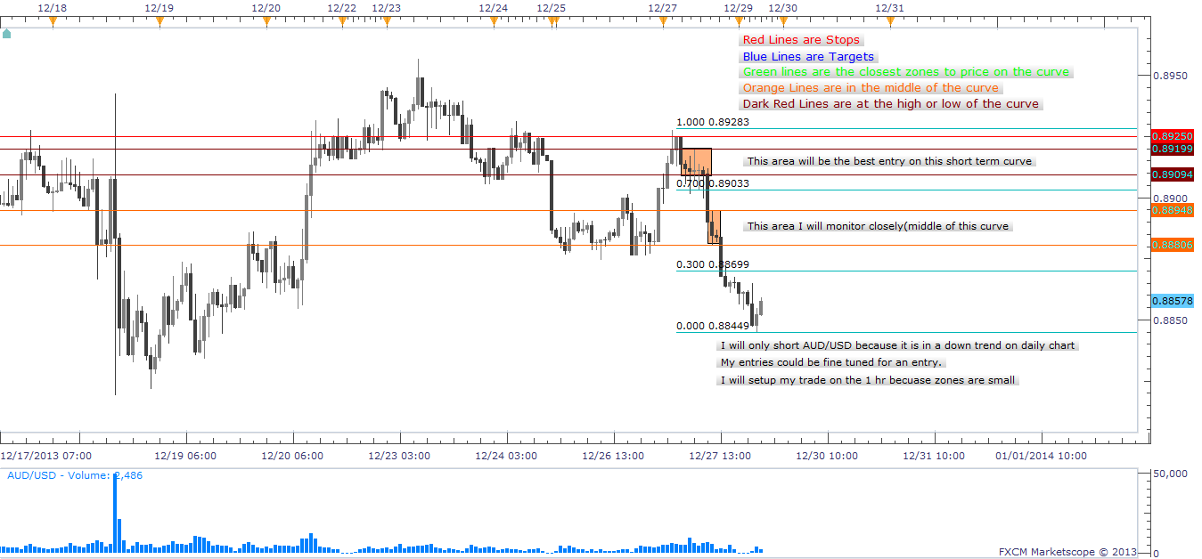
Aud/Usd Before Trade 12/29/2013-01

Slide 5
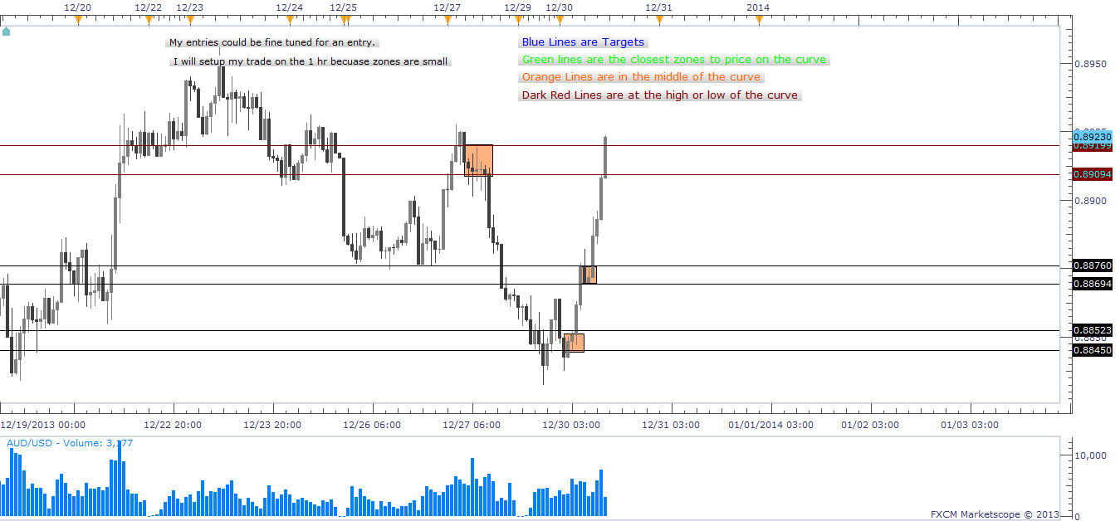
Aud/Usd Final 12/29-30/2013

Slide 6
Skill Development 12/30/2013 A/U
Trade Grade:
Trade Criteria Met?
Pre-Planned?
Entry:
Followed Entry Tactic?
Precision Entry?
Risk:
Position Size Correctly?
Stop Placed?
Stop At Good Location?
Exit:
Followed Exit Tactic?
Precision Exit?
Analysis:
Did I Study My Trade?
Yes- Top of Curve
Yes
Yes- #1 Entry
No- Price stopped me out
Yes-Low on long term curve
Yes-SpreadX3
Yes- Above Short term curve
No-No profit made
No-
Yes-Short term trend changing to uptrend on hourly charts. Will look for a new HH before entry.

Slide 7
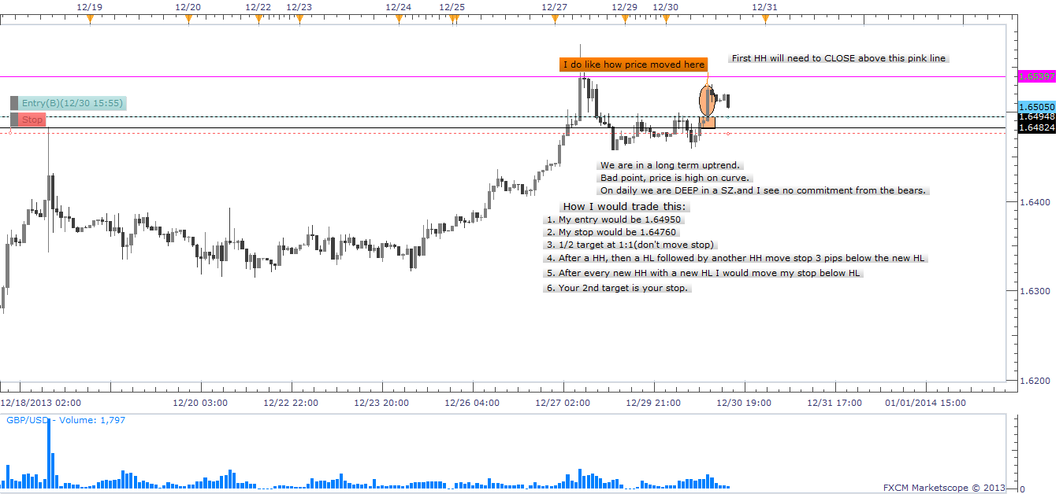
GBP/USD Before Trade 12/30/2013-01

Slide 8
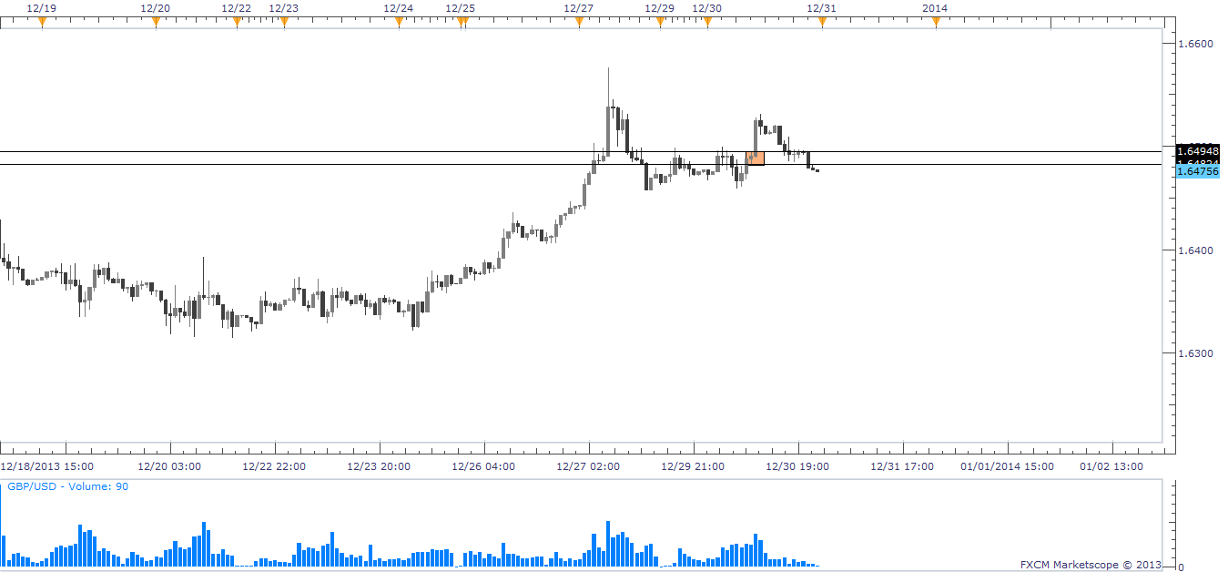
GBP/USD Final Trade 12/30/2013

Slide 9
Skill Development 12/30/2013 G/U
Trade Grade:
Trade Criteria Met?
Pre-Planned?
Entry:
Followed Entry Tactic?
Precision Entry?
Risk:
Position Size Correctly?
Stop Placed?
Stop At Good Location?
Exit:
Followed Exit Tactic?
Precision Exit?
Analysis:
Did I Study My Trade?
No-Top of the Curve
Yes-Long term uptrend
Yes-#1 entry
No-Small zone set up trade on 1 hr
Yes- 2,000 contract
Yes-Spread x3 below zone
Yes- Minimal risk
No- Stopped out
No-
Yes- Even though I was in a long term uptrend, price was at the top of the curve in a long term demand zone.

Slide 10
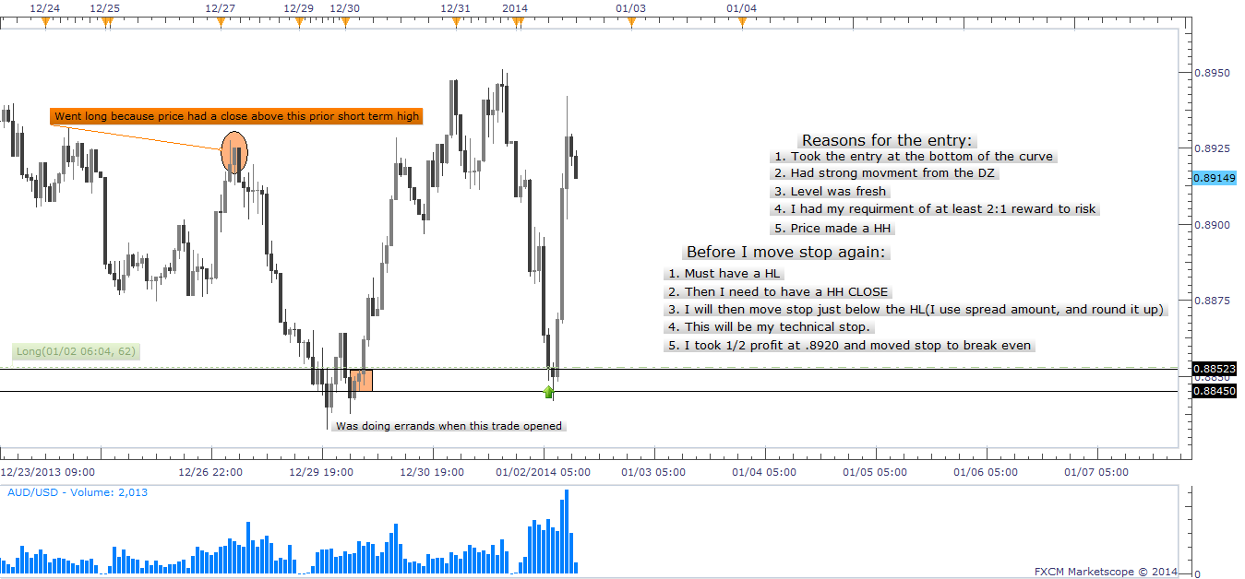
AUD/USD FIRST Trade 01/02/2014-01

Slide 11
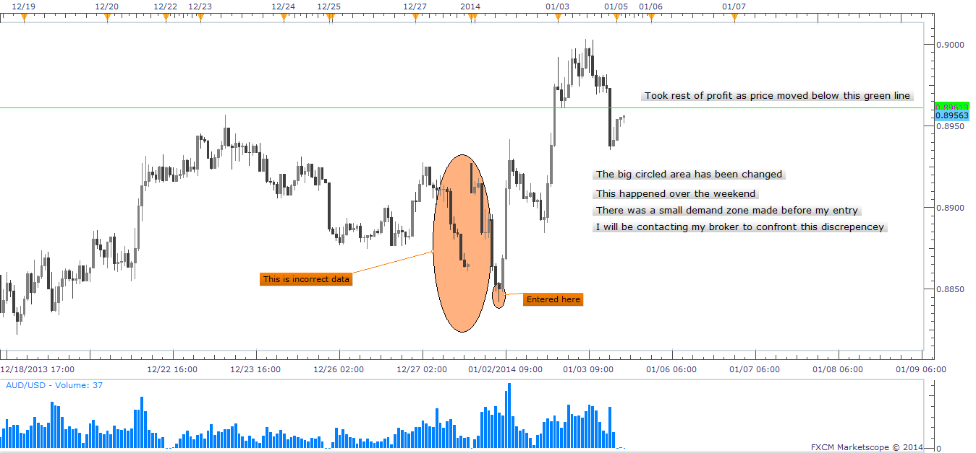
AUD/USD Final Chart 01/03/2014-change

Slide 12
Skill Development 01/03/2014 A/U
Trade Grade:
Trade Criteria Met?
Pre-Planned?
Entry:
Followed Entry Tactic?
Precision Entry?
Risk:
Position Size Correctly?
Stop Placed?
Stop At Good Location?
Exit:
Followed Exit Tactic?
Precision Exit?
Analysis:
Did I Study My Trade?
Yes- Demand Zone was fresh
Yes- Stop set
Yes- Limit
Yes
No- Could have entered 20,000 contract
Yes- Spreadx3 below zone low
Yes
Yes- First target hit
Yes- Used combination exit and tech. stop
Yes- When price is at the extreme of curve I can have a bigger contract. Also broker changed chart data over the weekend(01/04/2014-01/05/2014) Contacted

Slide 13
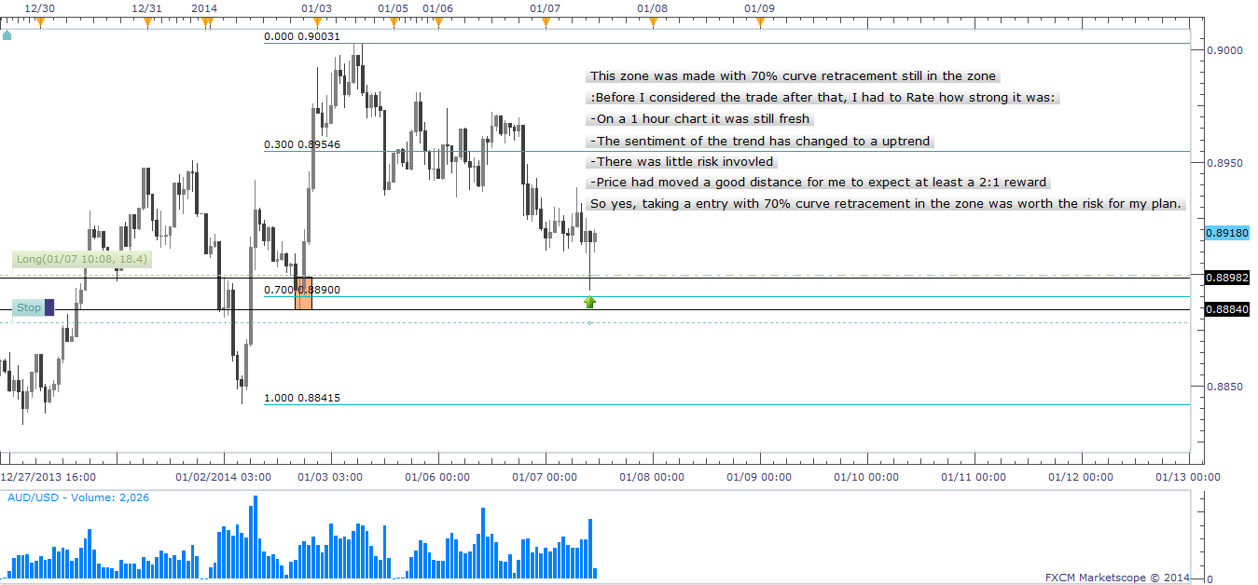
AUD/USD First Chart 01/07/2014-01

Slide 14
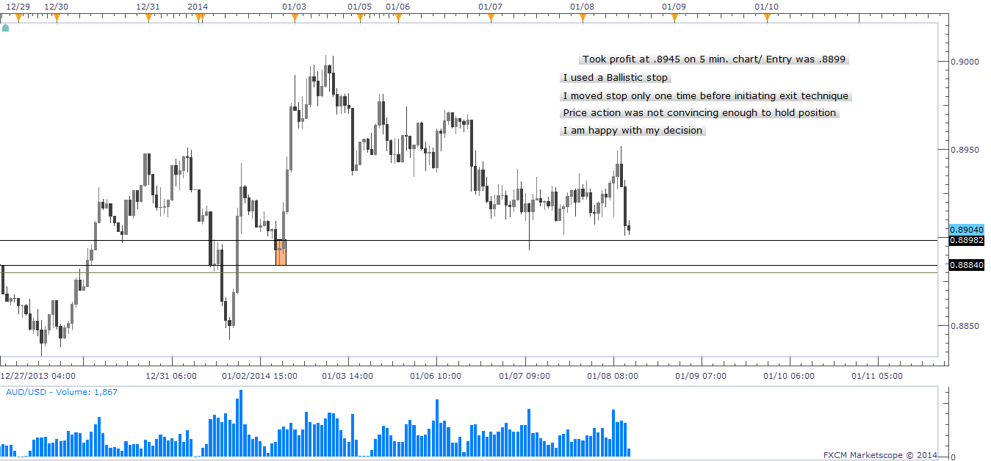
AUD/USD Final Chart 01/08/2014

Slide 15
Skill Development 01/08/2014 A/U
Trade Grade:
Trade Criteria Met?
Pre-Planned?
Entry:
Followed Entry Tactic?
Precision Entry?
Risk:
Position Size Correctly?
Stop Placed?
Stop At Good Location?
Exit:
Followed Exit Tactic?
Precision Exit?
Analysis:
Did I Study My Trade?
Yes- Low of curve
Yes-
Yes- Limit entry
No- Did not scale in, no need
No- Not enough reward , had another trade going
Yes
Yes- Moved once to breakeven over night before using ballistic stop.
No- Not enough price movement on rally
Yes- Switched to 5 min. chart and used ballistic stop
Yes- Comfortable with my decision to exit trade. Found a new entry in a demand zone using 1 hr and 5 min charts.

Slide 16
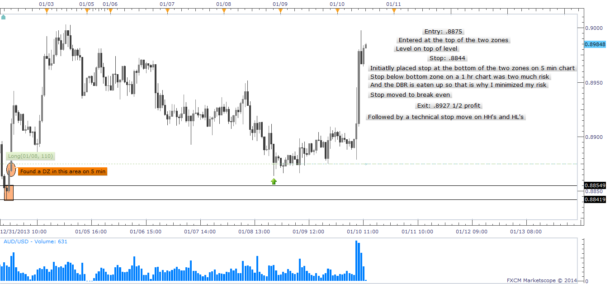
AUD/USD First Chart 01/10/2014-01

Slide 17
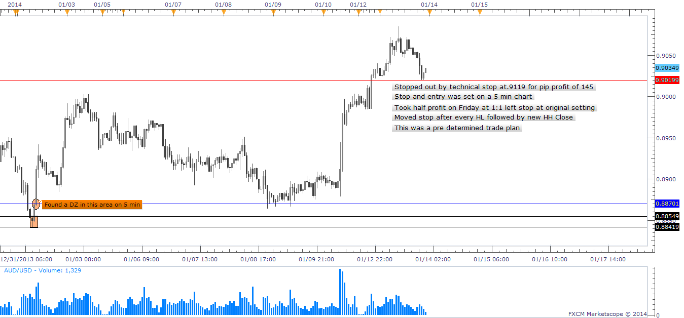
AUD/USD Final Chart 01/13/2014

Slide 18
Skill Development 01/13/2014 A/U
Trade Grade:
Trade Criteria Met?
Pre-Planned?
Entry:
Followed Entry Tactic?
Precision Entry?
Risk:
Position Size Correctly?
Stop Placed?
Stop At Good Location?
Exit:
Followed Exit Tactic?
Precision Exit?
Analysis:
Did I Study My Trade?
Yes- Strong zone at low of curve
Yes-
Yes- Limit entry on full contract
Yes- Found better entry on 5 min chart
No- Would have risked another half of a contract but had other trade.
Yes
Yes- Moved stop up to lock in more profit
Yes- Took 1:1 and left stop at original setting
Yes- Used combo exit strategy
Yes- Did well to move stop after I had a RBR. I had already taken ½ profit before the RBR.

Slide 19
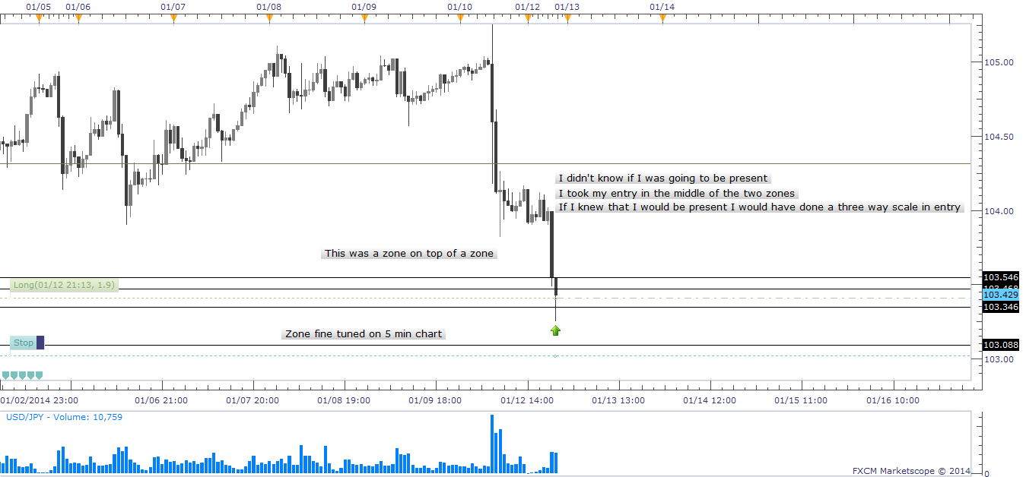
USD/JPY First Chart 01/12/2014-01

Slide 20
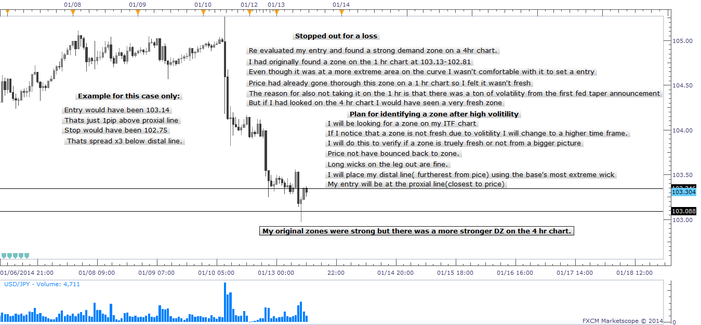
USD/JPY Final Chart 01/13/2014

Slide 21
Skill Development 01/13/2014 U/J
Trade Grade:
Trade Criteria Met?
Pre-Planned?
Entry:
Followed Entry Tactic?
Precision Entry?
Risk:
Position Size Correctly?
Stop Placed?
Stop At Good Location?
Exit:
Followed Exit Tactic?
Precision Exit?
Analysis:
Did I Study My Trade?
Yes- low on curve/ Not the lowest
Yes-
Yes- Limit entry
Yes- Pre determined entry
Yes- .5 for a contract
Yes- Spread x3
Yes/No- For the zone it was a good location
No-Stopped Out
No
I had pre determined that the zone with high volatility was not fresh. After being stopped out I looked at a higher time frame to find that the zone was fresh for a stronger entry on the curve.

Slide 22
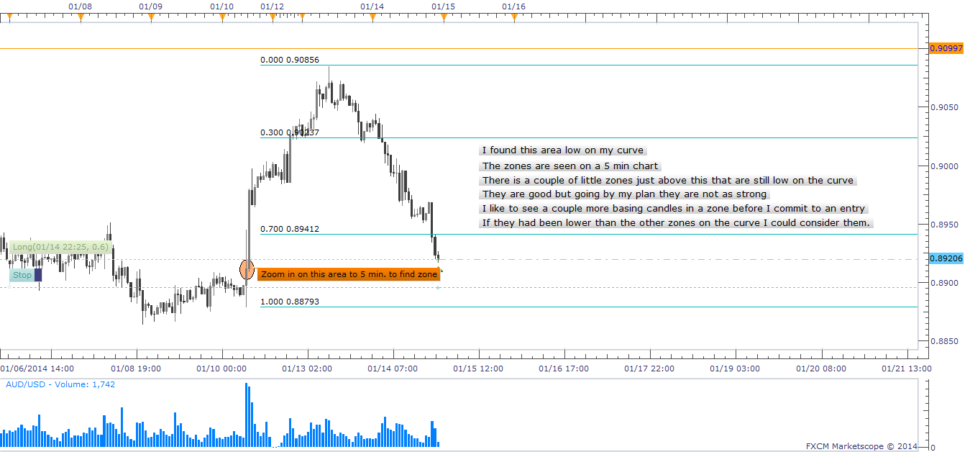
AUD/USD First Chart 01/14/2014

Slide 23
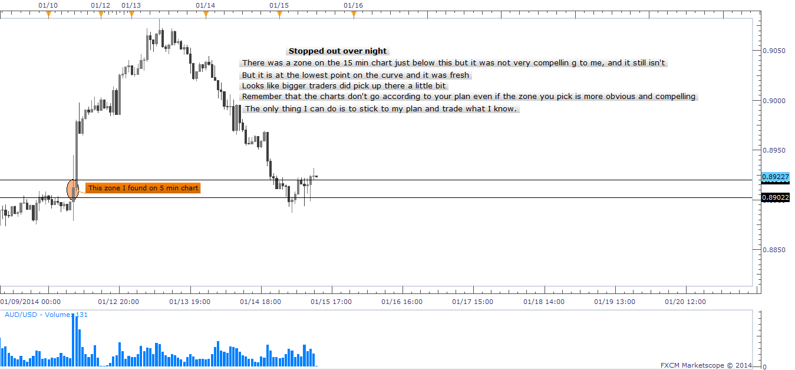
AUD/USD Final Chart 01/15/2014

Slide 24
Skill Development 01/15/2014 A/U
Trade Grade:
Trade Criteria Met?
Pre-Planned?
Entry:
Followed Entry Tactic?
Precision Entry?
Risk:
Position Size Correctly?
Stop Placed?
Stop At Good Location?
Exit:
Followed Exit Tactic?
Precision Exit?
Analysis:
Did I Study My Trade?
Yes- Low on the curve
Yes
Yes- Limit entry
Yes- Setup on 5 min chart
Yes- Full contract
Yes- Spread x3
Yes- Below distal line
No- Stopped out at .8893
No-
Yes- Still found that the less compelling zone lower on the curve succeeded to be more of a stronger entry. It was not very compelling or obvious while I was pre determining my trade entry. I learned that all zones at the extreme of the curve can be used for a setup if they are on a higher timeframe.

Slide 25
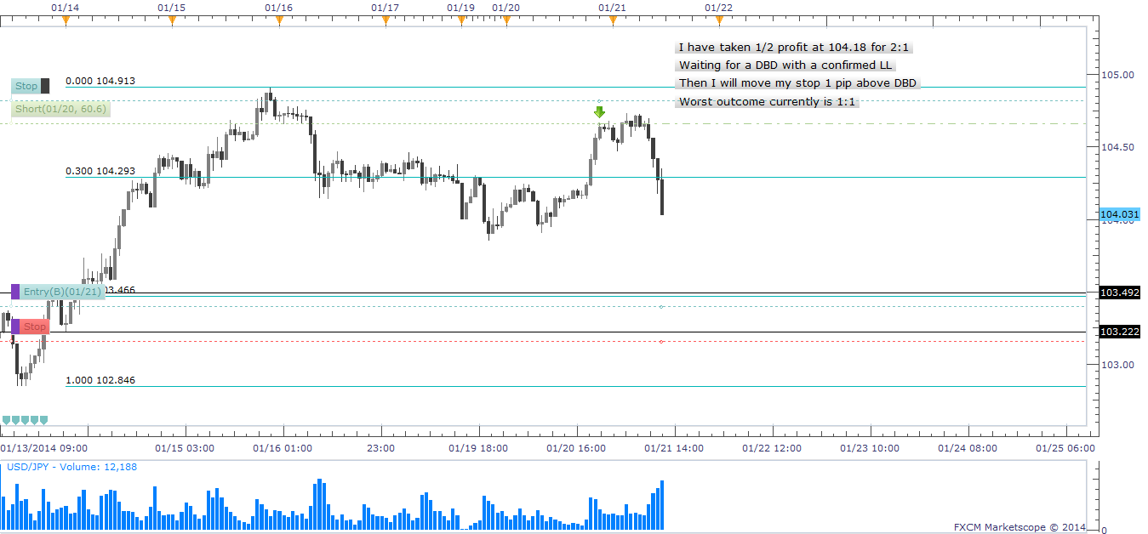
USD JPY First Chart 01/21/2014-01

Slide 26
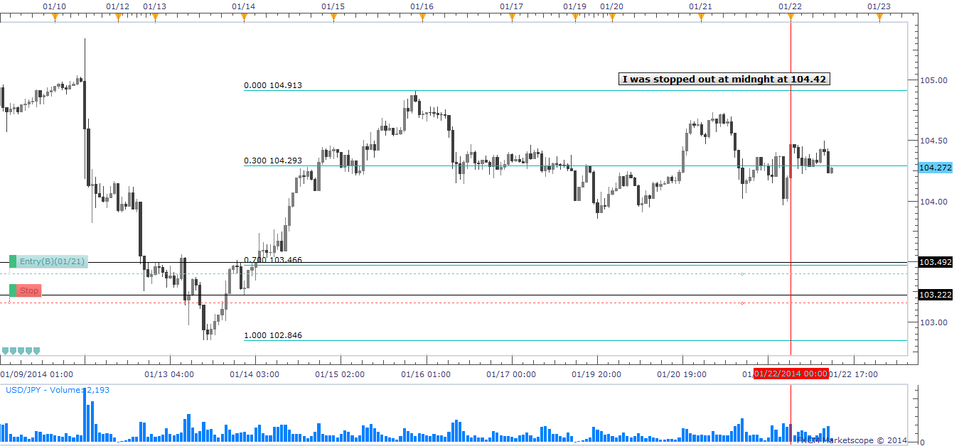
USD/JPY Final Chart 01/22/2014

Slide 27
Skill Development 01/15/2014 A/U
Trade Grade:
Trade Criteria Met?
Pre-Planned?
Entry:
Followed Entry Tactic?
Precision Entry?
Risk:
Position Size Correctly?
Stop Placed?
Stop At Good Location?
Exit:
Followed Exit Tactic?
Precision Exit?
Analysis:
Did I Study My Trade?
Yes- Supply zone high on the curve
Yes-
Yes- Full Contract
Yes- Confirmation entry
Yes
Yes- Spread x3 above distal line
Yes
Yes- ½ Profit at 2:1
Yes- Moved stop after I had a LH and LL
Yes- Entry was good and stop was set correctly. Moved stop only once then stop was triggered for a overall gain. I would have done nothing else.

Slide 28
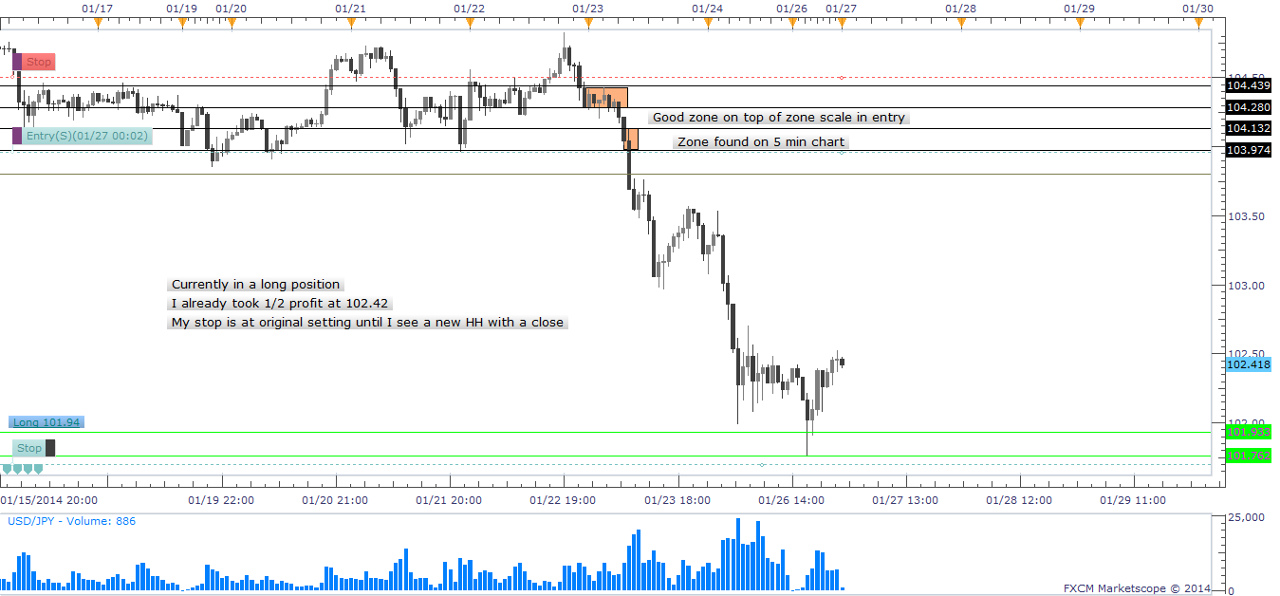
USD/JPY First Chart 01/26/2014-01

Slide 29
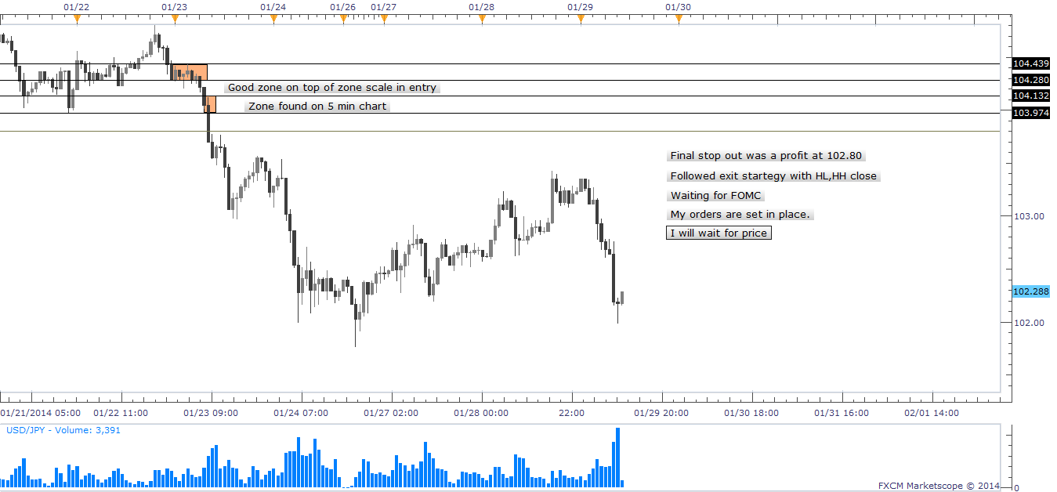
USD/JPY Final Chart 01/29/2014

Slide 30
Skill Development 01/15/2014 U/J
Trade Grade:
Trade Criteria Met?
Pre-Planned?
Entry:
Followed Entry Tactic?
Precision Entry?
Risk:
Position Size Correctly?
Stop Placed?
Stop At Good Location?
Exit:
Followed Exit Tactic?
Precision Exit?
Analysis:
Did I Study My Trade?
Yes- Waited for price to move toward order
Yes- Had entry and stop
Yes-
Yes- Limit order at proximal line
Yes- 1 full contract
Yes- Spread x3 below distal line
Yes
Yes- Took ½ profit at 2:1 let rest run by moving stop
Yes- Used HL and HH closes before moving stop below HL
Yes- I could have entered ½ at proximal line then I could have done a zone entry in the zone as price turned around.

Slide 31
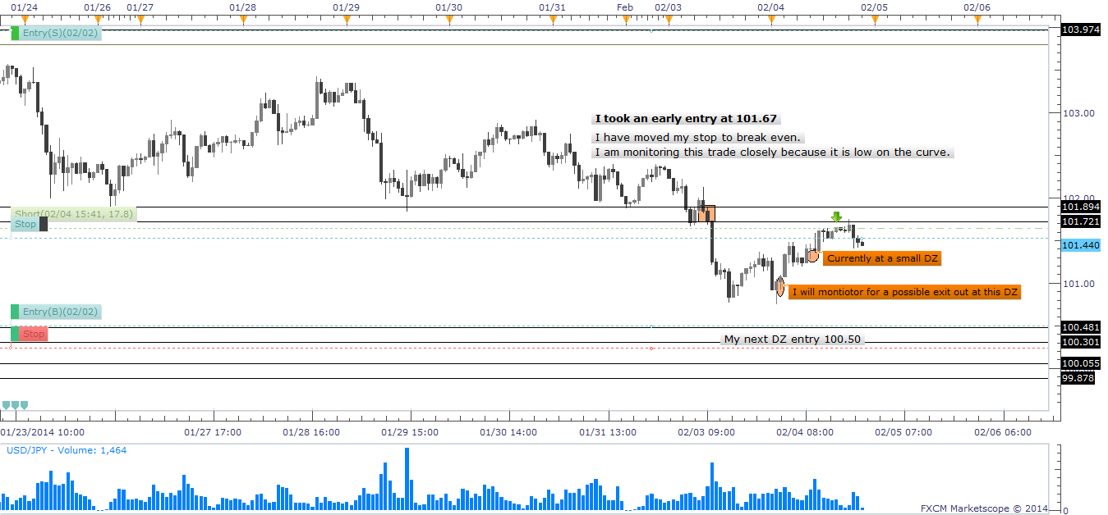
USD JPY First Chart 02/04/2014-01

Slide 32
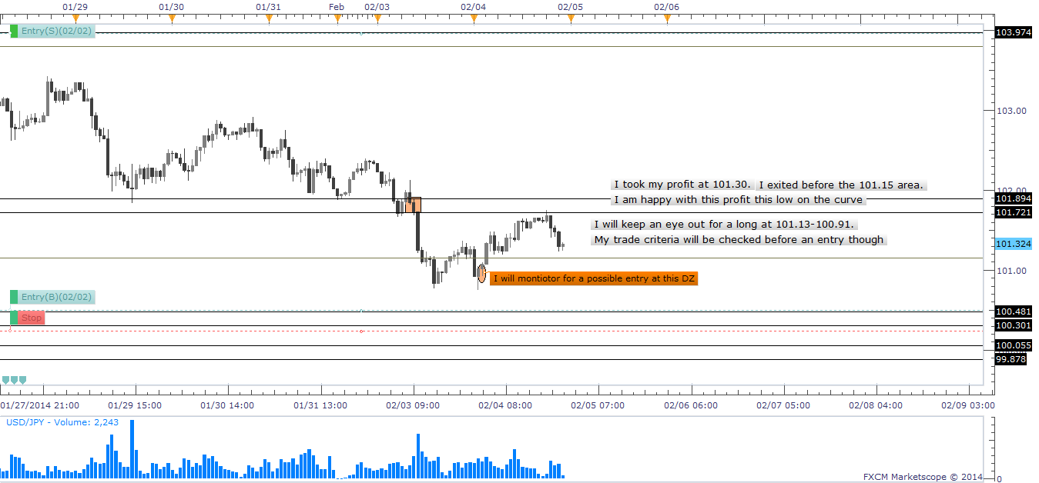
USD/JPY Final Chart 02/04/2014

Slide 33
Skill Development 01/15/2014 U/J
Trade Grade:
Trade Criteria Met?
Pre-Planned?
Entry:
Followed Entry Tactic?
Precision Entry?
Risk:
Position Size Correctly?
Stop Placed?
Stop At Good Location?
Exit:
Followed Exit Tactic?
Precision Exit?
Analysis:
Did I Study My Trade?
Yes-SZ high on the curve on 5 min chart
Yes- Limit entry.
Yes- limit
Yes – Full contract
Yes
Yes- spread x3 from high of distal line
Yes
Yes-
Yes- Took profit before lowest DZ on short term curve
Yes- I need to not be so nervous about taking shorts. I need to respect my plan and follow my exit tactics by moving my stop at appropriate times.

Slide 34
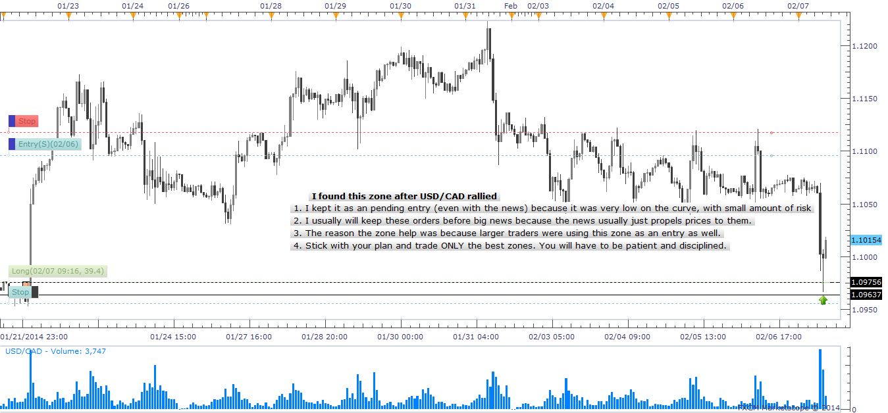
USD/CAD First Chart 02/07/2014-01

Slide 35
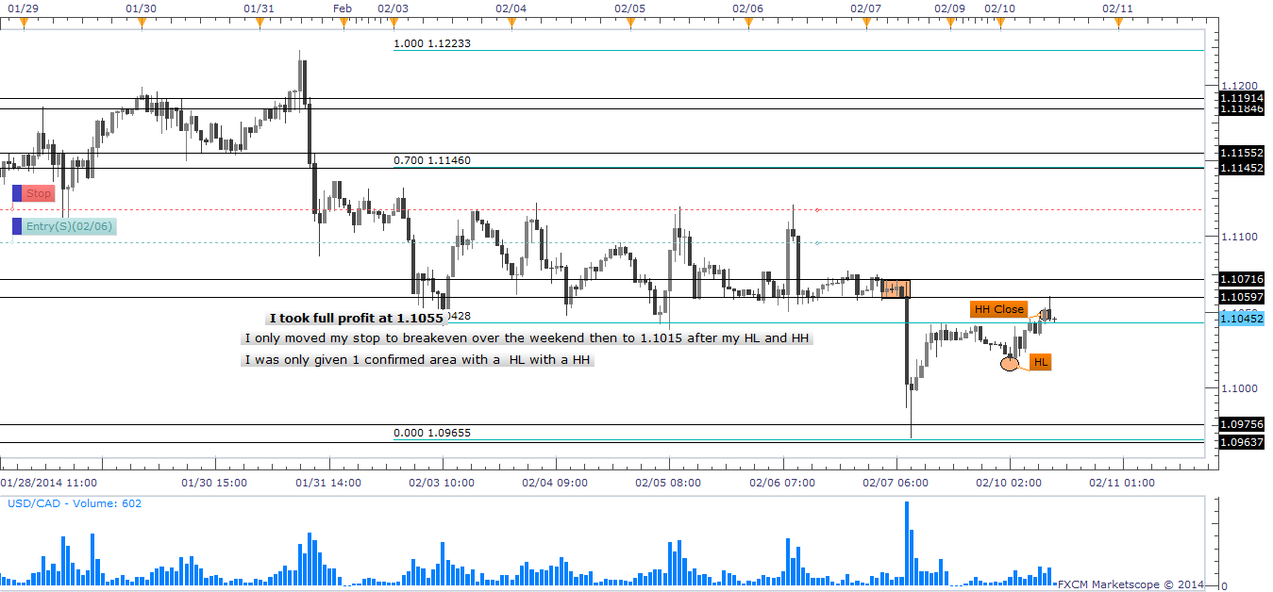
USD/CAD Final Chart 02/10/2014

Slide 36
Skill Development 02/10/2014 U/C
Trade Grade:
Trade Criteria Met?
Pre-Planned?
Entry:
Followed Entry Tactic?
Precision Entry?
Risk:
Position Size Correctly?
Stop Placed?
Stop At Good Location?
Exit:
Followed Exit Tactic?
Precision Exit?
Analysis:
Did I Study My Trade?
Yes- Low on curve
Yes
Yes- #1 limit entry
Yes-All at proximal line
No- Could have risked more because I was much lower on the curve.
Yes
Yes
No- Could have held position longer and used stop as exit
No- Didn’t wait for a new HL and HH close.
Yes- Price action was very slow so I exited just after it touched and returned from a SZ. I had locked in profit already and could have waited it out since it is still a little low on the hourly curve.

Slide 37
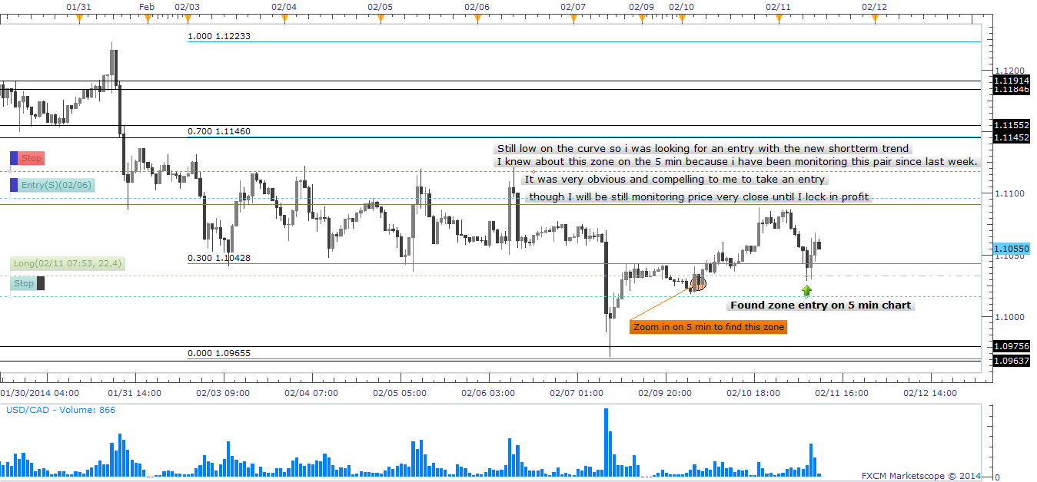
USD/CAD First Chart 02/11/2014-01

Slide 38
Skill Development 02/11/2014 U/C
Trade Grade:
Trade Criteria Met?
Pre-Planned?
Entry:
Followed Entry Tactic?
Precision Entry?
Risk:
Position Size Correctly?
Stop Placed?
Stop At Good Location?
Exit:
Followed Exit Tactic?
Precision Exit?
Analysis:
Did I Study My Trade?
Yes
Yes
Yes
Yes
Yes
Yes
Yes
No- Price action not strong enough
No-Took full profit on manual exit
Yes-
Price was too high on the curve so low probability of success

