Slide 1
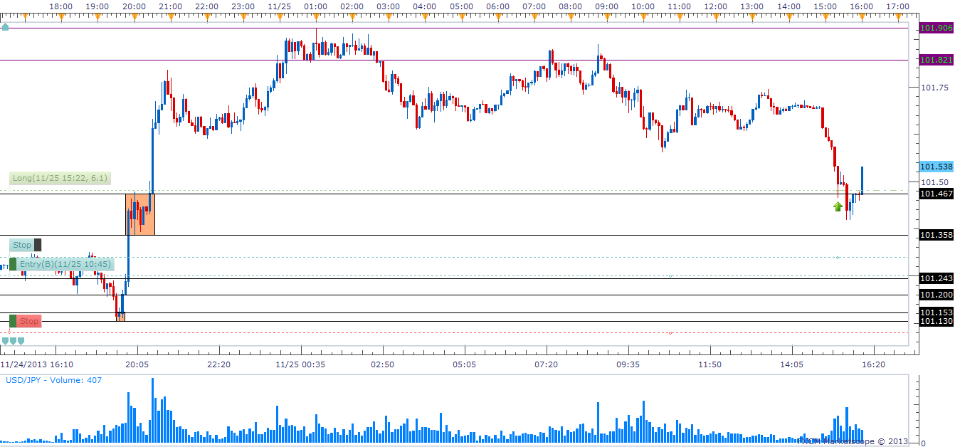
Example of Taking a Three Way Scale in on a Wider Zone 11/25/2013u/j

Slide 2
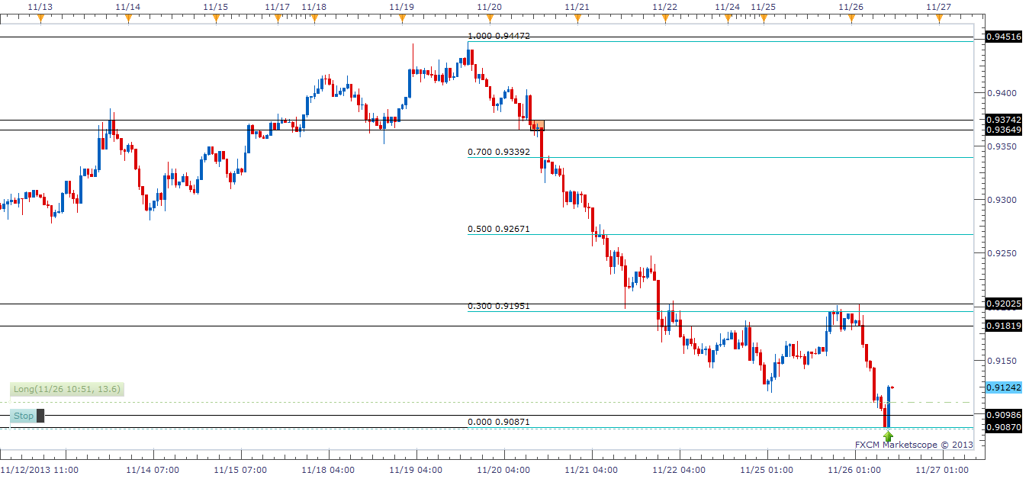
First Example of Entry in a Low Curve Zone 11/26/2013a/u

Slide 3
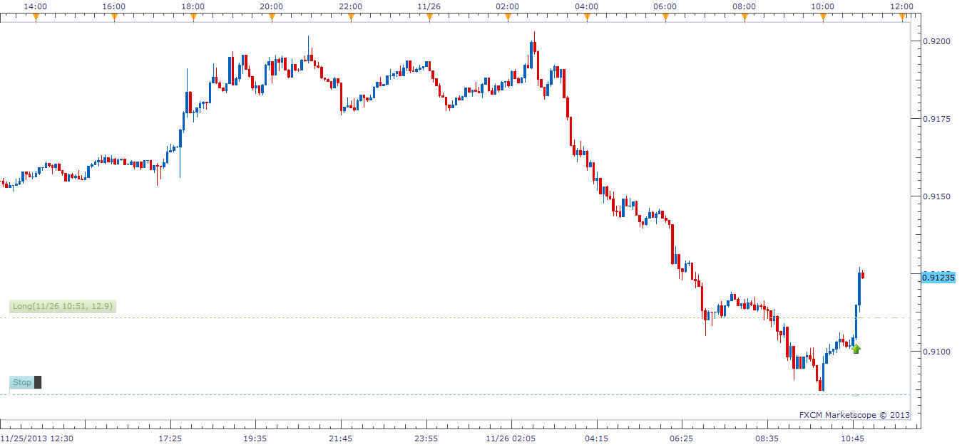
Second Example of Entry in a Low Curve Zone 11/26/2013a/u

Slide 4
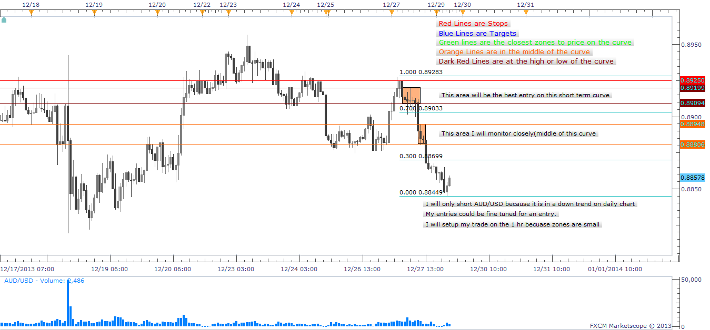
Aud/Usd Before Trade 12/29/2013-01

Slide 5
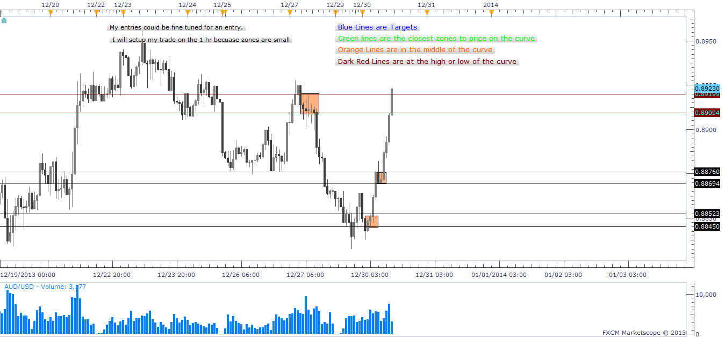
Aud/Usd Final 12/29-30/2013

Slide 6
Skill Development 12/30/2013 A/U
Trade Grade:
Trade Criteria Met?
Pre-Planned?
Entry:
Followed Entry Tactic?
Precision Entry?
Risk:
Position Size Correctly?
Stop Placed?
Stop At Good Location?
Exit:
Followed Exit Tactic?
Precision Exit?
Analysis:
Did I Study My Trade?
Yes- Top of Curve
Yes
Yes- #1 Entry
No- Price stopped me out
Yes-Low on long term curve
Yes-SpreadX3
Yes- Above Short term curve
No-No profit made
No-
Yes-Short term trend changing to uptrend on hourly charts. Will look for a new HH before entry.

Slide 7
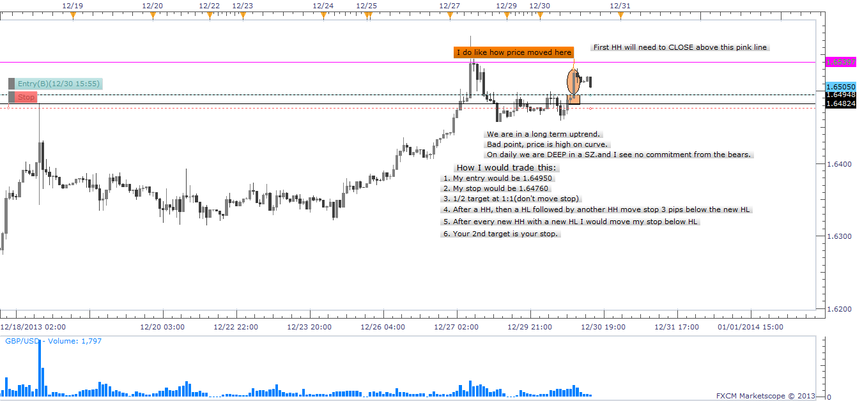
GBP/USD Before Trade 12/30/2013-01

Slide 8
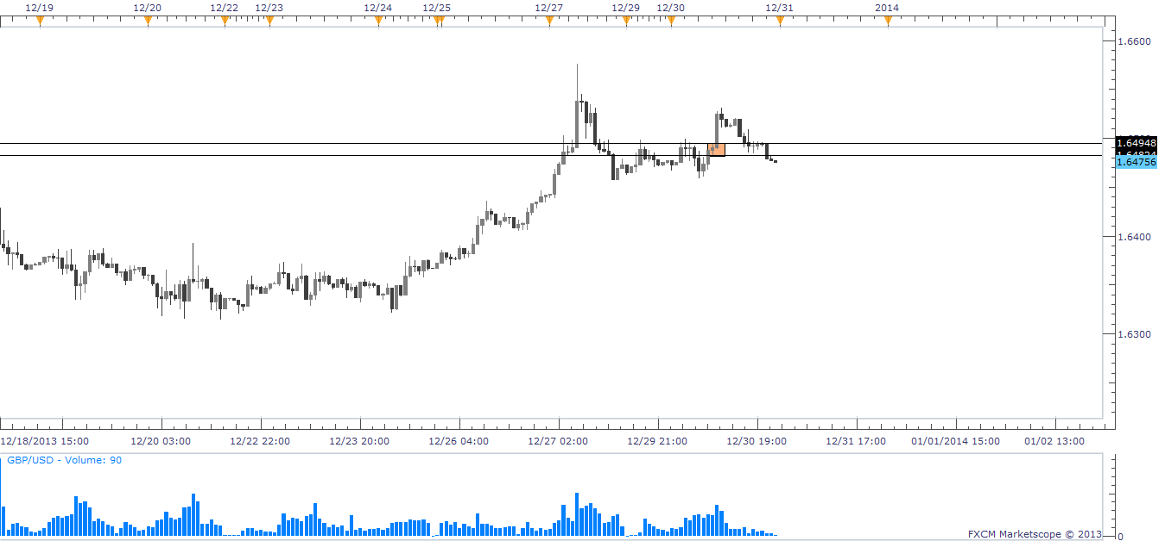
GBP/USD Final Trade 12/30/2013

Slide 9
Skill Development 12/30/2013 G/U
Trade Grade:
Trade Criteria Met?
Pre-Planned?
Entry:
Followed Entry Tactic?
Precision Entry?
Risk:
Position Size Correctly?
Stop Placed?
Stop At Good Location?
Exit:
Followed Exit Tactic?
Precision Exit?
Analysis:
Did I Study My Trade?
No-Top of the Curve
Yes-Long term uptrend
Yes-#1 entry
No-Small zone set up trade on 1 hr
Yes- 2,000 contract
Yes-Spread x3 below zone
Yes- Minimal risk
No- Stopped out
No-
Yes- Even though I was in a long term uptrend, price was at the top of the curve in a long term demand zone.

Slide 10
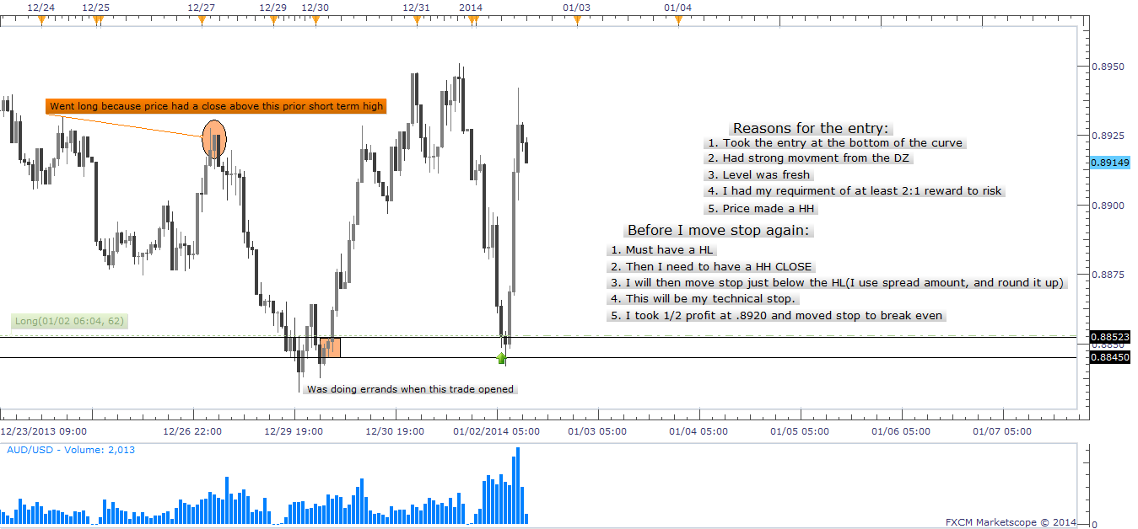
AUD/USD FIRST Trade 01/02/2013-01

Slide 11
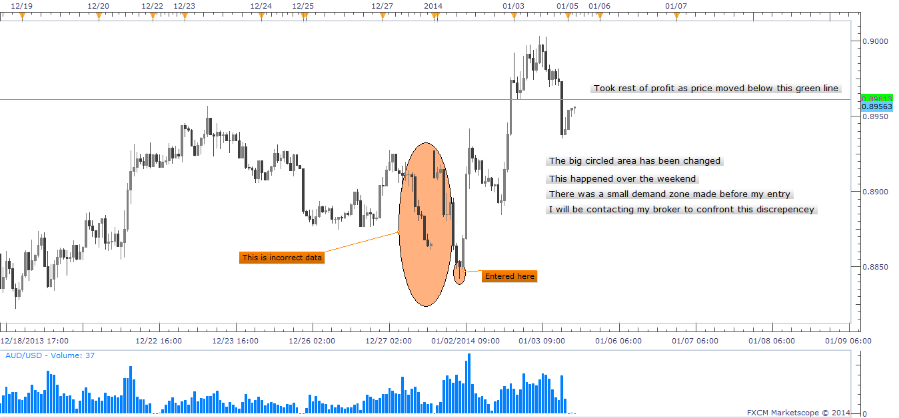
AUD/USD Final Chart 01/03/2014-change

Slide 12
Skill Development 12/30/2013 A/U
Trade Grade:
Trade Criteria Met?
Pre-Planned?
Entry:
Followed Entry Tactic?
Precision Entry?
Risk:
Position Size Correctly?
Stop Placed?
Stop At Good Location?
Exit:
Followed Exit Tactic?
Precision Exit?
Analysis:
Did I Study My Trade?
Yes- Demand Zone was fresh
Yes- Stop set
Yes- Limit
Yes
No- Could have entered 20,000 contract
Yes- Spreadx3 below zone low
Yes
Yes- First target hit
Yes- Used combination exit and tech. stop
Yes- When price is at the extreme of curve I can have a bigger contract. Also broker changed chart data over the weekend(01/04/2014-01/05/2014) Contacted

